Slide 1

Overview of the DAB+ System
Dr. Les Sabel - WorldDMB Technical Committee
2013

Slide 2
DAB Family of Standards
DAB+ Features
Ensemble Structure
System Structure
Network Options
The Future
Overview of the DAB+ System

Slide 3

Welcome to the DAB Family of Standards
One family provides the most cost effective delivery of digital radio and mobile TV
An introduction

Slide 4


The Eureka Family of Standards
DAB : 1995 Original audio with PAD and data services standard
T-DMB : 2006 Added video services for Mobile TV and enhanced data streaming
DAB+ : 2007 Enhanced audio service efficiency
Why DAB+?
One family provides the most cost effective delivery of digital radio and mobile TV
2.5 times more audio services than DAB due to the use of HE AAC+ v2
Slightly better coverage – 1 to 2dB better than DAB – better FEC coding
More flexibility for Programme Associated Data delivery
PAD content has much stronger error protection
The DAB Family of Standards

Slide 5

For detailed description of the DAB+ system refer to the following ETSI standards documents
EN 300 401 Main document
TR 101 496-1, -2, -3 Guidelines of use and operation
TS 102 563 Transport of AAC audio
See http://www.worlddab.org
or
http://www.etsi.org/standards
DAB Standards

Slide 6
DAB+ Features
Overview of the DAB+ System

Slide 7

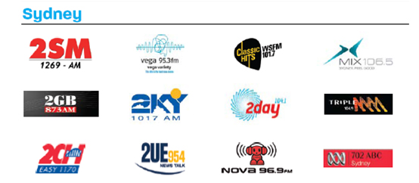








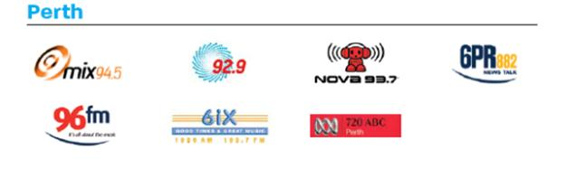






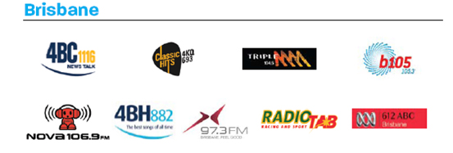





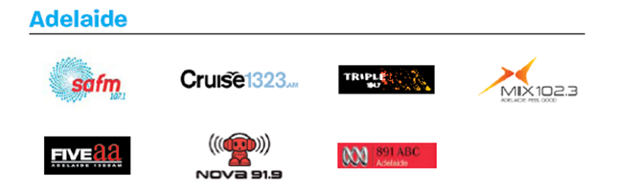
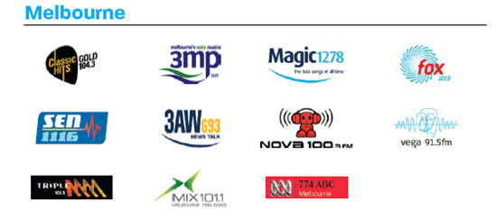




Audio - Room for Lots of Services
Australian example
Simulcast stations (AM / FM) new DAB+ only stations
DAB+ Features

Slide 8
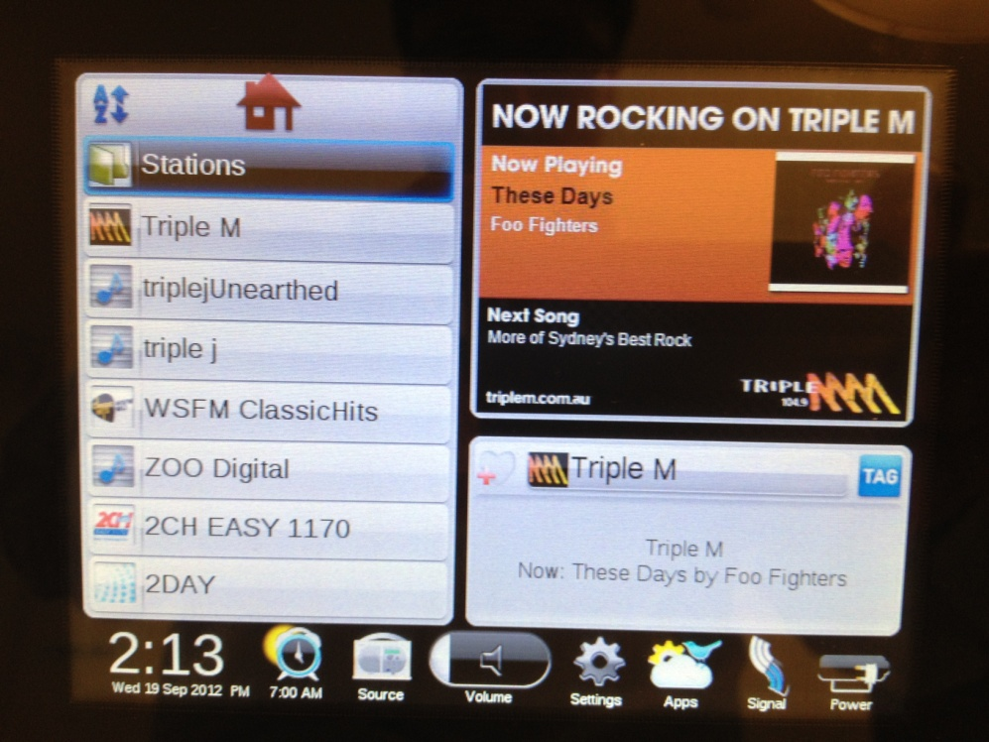
Choose the station from a list
No more need to remember the station’s frequency!!!
Station list
Easy to choose a station, listener has more information about the services available
DAB+ Features

Slide 9
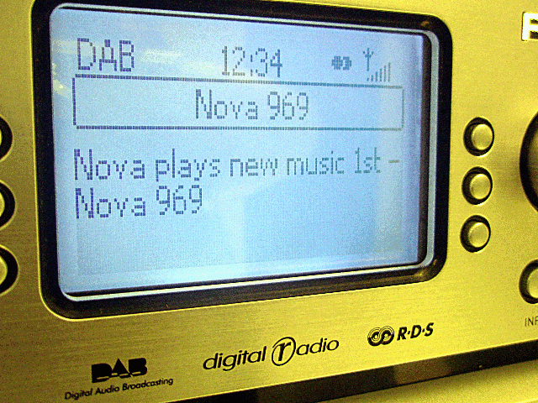
Programme Associated Data (PAD)
Dynamic Label Segment – Text Delivery
Straight forward, effective
Up to 128 characters per text segment
All DAB+ receivers have DLS text display
Good receivers block text display or appropriate scrolling speed
DAB+ Features

Slide 10

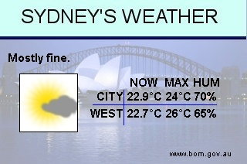

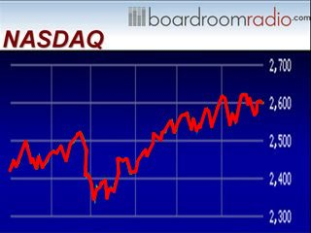

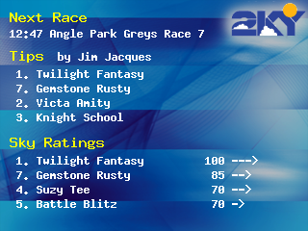
Programme Associated Data
Slideshow (SLS) Images
Further strengthens the audio message
Standalone advertising during song items
Promotion of station activities
Traffic and weather reports
Local news, happenings, community events
Sports results and stock market information
DAB+ Features

Slide 11
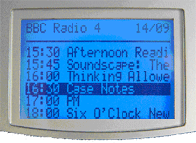
Data Services
Electronic Programme Guide (EPG)
Very useful tool for promotion of programs, talent, competitions
Especially useful for multilingual national broadcasters with scheduled programme slots
Is flexible, can be station, network or ensemble based
Some receivers can record programs for later listening
DAB+ Features

Slide 12
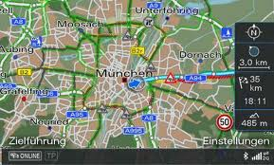
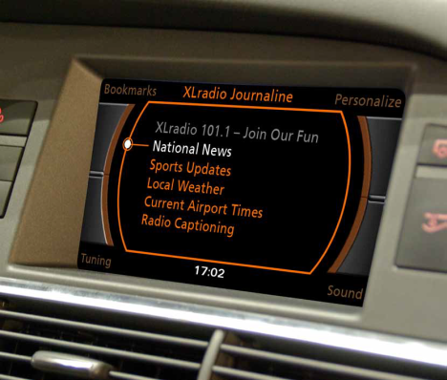

Data Services – Other
Traffic e.g. TMC and TPEG can provide up to the moment information on
current traffic flow and congestion
fuel locations and prices
parking
Journaline
Hierarchical categorised text service
Custom Applications can be developed
DAB+ Features

Slide 13
Ensemble Structure
Overview of the DAB+ System

Slide 14


Ensemble Structure
Multiple different radio stations transmitting on the same frequency
Multiple different radio stations use the same transmitter
Multiple different radio stations share the cost of that single transmission
Very flexible to ensure the broadcaster can deliver the content they provide in the most cost effective manner
Ensemble Structure

Slide 15
Ensemble Structure
An Ensemble will typically carry multiple services from multiple radio networks,
for example:
Network 1 – 2 stations (services) 128kbps
Network 2 – 4 stations 256kbps
Network 3 – 3 stations 192kbps
Network 4 – 9 stations 576kbps
Total 18 stations 1152kbps
Each network can have their own allocated capacity on the ensemble
  No other network has access to that capacity
Each network can reconfigure their allocated capacity anytime without impacting the other networks’ services
  Pop-up services change their name and sometimes bit rate regularly
Ensemble Structure

Slide 16
Ensemble Structure
Ensemble 1
Total Capacity = 1152kbps (FEC = EEP3A)
Network 1 allocation, e.g. 128kbps
Network N allocation, e.g. 192kbps
Station A
Station B
Station X
Station Y
Station Z
Sub-Channel 0
Sub-Channel 1
M
M+1
M+2
64kbps
64kbps
32kbps
64kbps
96kbps
Ensemble Structure

Slide 17
Ensemble Structure
Each ensemble has
its own Ensemble Label
its own unique Ensemble ID code
can carry a unique identifying code of the transmitter (TII)
a Signalling Channel – the Fast Information Channel (FIC)
  Provides details about all services (stations) carried
    Service labels
    Bit rates
    Data location in the stream
  Provides details of all data services and PAD
  Provides announcements and warnings
Ensemble Structure

Slide 18
System Structure
Overview of the DAB+ System

Slide 19

Example DAB+ network
Repeater Transmitter
IP is generally preferred for both contribution networks
Studio 1
COFDM
and distribution networks
PAD system
Broadcast System
Service Mux
(Opt)
Audio Encoders x N
Local Controller
Ensemble Controller
Telecoms
cloud
Telecoms
cloud
EMUX
Studio N
PAD system
DMUX
Audio Encoders x M
Service Mux
(Opt)
COFDM
Switch / Router
Main Transmitter
Local Controller
System Structure

Slide 20
DAB+ Audio
Many combinations to allow the most cost effective delivery of different audio content types
HE AAC+ V2 audio encoding table combinations
Coding Technologies / Dolby AAC+ implementation
System Structure

Slide 21
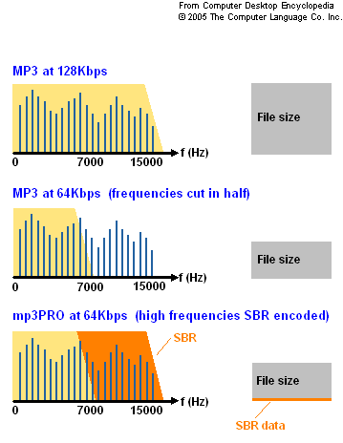
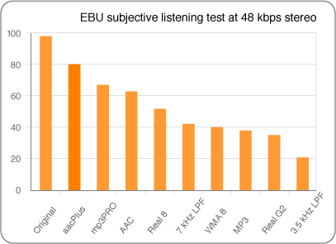
DAB+ Audio Encoding
Spectral Band Replication
Efficient sample rate and bit rate reduction method
Only slight audio degradation
System Structure

Slide 22
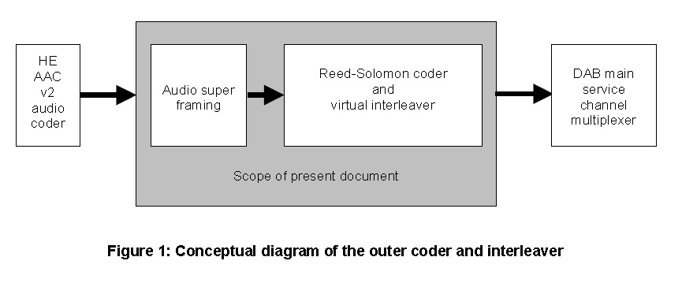
DAB+ Audio Encoding
Outer layer of FEC coding and interleaving provides protection for PAD – especially important to ensure robust SLS image delivery
Signal Flow with outer layer FEC
System Structure

Slide 23
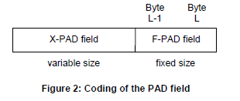
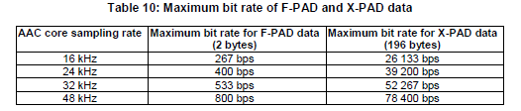
Audio - PAD
XPAD size, music/speech flag, command channel
PAD for DLS and SLS delivery
Typical use: SBR on @ 24kHz core sampling rate, 3 frames per super-frame, 1 super-frame per 120mS
System Structure

Slide 24
Audio Bit Rates v PAD Bit Rate
Sub-Channel bit rate (kbps) | FEC Overhead 10% | Payload capacity (kbps) | PAD (kbps) | Audio bit rate (kbps)
32 | 3.2 | 28.8 | 1 | 27.8
32 | 3.2 | 28.8 | 2 | 26.8
32 | 3.2 | 28.8 | 4 | 24.8
32 | 3.2 | 28.8 | 8 | 20.8
48 | 4.8 | 43.2 | 1 | 42.2
48 | 4.8 | 43.2 | 2 | 41.2
48 | 4.8 | 43.2 | 4 | 39.2
48 | 4.8 | 43.2 | 8 | 35.2
64 | 6.4 | 57.6 | 1 | 56.6
64 | 6.4 | 57.6 | 2 | 55.6
64 | 6.4 | 57.6 | 4 | 53.6
64 | 6.4 | 57.6 | 8 | 49.6
64 | 6.4 | 57.6 | 16 | 41.6
80 | 8 | 72 | 1 | 71
80 | 8 | 72 | 2 | 70
80 | 8 | 72 | 4 | 68
80 | 8 | 72 | 8 | 64
80 | 8 | 72 | 16 | 56
Need to ensure the correct balance between audio bit rate, audio settings and PAD
Audio bit rate ≈ Sub-Channel bit rate *0.9 – PAD bit rate
SLS images are best synchronised with audio using pre-delivered images and header update display triggers, either
TriggerTime = time/date or
TriggerTime = now
System Structure

Slide 25
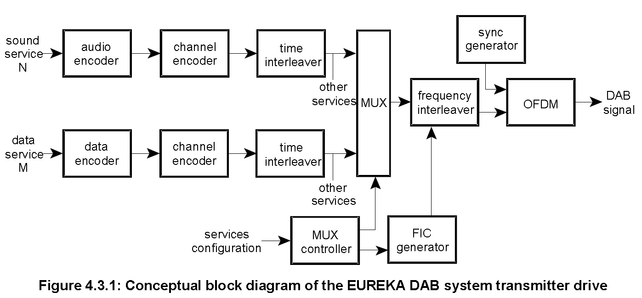
Signal Flow - Transmitter
DAB+ Outer layer FEC coding and interleaving here
System Structure

Slide 26
FEC Code Rate Comparison
FEC Code | Code Rate | Capacity (kbps) | Number of 64kbps channels | Approximate power required relative to 3A
1A | 1/4 | 576 | 9 | -3 to -6dB
2A | 3/8 | 864 | 13 | -2 to -3dB
3A | 1/2 | 1152 | 18 | 0
3B | 2/3 | 1536 | 24 | +3dB
4A | 3/4 | 1728 | 27 | +6dB
Payload capacity and transmit power can be traded
Stronger FEC protection = lower capacity BUT lower power for the same coverage area
System Structure

Slide 27
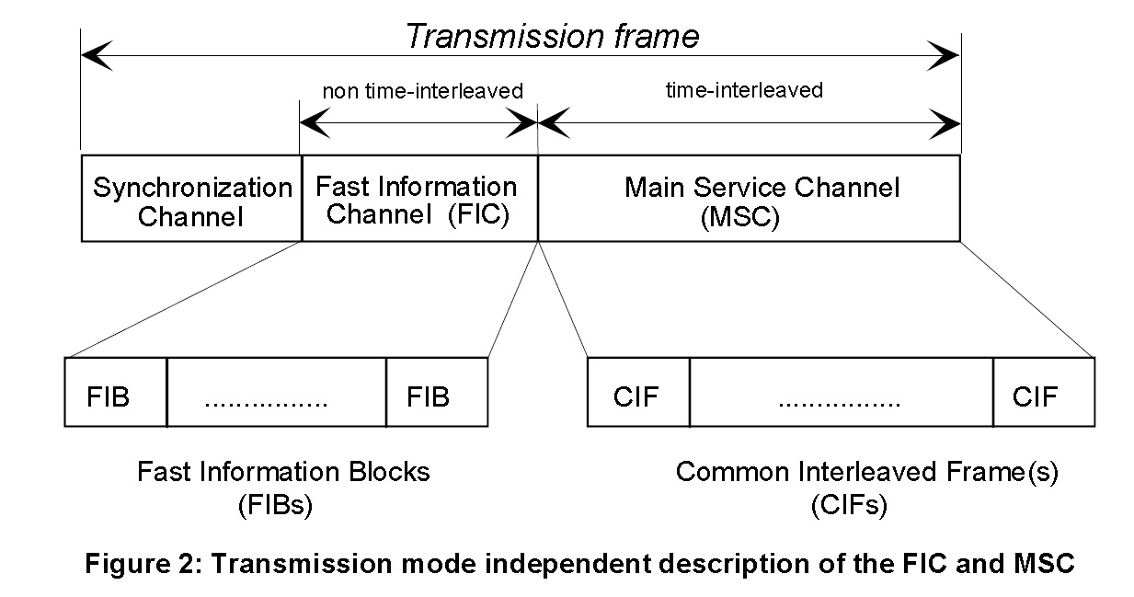
Transmission Structure
Signalling and service information is sent in the Fast Information Channel
96mS
System Structure

Slide 28
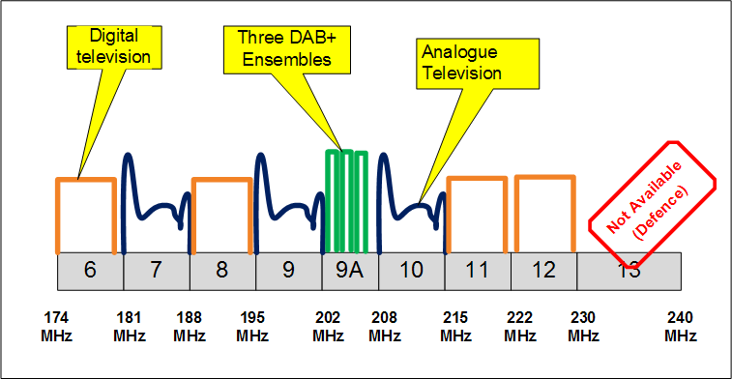
DAB+ Transmission – Australian VHF channels
Initial Band III allocation for metro cities
2 DTV channels allocated = 14MHz = 8 DAB channels = 8A, B, C, D, 9A, B, C, D
System Structure

Slide 29
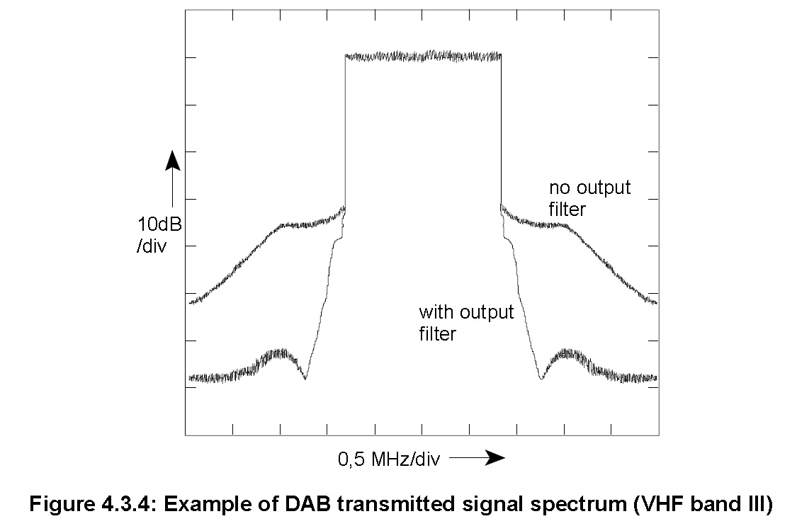
RF Spectrum
Channel edge shoulders at -40dB
Far off adjacent power at <-60dB
Overview
Signal bandwidth = 1536 carriers at 1kHz each => 1.535MHz
Channel bandwidth = 1.712 MHz
System Structure

Slide 30
Network Options
Overview of the DAB+ System

Slide 31
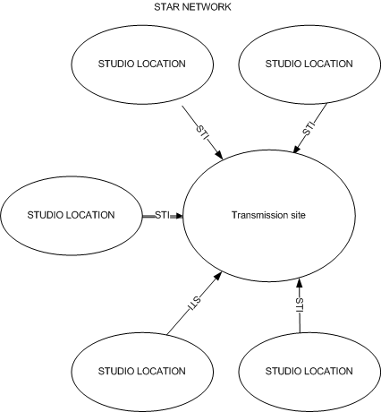
Star Network
Central multiplexing equipment
Privacy
Stations are in control of their content
Individual links per studio site
Simple networking
This architecture is often used for stand-alone / isolated installations such as single city or area transmissions
Network Options

Slide 32
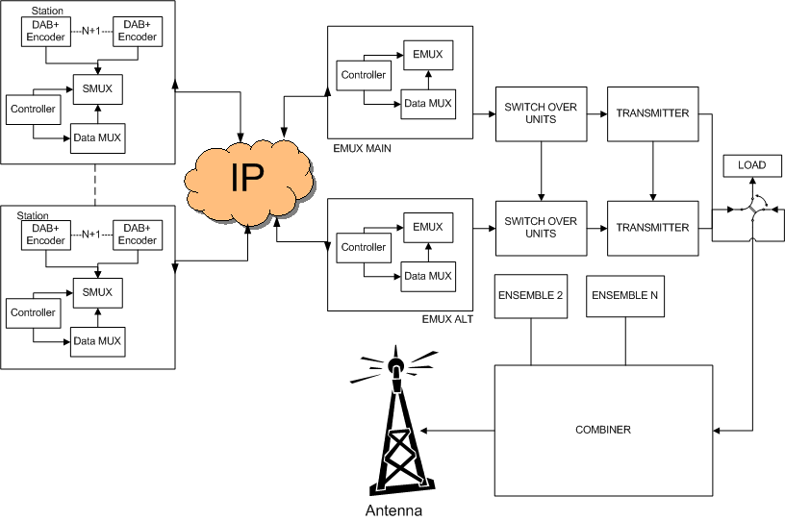
Redundant common ensemble multiplexing and transmitters
Star Network
Number of service encoders, PAD and redundancy can vary between broadcasters
Network Options

Slide 33
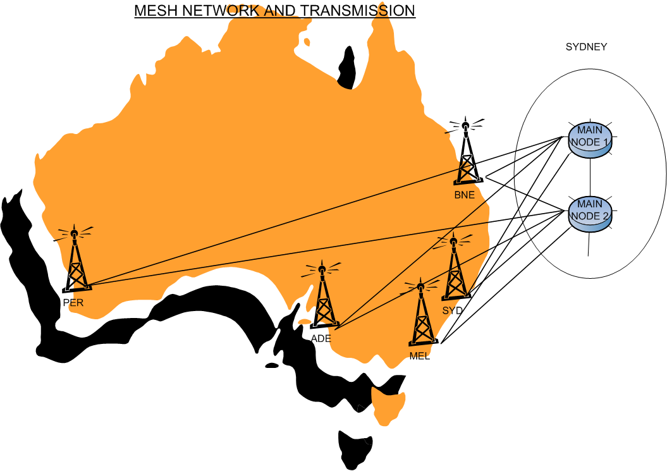
Mesh Network
Suitable for distributed broadcast networks such as national multi-studio networks
Transparent interconnect between sites
Typically uses a multicast enabled VPN
High Redundancy and Reliability
Content produced at any site can be transmitted at any site
Network Options

Slide 34
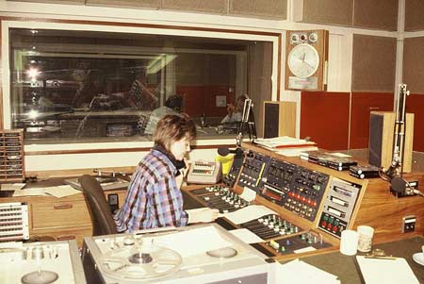

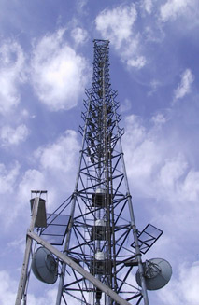

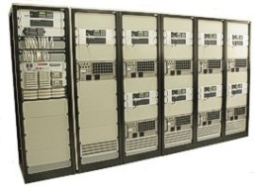
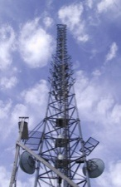

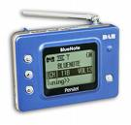
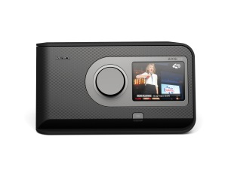
Monitoring Equipment - Overview
Tx Monitor
ETI Monitor
Service Monitor
Ensemble Recorder
In-Field Monitors
Multiple monitoring points throughout the system allow rapid fault finding and rectification
Listeners
Repeaters
Listeners provide the ultimate feedback!!
Network Options

Slide 35
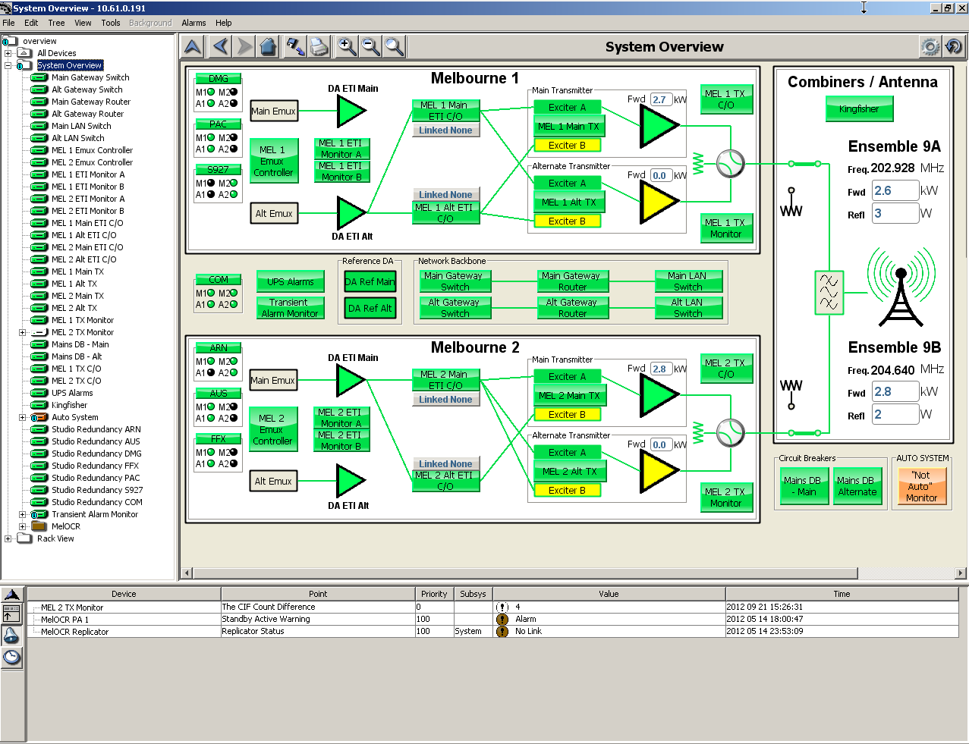
Network Management System
Network Management is essential for rapid fault detection and correction
Virtually all equipment now has SNMP fault reporting
Remote access via web interface allows best grade of service
Network Options

Slide 36
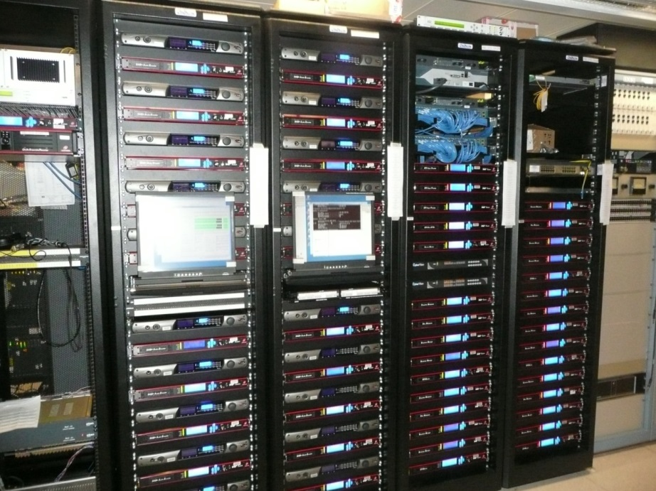
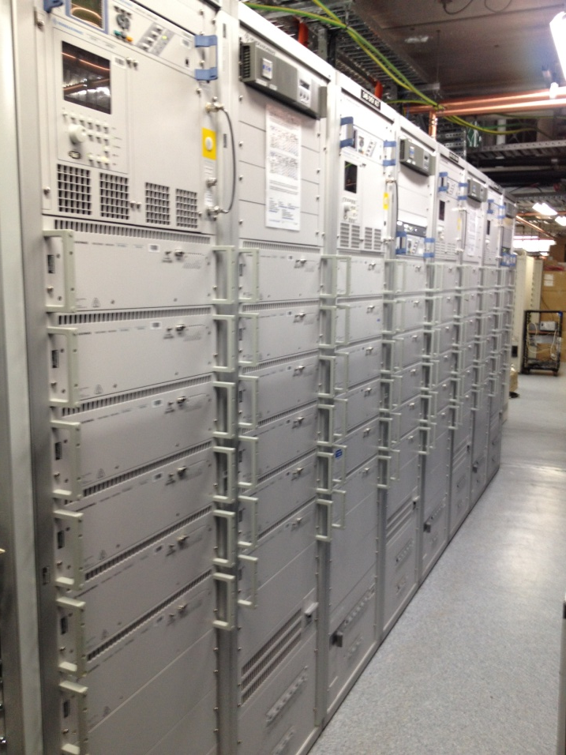
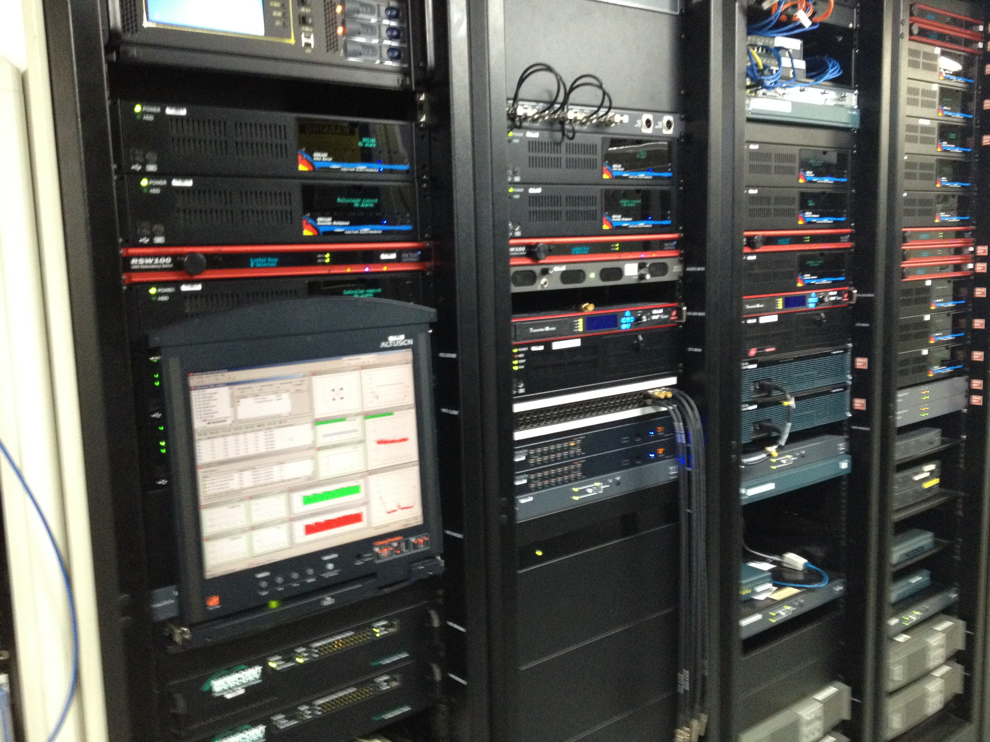
Examples of DAB+ multiplexer and transmitter equipment
Network Options

Slide 37
The Future
Overview of the DAB+ System

Slide 38
The Future – Hybrid Radio
DL+ and CAT-SLS are examples of Hybrid Radio
Providing More Information to listeners on demand
Tagging and reminders for later content use
The standards are being written now!
Hybrid Radio combines digital radio broadcast to deliver audio and common PAD to many AND the internet to provide individual actions and services
Hybrid Radio

Slide 39
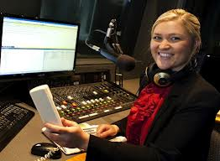
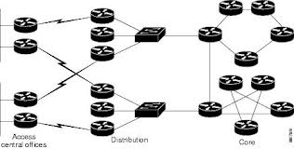
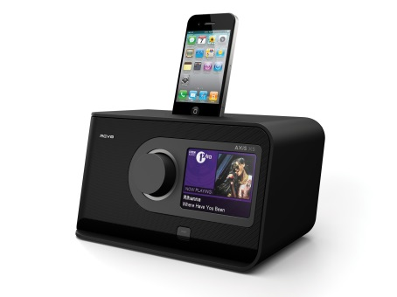

What is Hybrid Radio
Transmission Information from Broadcaster
Broadcaster
Telco network
Free to Air DAB+ broadcast with PAD
Broadcaster interaction
WiFi connection
Hybrid Radio
Touchscreen for basic actions
Bluetooth connection
for browser actions
3rd Party services
Home Operation

Slide 40

What is Hybrid Radio
Broadcaster
Transmission Information from Broadcaster
Mobile network
Broadcaster interaction
Mobile internet
Free to Air DAB+ broadcast with PAD
DAB+ capable mobile phone can use full range of hybrid functions
3rd party services
Mobile Operation

Slide 41
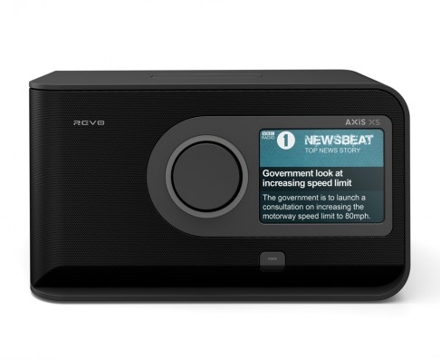
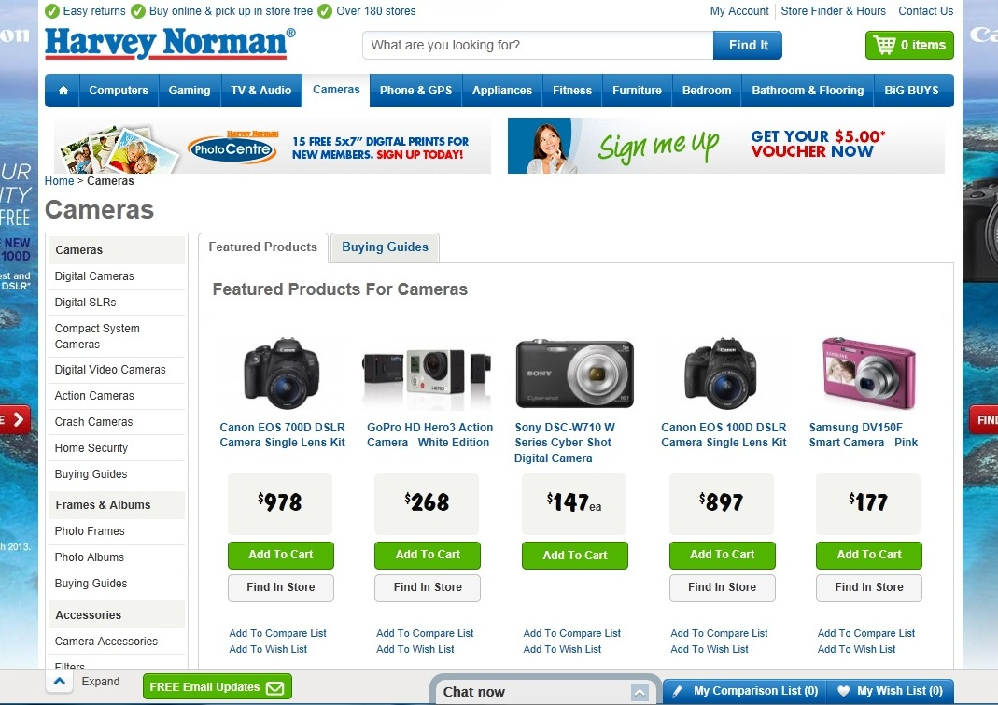
More Information: Use Case Example 1 – connection to an advertiser
Screen tap
Accessing a website from a URL delivered associated with a product / service being advertised
Hybrid Radio Use Cases

Slide 42


More Information: Use Case Example 2 – Artist Information
Screen tap
Listeners can access more information about the current artist, tour dates, biographical info, purchase
Hybrid Radio Use Cases

Slide 43
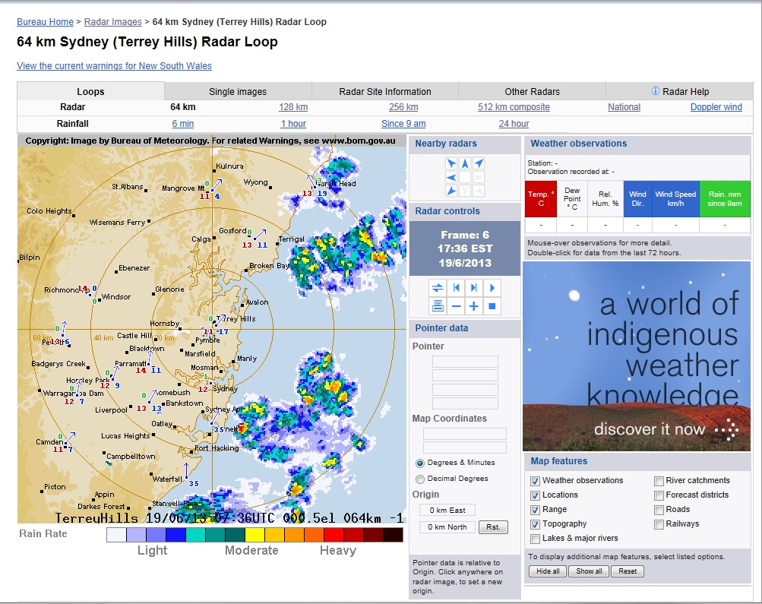

More Information: Use Case Example 3 – Public Information
Button press
Accessing a website from a URL delivered associated with the information provided
Hybrid Radio Use Cases

Slide 44
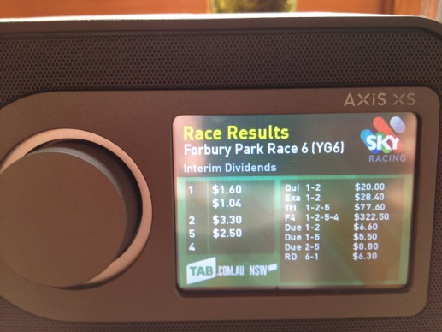
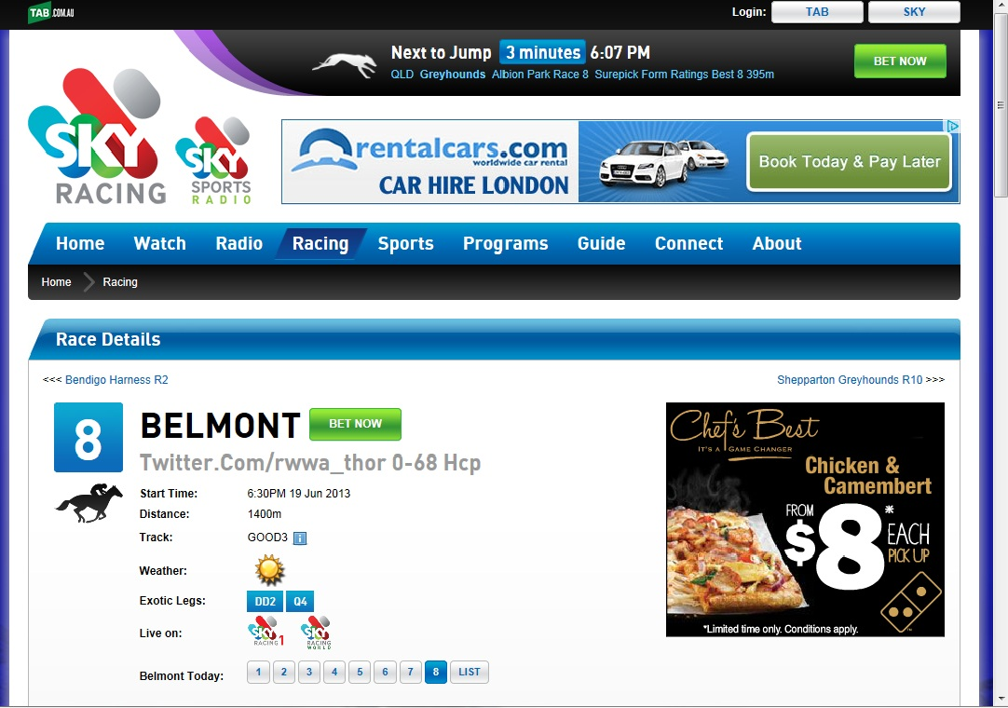
More Information: Use Case Example 4 – Sports Results
Screen tap
Drives listeners to use additional broadcaster facilities, value add advertising and cross promotion
What sport is on tonight, current and previous results, betting
Hybrid Radio Use Cases

Slide 45
Summary – Top Tips
DAB+ is the best Digital Radio delivery system available
Proven technology
Cost effective infrastructure
Deployed worldwide and expanding rapidly
Very flexible operation for broadcasters
Huge range of receiver products
Great features including scrolling text, images, EPG and data services
Many new developments including Interactivity
Overview of the DAB+ System

Slide 46
les.sabel@scommtech.com.au
For more information

