Slide 1
WorldDAB
Report from the
WorldDAB APAC Technical Group
Dr. Les Sabel
APAC TG Chair
ABU DBS 2023 – WorldDAB workshop
Notes:
Welcome

Slide 2
WorldDAB APAC Technical Group
AGENDA
Who are the APAC TG and what do we do?
Current status and activities
ebook
What’s on in 2023

Slide 3
WorldDAB APAC Technical Group
Who are we?

Slide 4
WorldDAB APAC Technical Group
The APAC Technical Group is focused on providing on-going education and support for members of the broadcast industry who are interested in DAB+
We provide opportunities to
Meet and discuss issues and activities
Provide presentations on a wide range of topics
Members and membership
76 members from all areas of the broadcast ecosystem
No need to be a WorldDAB member to become a member
Notes:
Previous topics have had 2 main focal points 1) the process of establishing DAB digital radio and 2) details of the technical systems required to implement and operate a DAB+ network

Slide 5
WorldDAB APAC Technical Group
Current status and activities

Slide 6
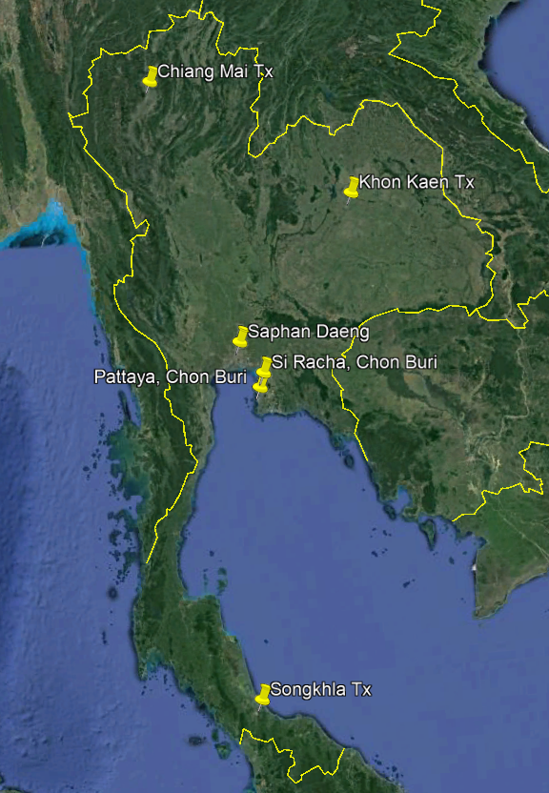
WorldDAB APAC Technical Group
APAC current status and activities
Case study: Thailand
Bangkok trials (since 2019)
Regional trials (from 2022)
Focus
Functional testing
Field testing – outdoor and indoor
Education and training
Notes:
The trials are sponsored by the Thailand National Broadcasting and Telecommunications Commission , The NBTC, and undertaken by the Royal Thai Army’s Radio and television division, TV5.
Here is a small snapshot of the project

Slide 7
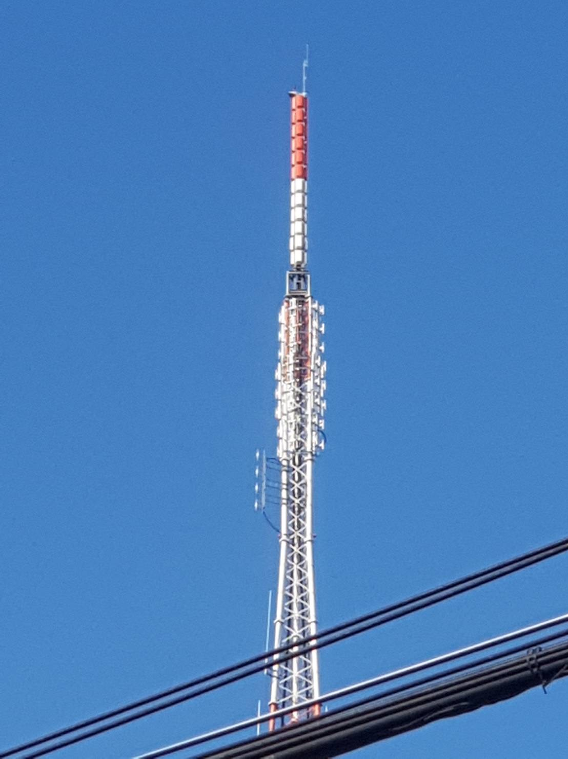
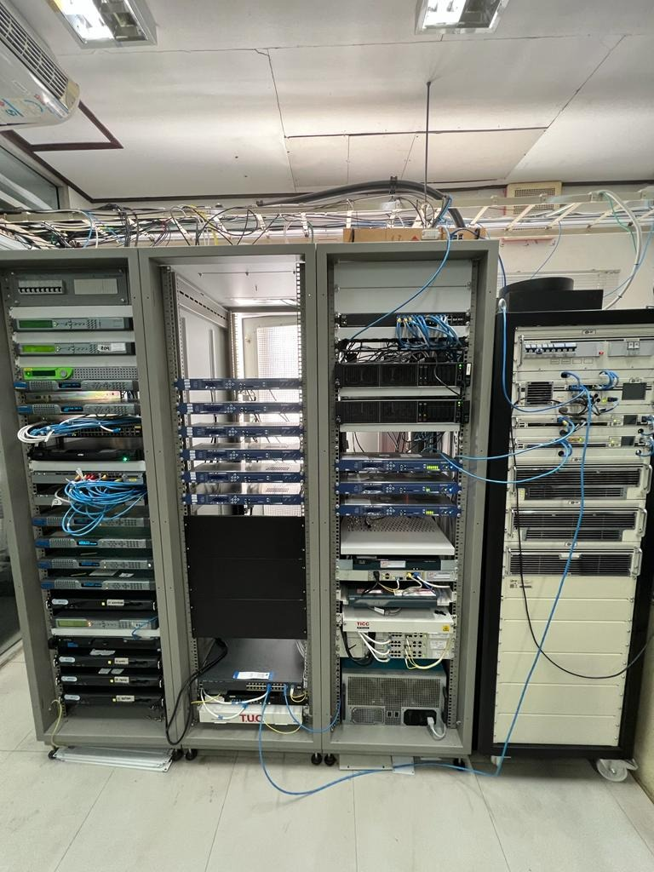
WorldDAB APAC Technical Group
Bangkok trials
Central Bangkok transmission site
10 kW ERP
Directional antenna
18 audio services
1 data service
Notes:
The BKK trial had 2 phases, the first in 2019 with a 10 kW directional antenna.

Slide 8
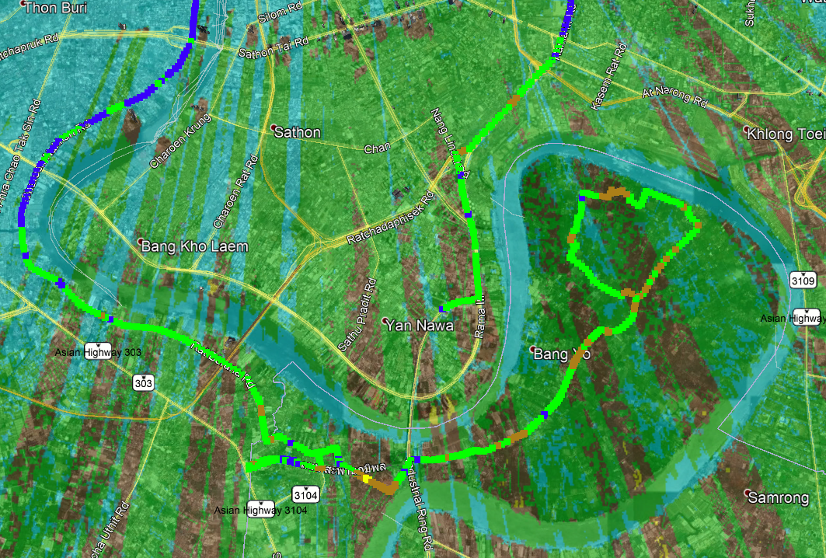
WorldDAB APAC Technical Group
Bangkok trials (2019)
The initial coverage predictions were supported by extensive field trials
The coverage to the south of the CBD is compromised due to the many very tall buildings in the CBD
Notes:
A number of areas of coverage deficiency were found including the area south of the CBD. Here we see the predicted coverage of that area along with the filed testing of the area. The correlation of the tuned prediction and the field test data was 97%

Slide 9
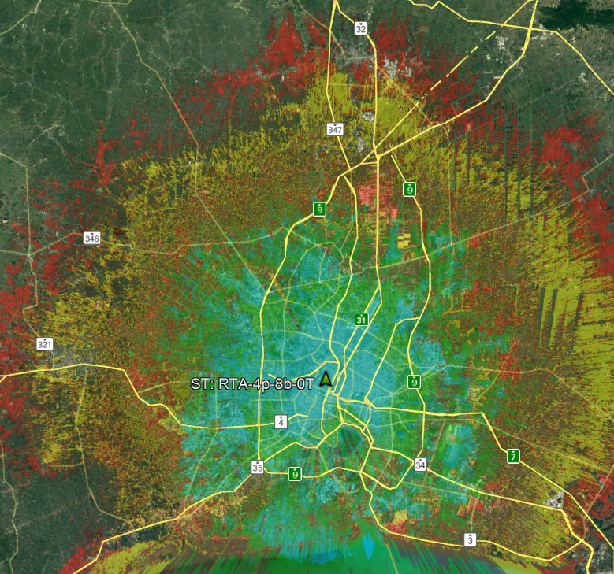
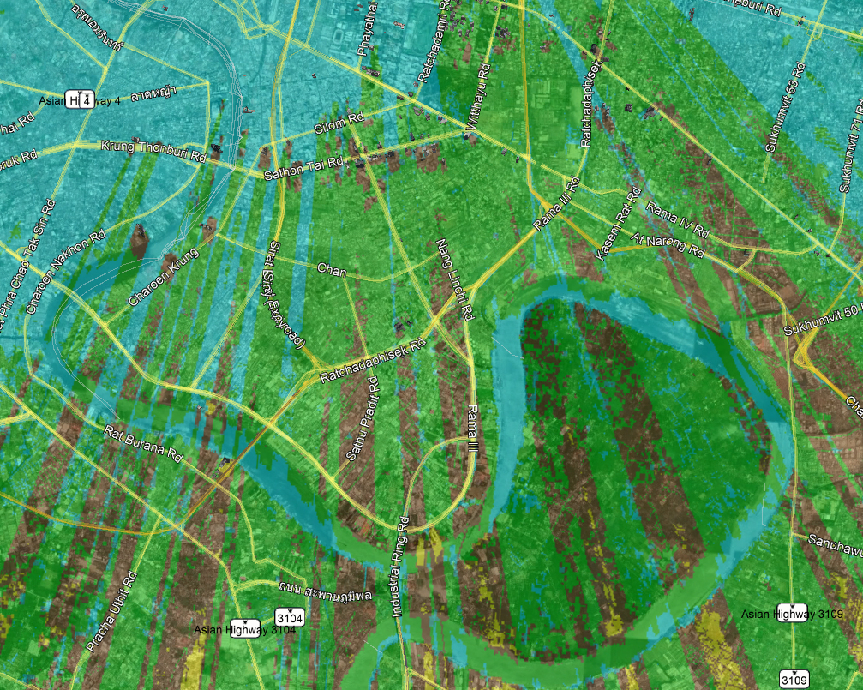
WorldDAB APAC Technical Group
Bangkok trials (2022)
18 kW ERP
Omni directional antenna
Notes:
The second stage in 2022 updated the antenna pattern to Omnidirectional and increased ERP to 18 kW providing much better coverage, including the area south of the CBD. The coverage to the north was also significantly improved due to the upgrade to an omnidirectional antenna HRP.

Slide 10
WorldDAB APAC Technical Group
APAC current status and activities
Case study: Thailand
Regional trials (from 2022)
Focus on 4 regional areas / centres
Chon Buri
Chiang Mai
Khon Kaen
Song Khla
Notes:
The regional trials are ongoing and will support future DAB planning activities.
This is a great demonstration of how to move forward with DAB, how to test and improve coverage and how to learn the technical aspects on DAB systems.

Slide 11
WorldDAB APAC Technical Group
Establishing DAB+ digital radio: an ebook

Slide 12
e-book announcement
The WorldDAB e-book
Establishing DAB+
Digital Broadcast Radio
Launched on World Radio Day
13 February 2023

Slide 13
Contents
Overview of DAB+ features
DAB adoption overview
Initial investigations and research
Demonstrations
Formal DAB Standard adoption
DAB+ requirements and allotment planning
System planning and design
Rollout
Operations
Analogue Switch Off
Notes:
Areas covered

Slide 14
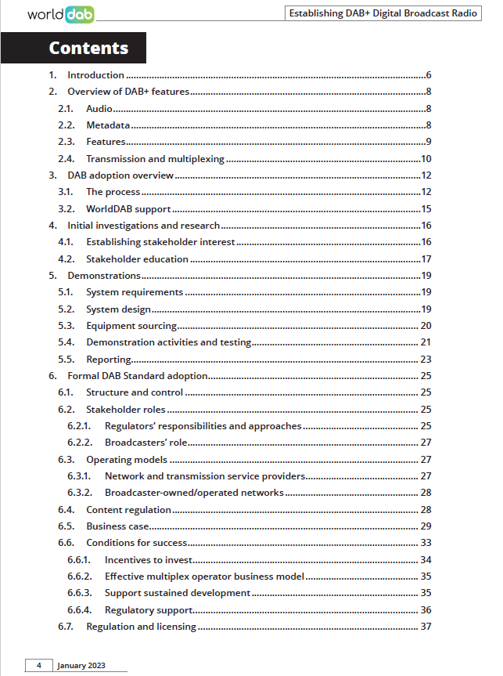
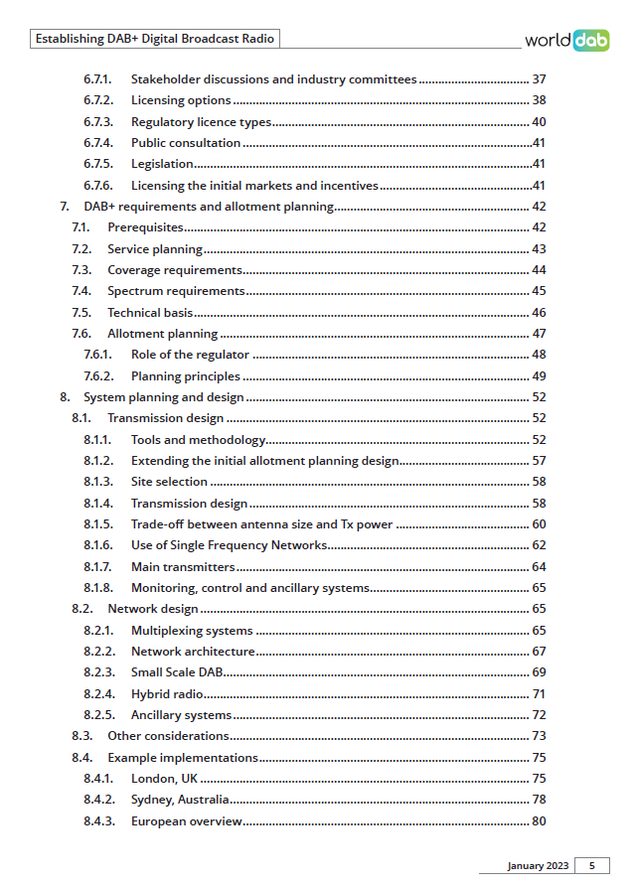
e-book
Notes:
Here are some of the topics covered, we see emphasis here on Formal adoption, requirements, planning and system design

Slide 15
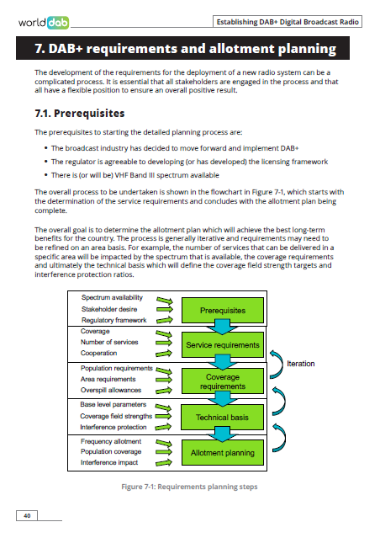
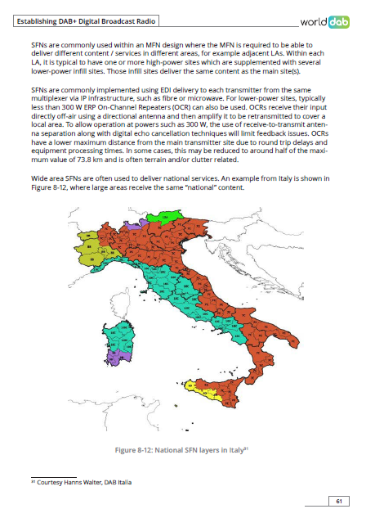
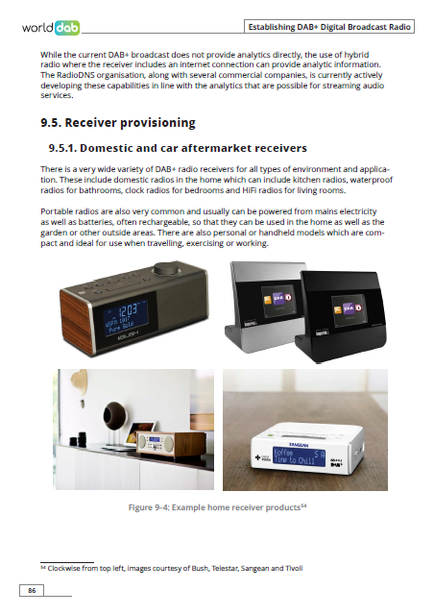
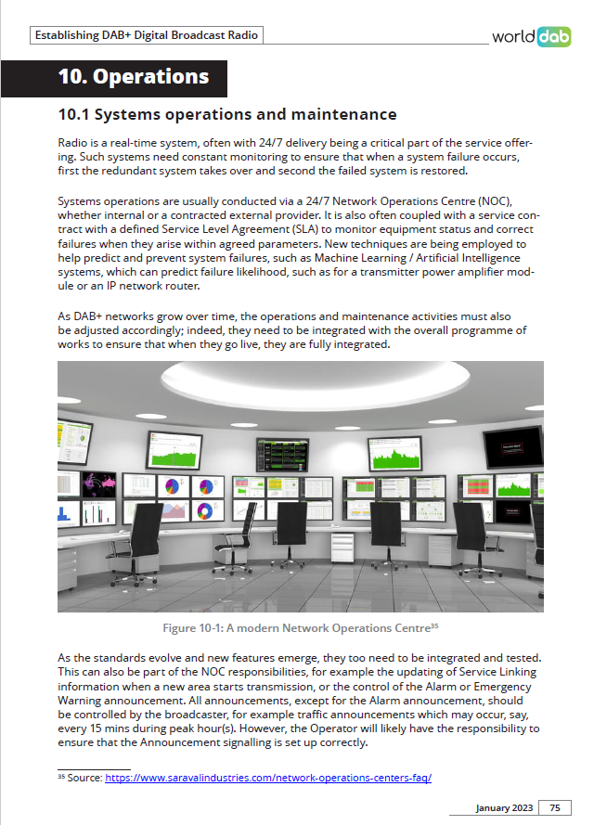
e-book
https://www.worlddab.org/resources/establishing-dab-plus-ebook
Notes:
Some examples pages – requirements, networks, receivers and operations
I encourage you to take look, you can down load the ebook from the WorldDAB website for free

Slide 16
WorldDAB APAC Technical Group
What’s on in 2023

Slide 17
WorldDAB APAC Technical Group
We are currently planning the next meeting for later this year
For 2023 we are moving to a webinar format with presentations from broadcast industry specialists across a wide range of topics
We will also provide the opportunity to discuss issues with industry experts
Please contact me to suggest areas of interest
Notes:
Current suggestions include the comparison of DAB+ vs 5G broadcast – the pros and cons
All areas of discussion are welcome

Slide 18
Thank you
For further information, please contact:
www.worlddab.org
or
les.sabel@scommtech.com.au
or
les.sabel@worlddab.org
Notes:
Please contact me if you would like to discuss any areas of interest or suggest topics for future TG meetings.

