Slide 1


Transmission solutions to manage cost
Eng. Oscar Hu
Eng. Oscar Hu
Regional Sales Manager
Notes:
Thanks ABU-DBS and World DAB to give me time di talk about the latest transmission solution on the DAB and how it will be affected on the cost.
Before start the presentation I just give a brief introduction of my self and of Gates Air.
I’m Oscar Hu and I’m Regional Sales Manager for Gates Air. I’m in the broadcasting industry for the last 20 year and I was involved in all the digitalization process and developing for the TV and Radio.
With Gates I want share my expertise and experience to provide the best optimized in DAB transmission solution

Slide 2








A Long history of Innovation
1922
1929
1957
1996
2008
2015
2019
2022
What’s
Next
Next-Gen TV,
LTE Broadcast, ISM HP RF
First Commercial
Radio Station
Harris Acquires
Gates Radio
Liquid-
cooled FM Transmission
Industrial
Pulsed
Amplification
100th Anniversary
First TV Broadcast
First Digital
TV Broadcast
Mobile
TV
GatesAir has been a pioneer in over-the-air broadcasting for 100 years
We developed groundbreaking over-the-air radio and television transmitter designs that continue to this day
GatesAir actively and proudly participates in projects that set new standards in broadcasting, content delivery, and more
Notes:
Gates has long history of innovation, the founder Parker Gates at the age of 14 has develop by himself a Radio receiver and his parents help him to open the Gates Radio Company in 1922.
in 1957 the company changed name and become Harris and then in 2013 back to the original name as Gates Air.
During more then 100 year of history we made thousand of technologies patents in Radio and TV.

Slide 3
GatesAir - Design philosophy
Design Focus includes:
High-efficiency: at ALL POWER LEVELS (low, medium and high power)
High-efficiency: BROADBAND (no tuning, no jumpers, no hardware modifications)
High-efficiency: COMPACT DESIGNS: 130W in 1RU, 400W in 2RU, 1,900W in 3+1RU, etc.
High Efficiency = LOW HEAT DISSIPATION for increased transmitter lifetime and reduced costs (HVAC)
Focus on “no cable” designs: EASY MAINTENANCE,
Focus on develop special products custom designed for specific applications.
Notes:
Then for DAB the design philosophy of the company is always to provide the most effective, high efficiency easy to use system.
In the next few slide I will show our traditional standard transmitter lines and exciters, then I’ll introduce new system that can lead to have cost effective solution for the implementation and cost maintenance

Slide 4
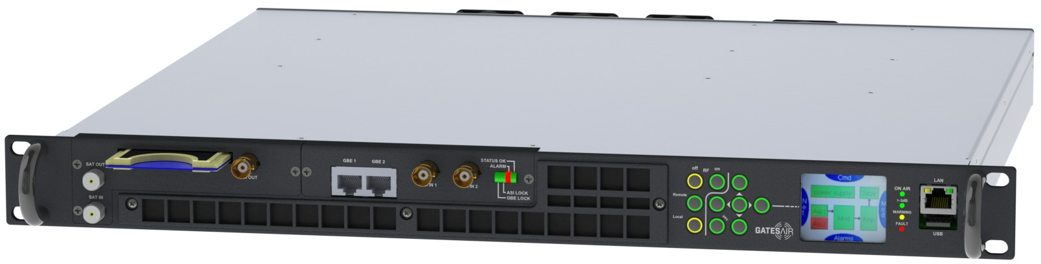
Maxiva LOW Power ULTRA-COMPACT series
KEY FEATURES
Available output power: 15W - 30W – 80W – 150W average DTV
High-efficiency, Doherty broadband VHF BIII
Adaptive pre-correction
ETI + EDI + DVB-S/S2 + RF input interfaces available
Configurable as: Transmitter, Transposer, Re-generative Gap Filler
Hot Swappable Power Supply & RF amplifier
DAB+/DMB Standard
HTML5 Interface
Notes:
Our low power line is ultra compact with high efficiency power that can use from 15w to 150w in just one Rack Unit.
This unit is used to excite bigger system or just stand alone.

Slide 5
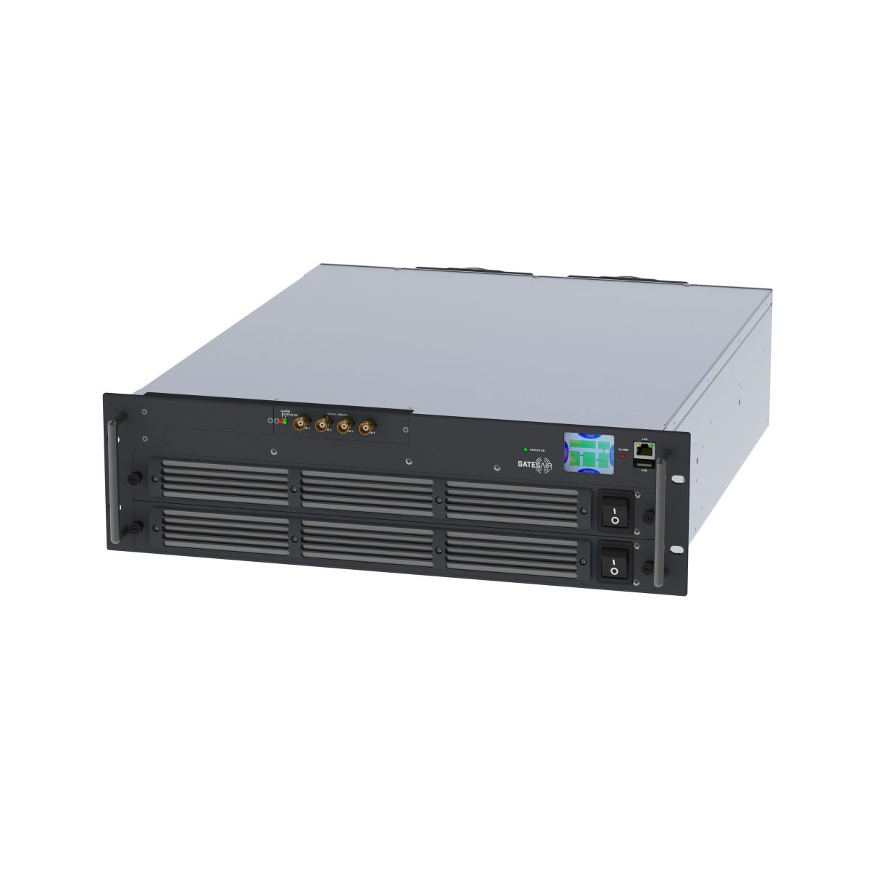
Maxiva ULTRA-COMPACT series
KEY FEATURES
Available power levels: 300W (2RU) – 450W (2RU) – 550W – 750W (3RU)
High-efficiency broadband VHF BIII
Adaptive pre-correction circuits with MER >33 dB typical
EDI + ETI + DVB-S/S2 + RF input interfaces available
Transmitter, Repeater, Transposer, Re-generative Gap Filler
Hot-swappable Power Supply from front panel
DAB+/DMB
Notes:
Then stay in our compact solution up to 3 RU we can transmit from 300w up to 750w
With this power you can already cover a small city or a small island.
Many application can be use as repeater, backup, retransmitter and so on.

Slide 6
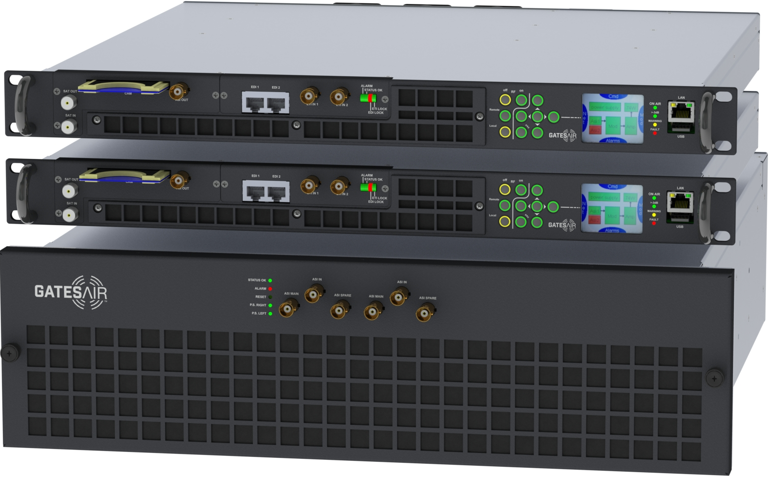
Medium Power Air-Cooled
KEY FEATURES
Available output power: 300W, 450W, 550W, 750W, 1200W, 1500W, 1900W. Single or Dual redundant Exciters
High-efficiency broadband VHF
Adaptive pre-correction circuits with MER > 33 dB typical
ETI + EDI + DVB-S/S2 + RF input interfaces available
Embedded ETI/EDI & RF Switch Over matrix for Dual Redundant Exciters
Hot Swappable Power Supplies
DAB+/DMB
Notes:
In addition to the compact solution we have our traditional medium power with single or dual exciter and one power amplifier.
In this solution it’s not needed a transmitter control unit, because everything is embedded on the power amplifier.
The PA can output up to 1.9kw power.

Slide 7
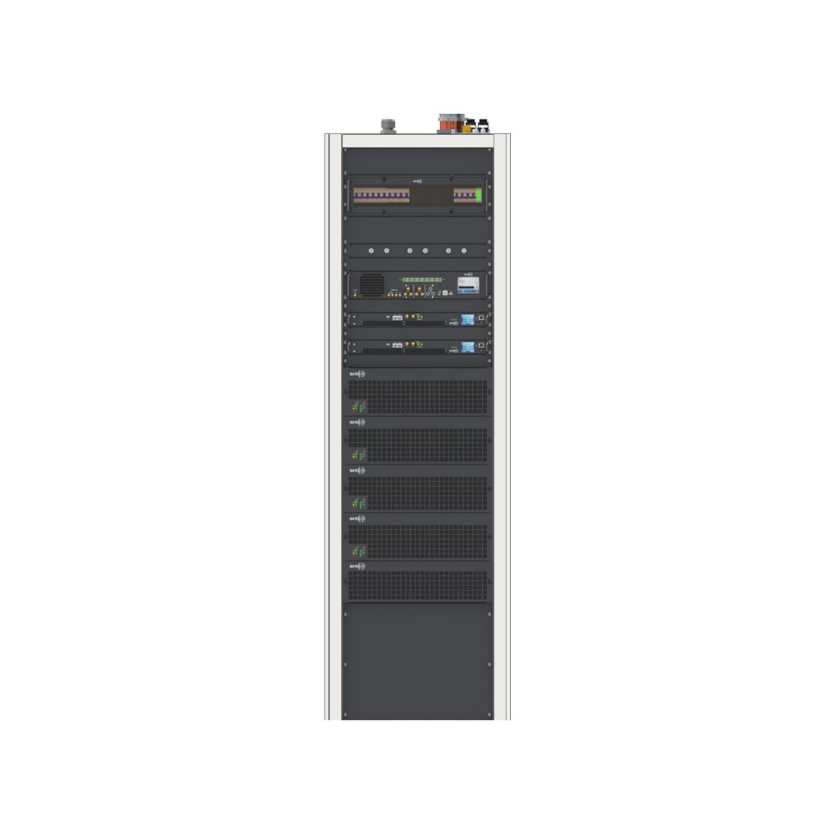
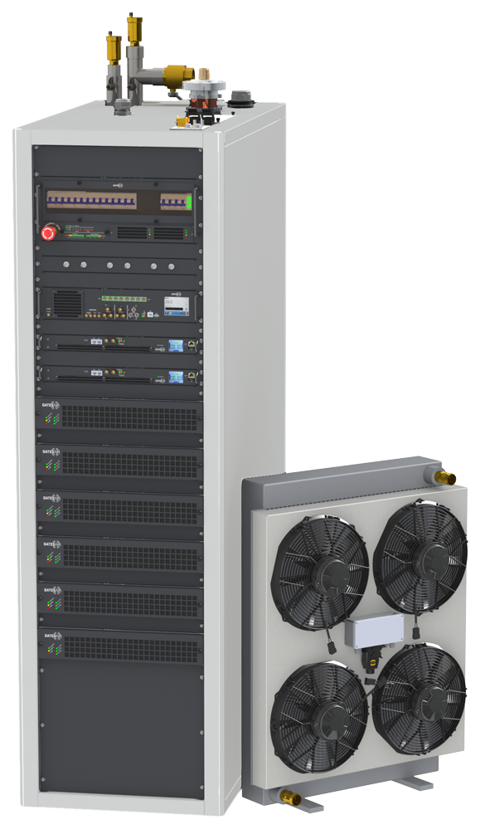
High Power Air & LIQUID -Cooled
KEY FEATURES
Available output power: from 3000W to 13,600W Air cooled and 45,600W Liquid Cooled
High-efficiency broadband VHF BIII
Adaptive pre-correction with MER >up to 33 dB typical
ETI + EDI + DVB-S/S2 + RF input interfaces available
Hot-swappable Power Supplies with 2 of 3 redundancy
Low consumption Pump and Heat Exchanger (pump + heat exchanger + external fans = 535W)
Dual Redundant Pumps standard
2 x coolant reserve tanks (8 litres) for automatic liquid refilling, reduces on-site maintenance
Very small external heat exchanger with 24V power
DAB+/DMB
Notes:
For the high power we have power starting from 3kw and above , we don’t have limit on the output power, it’s depending only how many Power amplifier in the system we want to install.
The transmitter can be air or liquid cooling and this one have special refilling tank system that automatically refill the liquid if is under certain level.
In all the transmitter can receive ETI , EDI , both or Satellite input, this is depend by the configuration that you need.
The efficiency of our RF design can reach up to 50% using our Doerthy technologies, this let save a lot of power consumption.
Especially now when the cost of the electricity is very high.

Slide 8
Energy consumption – Analog & Digital
Energy costs over 10 years of operation
DAB+ energy savings over 10 years
3,219,300 USD compared to FM
Transmitter | FM | DAB+
Power | 10 kW | 2.5 kW rms
Efficiency | 72% | 50%
Consumption per Transmitter | 13.9 kW | 5 kW
Transmitters | 18 | 1
Energy all Transmitters | 250 kW | 5 kW
Annual cost of energy | 328,500 | 6,570
FM
3,285
,000 USD
DAB+ energy savings
50x lower compared to FM
Power consumption in kW
Assumes 0.15 USD per kWh
HD -DRM+
DAB+
200
66
Example: 18 Radio Programs same coverage
Notes:
For example if we consider the analog FM system with the equivalent number of services of the DAB systems and with same coverage area.
Then the electric cost using analog is 50 times more then the DAB system.
This only consider the electrical cost, if we consider also the OPEX cost the difference will be much more higher.

Slide 9
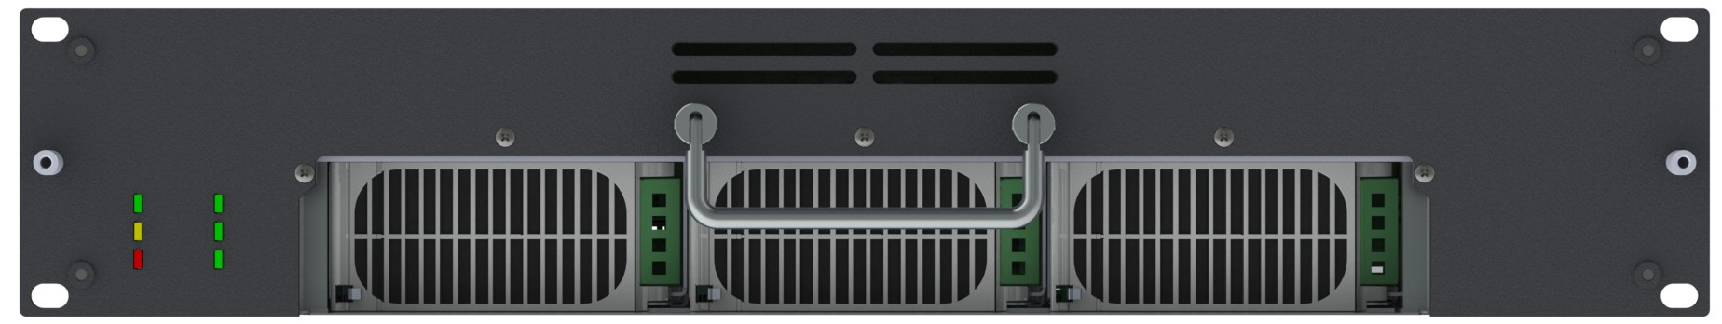

Power Supplies
2 of 3 High Redudancy Power supply system
PS1
100%
OUTPUT
POWER
PS2
PS3
Liquid-cooled PA module with front panel removed
FAILED
100%
OUTPUT
POWER
Same Power supply as FAX/FLX:
  GE Power CP2725
  450,000 hrs. MTBF
  96.3% efficient
Hot-swap, front access
PS2
PS3
FAILED
50%
OUTPUT
POWER
FAILED
PS3
Notes:
Back to our transmitter we improve also the robustness of our systems.
We develop a way to transmit at maximum power even if one of the PSU inside the PA will fail.

Slide 10
High efficiency technology - VHF Band III
TECHNOLOGIES ON THE MARKET
Narrow Band Doherty
Broadband Doherty
Up to 1-2 Channels
Problem with spare parts
Problem with N+1 systems
Complete VHF BIII from 170 to 240 MHz
Convenient for N+1 and Spares
Optimized Efficiency up to 41%
170 MHz
240 MHz
170 MHz
240 MHz
Not supported by GatesAir s.r.l.
Supported by GatesAir s.r.l.
Notes:
Talking about the RF part, the technologies available nowdays for the high efficiency is the narrow band Doerthy that let transmitter transmit only in few channel
This technologies is not cost effective if need to change channel in a second time, in addition we can have some problem when the transmitter is configured in N+1 mode for redundancy.
Gates is not using this technologies but the Broadband Doerthy that let have 50% RF efficiency and to 41% for the transmitter efficiency.

Slide 11
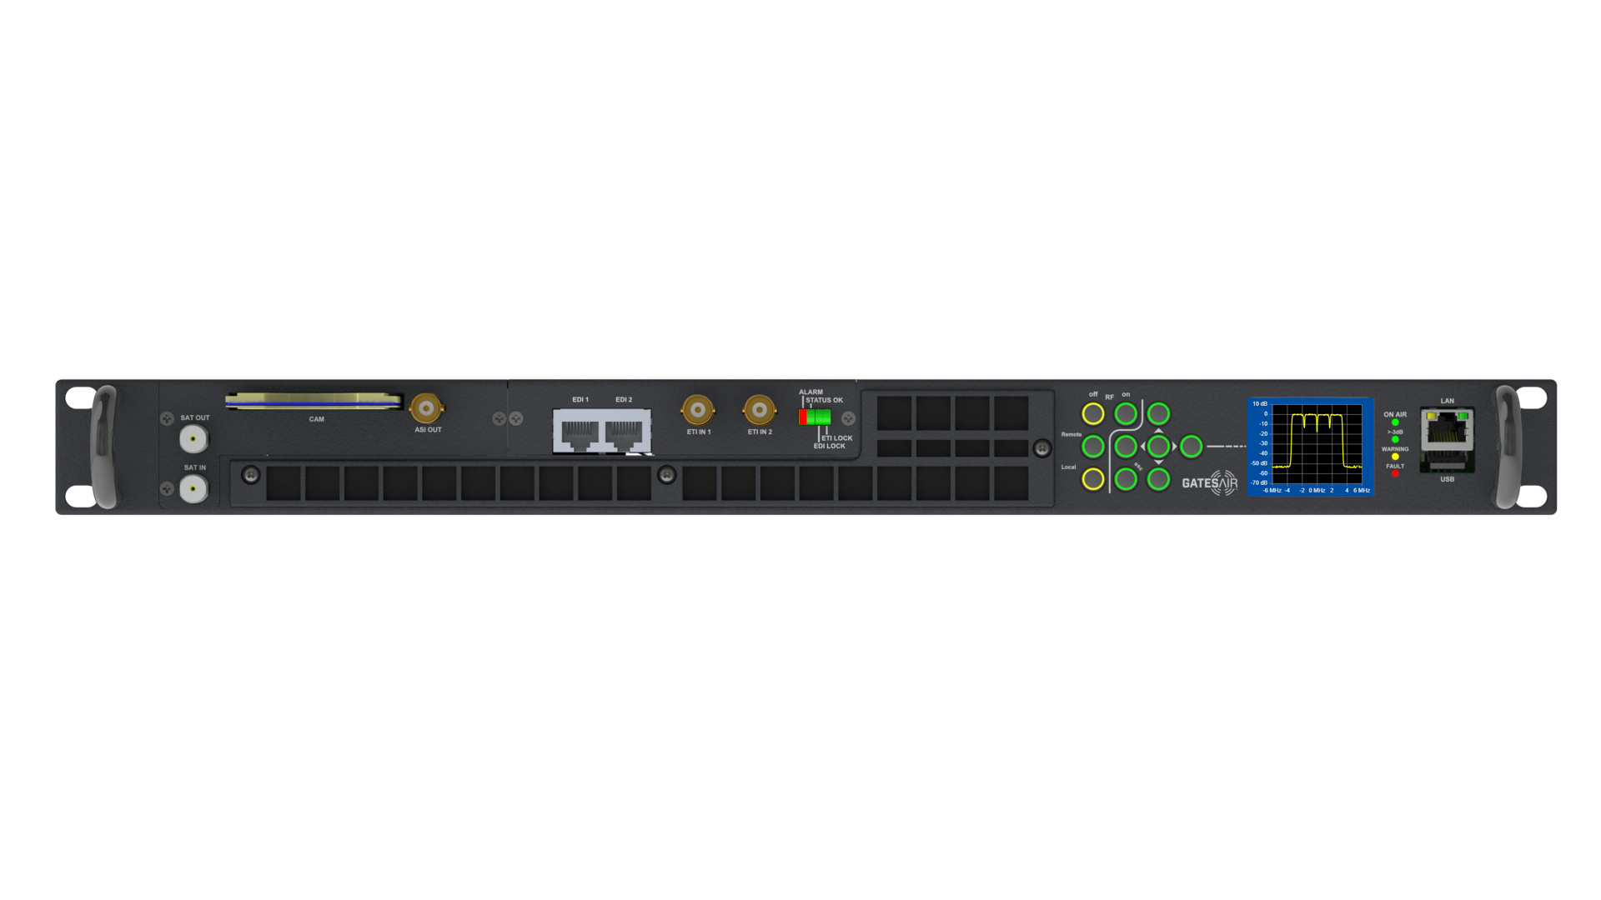
CASE MULTICARRIER TRANMITTER
DAB Multicarrier
Notes:
Now I want introduce some new concept of transmission system.
Suppose we can use only one system to transmit multiple carrier.
So all the discussion that we had for one system is multiply for the number of carriers.

Slide 12
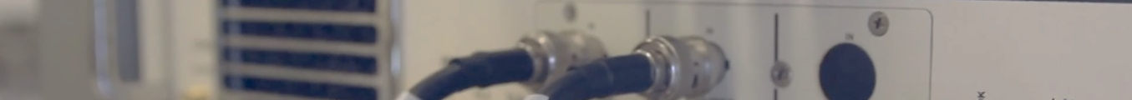

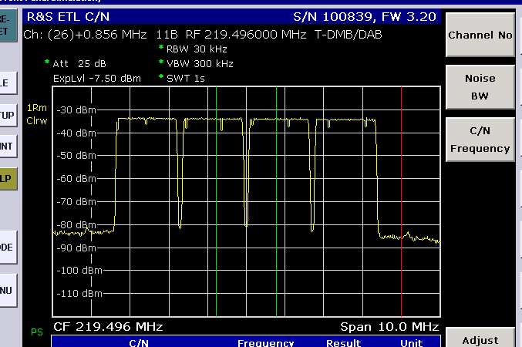
MULTICARRIER DAB
Spectrum – Up to 4 CH
Notes:
MultiCarrier DAB Transmitter:
It is a very innovative product, designed and developed to obtain significant technical and economic advantages. Currently it is the only one available on the market and it allows to generate or re-transmit up to 4 DAB/+ carriers using a single special modulator and single RF amplifier.
The technique of "common amplification" can be used thanks to a new algorithm that allows the precorrection of broadband linearity . The advantages are obvious: a single device instead of 4, and not needed of very bulky and expensive 4 channels DAB combiner,
Besides the inexpensiveness of the system, we highlight the easiness of installation and maintenance, the extremely compact size and extremely low power consumption.

Slide 13
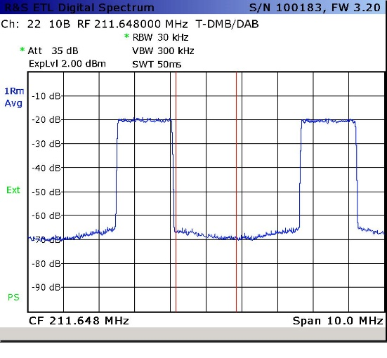
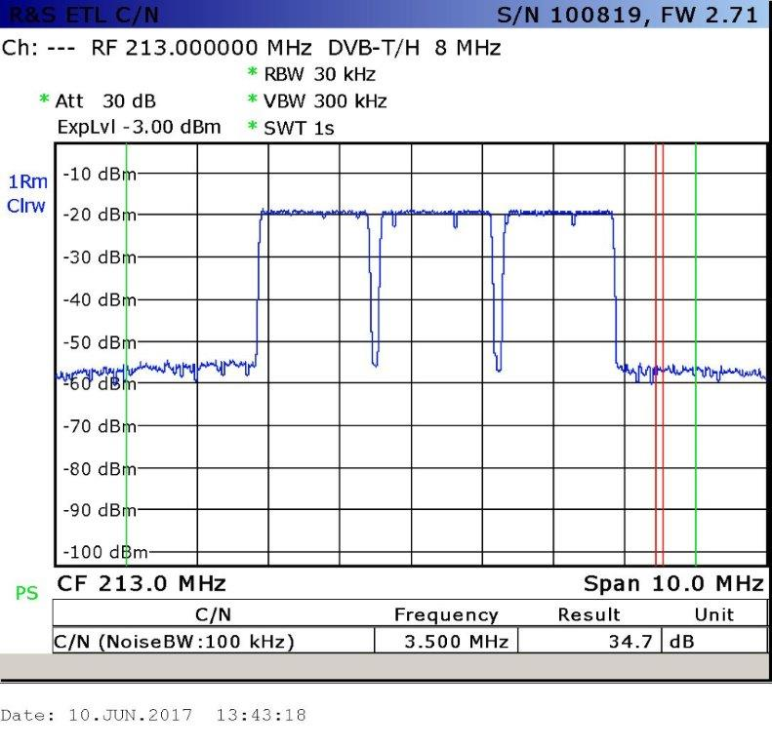
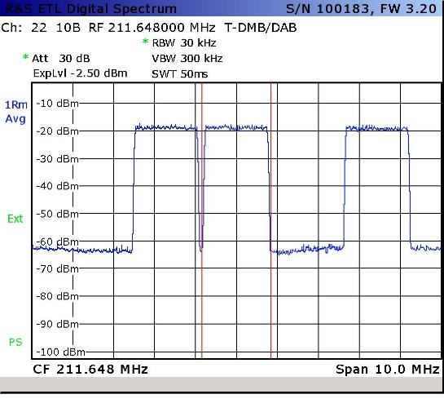
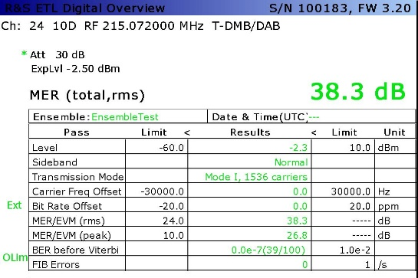
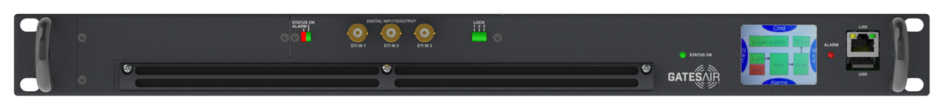
Multi Carrier DAB solutions reduce costs, and increase ROI
Tx Antenna
2 non adjacent channels
3 adjacent channels
3 non adjacent channels
VHF BIII Band Pass Filter
Notes:
Those are some other screen shot of the multiple carrier using 2 and 3 channel.
The MER that we can measure from this soltution is still very good and over 38 dB.

Slide 14
MULTICARRIER DAB
1RU Up to 150 Wrms Total
FRONT VIEW
Input Slot #1
Input Slot #2
1U
EDI In #1&2
DVB-S/S2 Receiver (Optional)
EDI In #3&4
Keyboard
Display
USB Port
ETI In #1
ETI In #2
Control Ethernet Port
Notes:
So this is the unit that can receive all the EDI on the two input and modulate it or can be receive using the ETI or DVBS.
Compact 1U rack 19 "chassis.
Output power up to 750W rms total in compact version (higher powers available).
Input interface: 2xEDI+2xETI, DVB-S/S2, 4xETI, RF inputs.
Common RF amplification.
Broadband VHF BIII Doherty Amplifier technology with high efficiency.
Supported Modulations: DAB / DAB + / T-DMB.
Multi-carrier modulation (4 channels), for adjacent and non-adjacent frequencies.
More economic than standard solutions.
More compact.
Less expensive to operate, lower power consumption.
Adaptive pre-correction circuits.
Built-in high-stability GPS / GLONASS receiver (Optional).
Hot swappable amplifier and power supply (for 1RU only).
SNMP, Web interface and Touch Screen display.
USB service interface for up-grade / download.

Slide 15
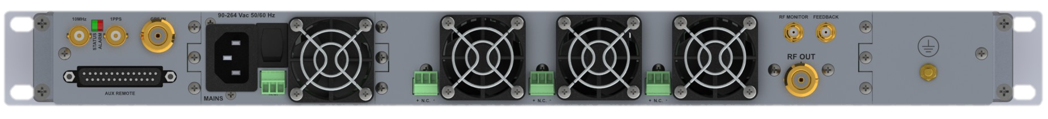
MULTICARRIER DAB
1RU Up to 150 Wrms Total
ONEDRIVER
ONEDRIVER 30 – ONEDRIVER 50 – ONEDRIVER 80H – ONEDRIVER 130H
BACK VIEW
GPS
Receiver
Power
Supply
RF Power Amplifier
1U
10 MHz In/Out
GPS In
RF Monitoring
Feedback (Pre-correction)
1 PPS In/Out
RF Out
Notes:
The output is from one RF connector in the back of the unit

Slide 16
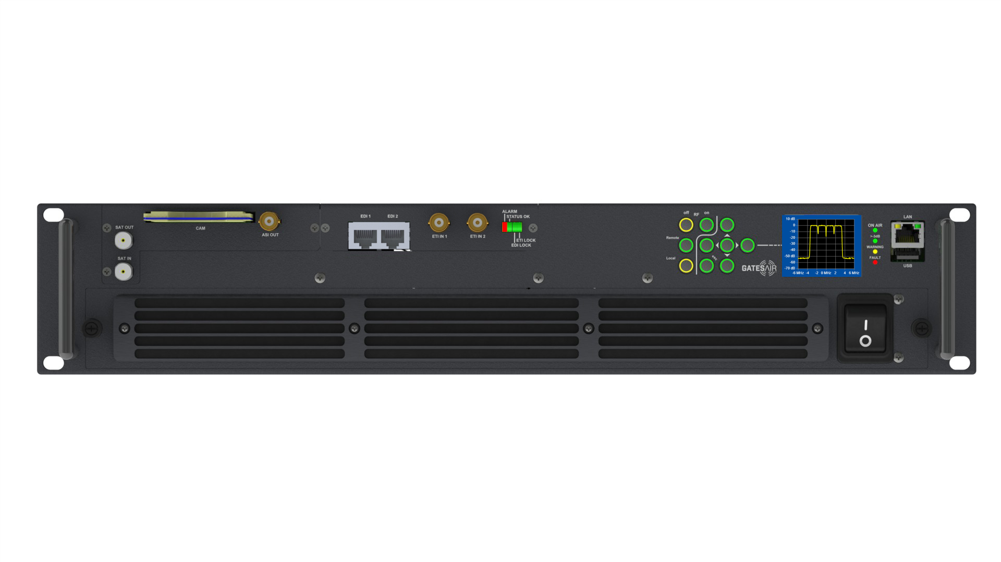
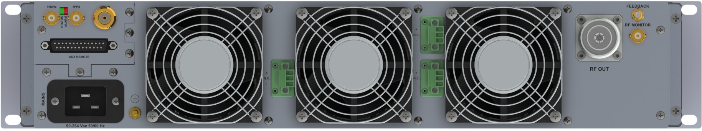
MULTICARRIER DAB – 240 Wrms Total
DVB-S/S2 Input
EDI In #1&2
Touch screen LCD
USB Port
ETI In #1
ETI In #2
Control Ethernet Port
EDI In #3&4
10 MHz In/Out
GPS In (Opzionale)
RF Out
Feedback
1 PPS In/Out
RF Monitoring
Notes:
Similar for the transmitter for 240w

Slide 17
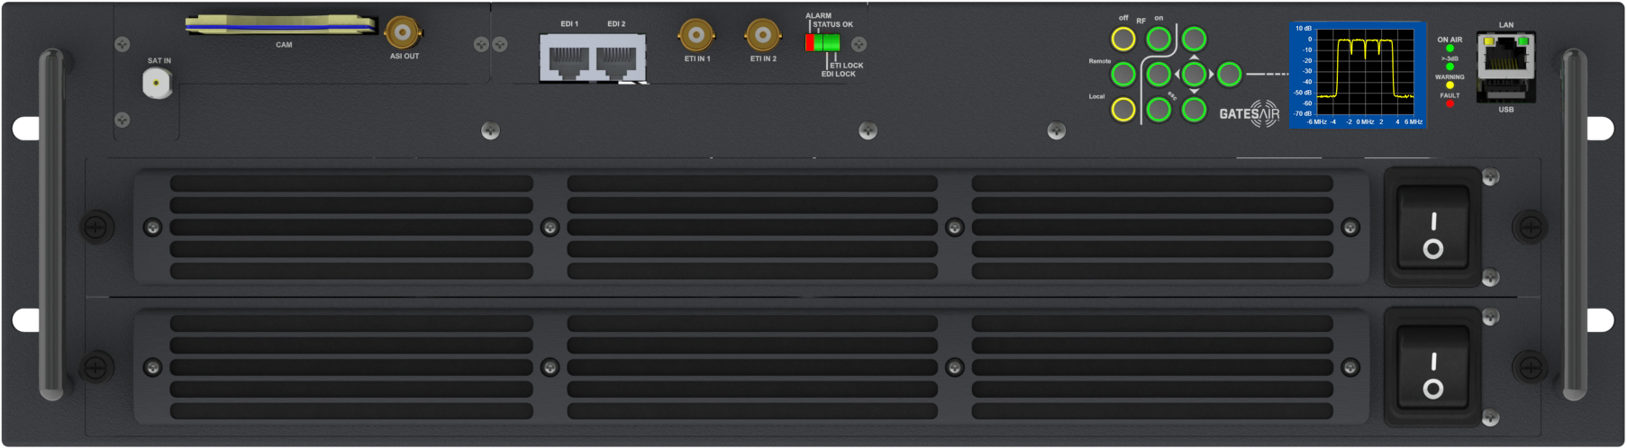
MULTICARRIER DAB – 3 RU Up to 750 Wrms Total
DVB-S/S2 Input
EDI In #1&2
Touch screen LCD
USB Port
ETI In #1
ETI In #2
Control Ethernet Port
EDI In #3&4
Notes:
And this is for transmitter up to 750w

Slide 18
Accessories: Automatic changeover
2+1 or 1+1 Configuration (N Connectors)
Front View
Switch Ethernet
Touch screen LCD
Control Ethernet Port
USB Port
Rear View
RF IN TX #1
RF IN TX #1
RF IN TX +1
RF Out
RF Out
Notes:
Someone can make question that the multicarrier system is not secure in term of redundancy, for this reason we can use a N+1 solution.
Here some of our product that can support this:
In this slide is the 2+1 and 1+1 with the N output connector
If the power is higher we can use the version with 7/16 connector

Slide 19

Accessories: Automatic changeover
Options
Option: ETI Input Splitter / Matrix
Option: Power supply
Notes:
An option of the automatic changeover unit and in case we are using the ETI we have the ETI input splitter/matrix that automatically switch the input to the active transmitter.

Slide 20
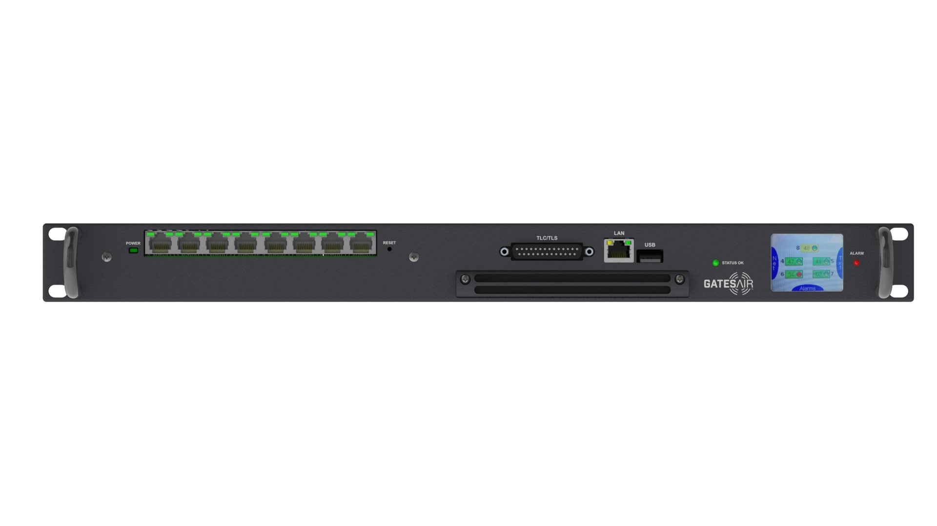
EXAMPLE: 1+1 (4+4ch) Configuration
Tx Antenna
1+1 Configuration
Main TX
RF OUT
Automatic changeover
VHF BIII Band Pass Filter
RF OUT
Spare TX
Notes:
This is an example of 1+1 with 4 DAB channels.

Slide 21
EXAMPLE: 1+1 (4+4ch) Configuration
Output filter: STANDARD VHF BIII Band Pass (NO DAB Filter required)
Notes:
To use the muti carrier we also need a special design for the filter that need to be wider compare using only one RF channel.

Slide 22
Systems comparison
Main Features
Multicarrier DAB
Standard solution
Number of Transmitters
1
4
Dimensions TX
1U
4 X 1U/2U/3U or bigger
Independent management of single mux
YES
YES
RF DAB Combiner
NO
YES
Special Filter Combiner: DAB + Services
(for special applications only - ex: tunnel coverage)
YES
YES
Power output W/CH *
175W rms
175W rms
Efficiency
Always better than standard solution
Always worst than Multicarrier
*higher powers available
Notes:
So concluding for the multiple carrier transmitter we have here a brief comparison.
# transmitter
Size transmitter
Combiner needed
Efficiency in term of power consumprion for services

Slide 23
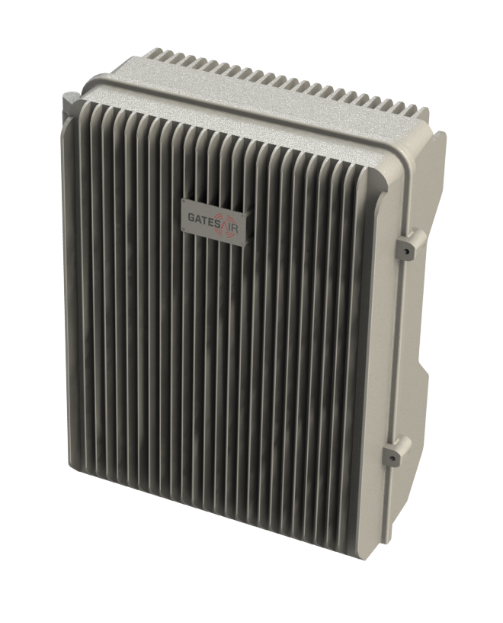
PMTX-1
Outdoor Transmitter
Notes:
We Gates Air we think beyond and we re-thinking the way of transmit.
We develop the first full outdoor DAB transmitter system

Slide 24
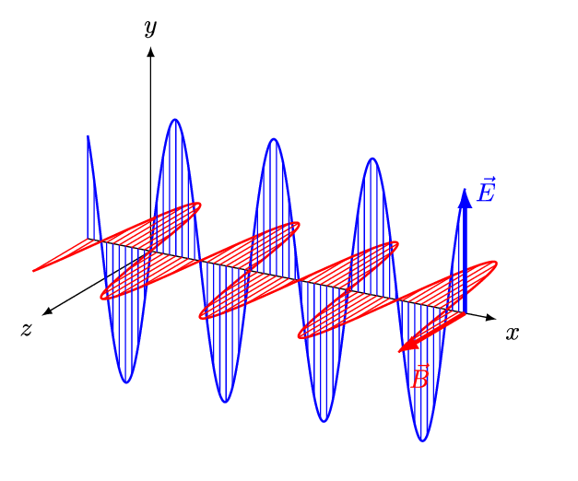
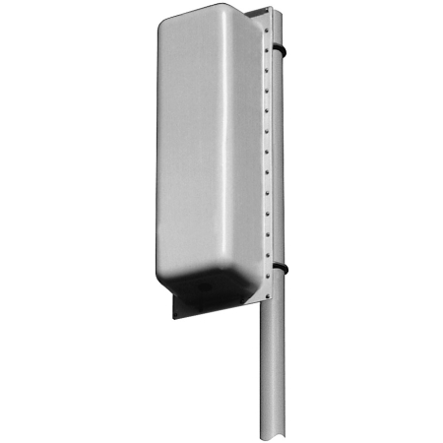

Getting away from the 19” Paradigm
Why an outdoor transmitter?
  Breaking the normal Broadcast tradition
  A complete “Transmitter in a box” concept
  Well-proven in other industries (cellular)
  No building, no indoor lease space
  Save $$, lower TCO
  Fast & easy to deploy
  Can make a great alternative solution for the lowest power level transmitters, repeaters
Antenna
RF Out
Complete Transmitter System
In a
(sealed) Box
RF In or Program Stream In
Power
Notes:
Why an outdoor transmitter.
it;;s to think outside the normal concept of Radio TV transmission.
It’s a complete transitter in unique box
But it’s not a very new technologies, it’s something that is well proven in other industries
For this system no need building, no indoor lease spare
No need air conditioning!!
This is transform in save dollar and lower Total cost of Ownership
Will be fast and easy deploy
And can make great alternative soluition for Low power lever ltransmission and repeaters.

Slide 25
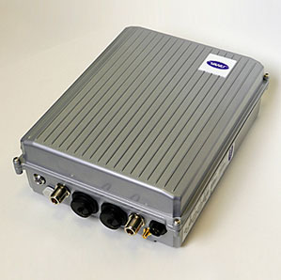
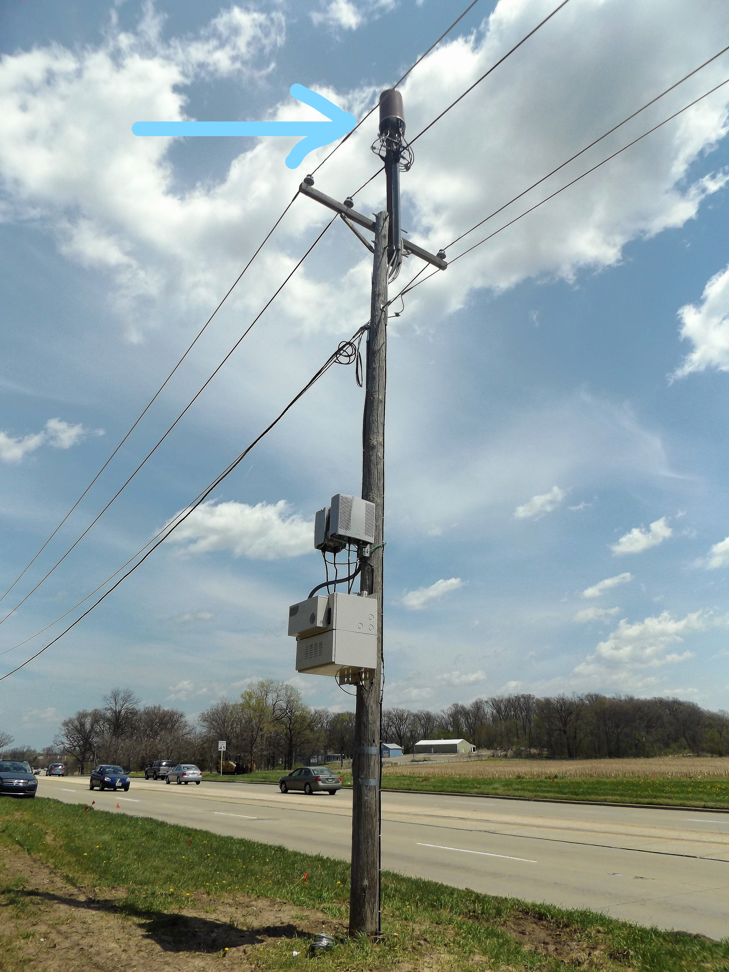
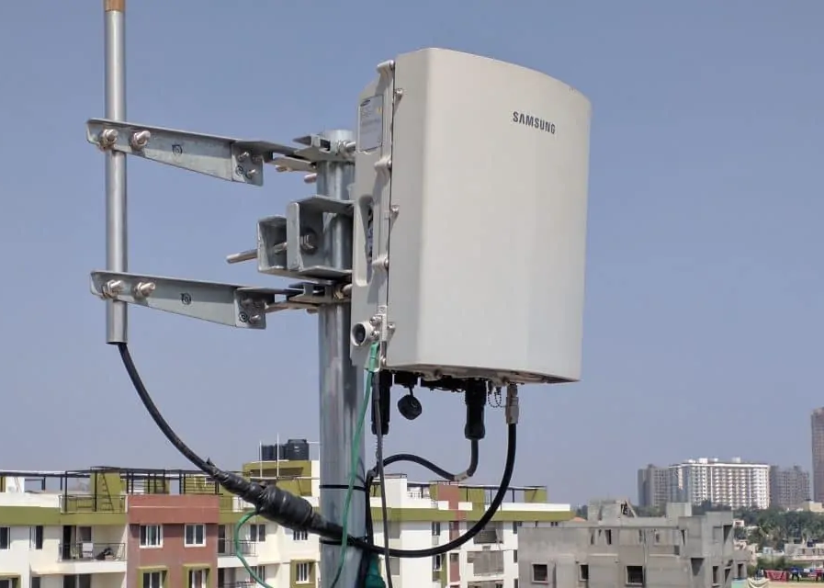
It’s Not a Totally New Concept
Examples of outdoor transmitters
Courtesy Vanu Inc.
Low Power Cell Tx (Vanu)
Efficient transmitter: This 50-watt (power consumption) unit is the lowest-power outdoor cell-phone base station in the world, according to an analysis by its maker.
Power Pole-mounted 5G Tx & Antenna (Unknown Brand)
Courtesy Samsung Group
Cellular Base Station Tx (Samsung)
Notes:
This is example of existing concept but use for different industry.
This show the system is well proven.

Slide 26
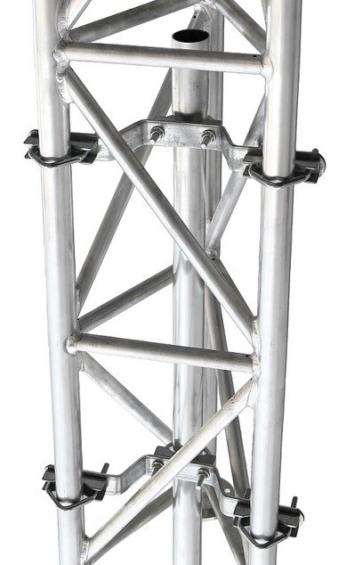
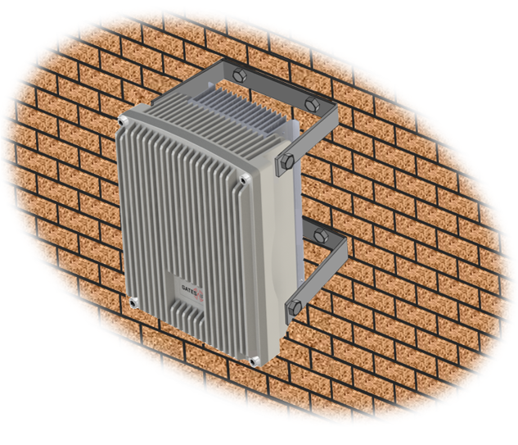

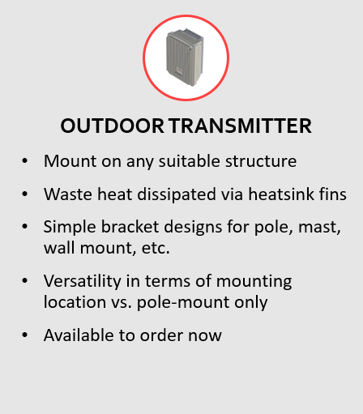
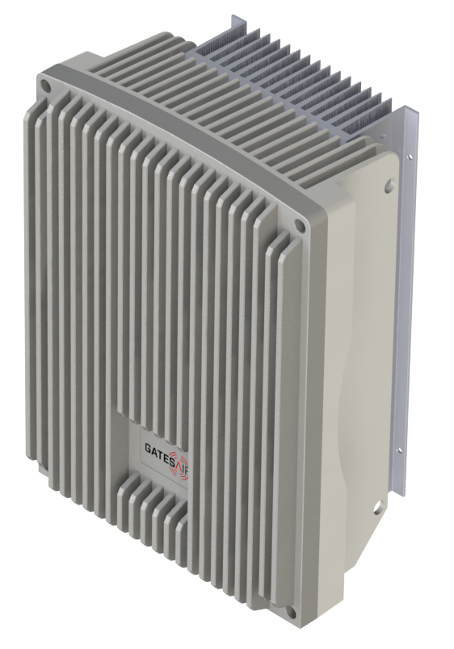

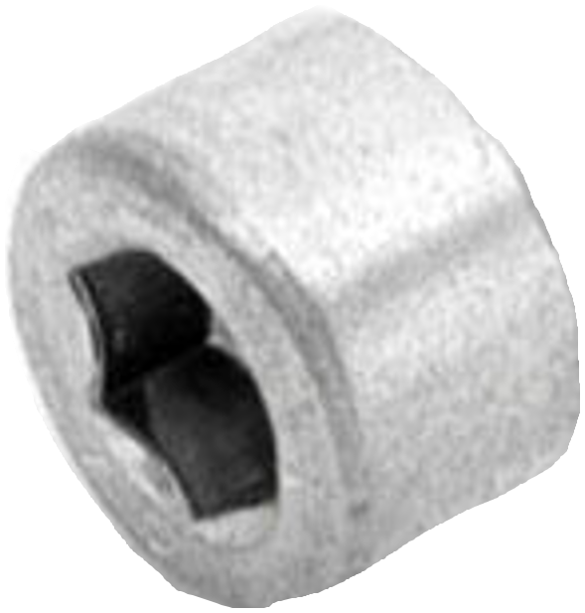
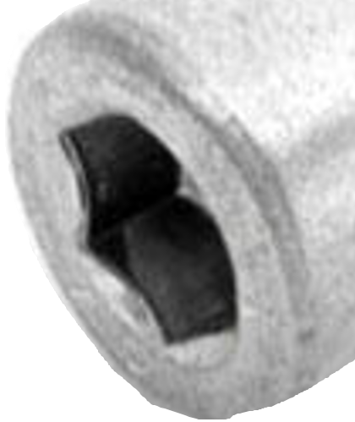

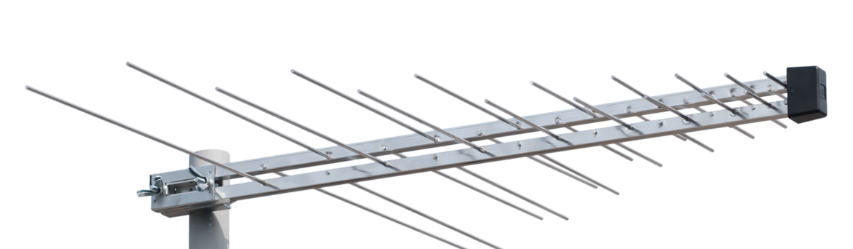
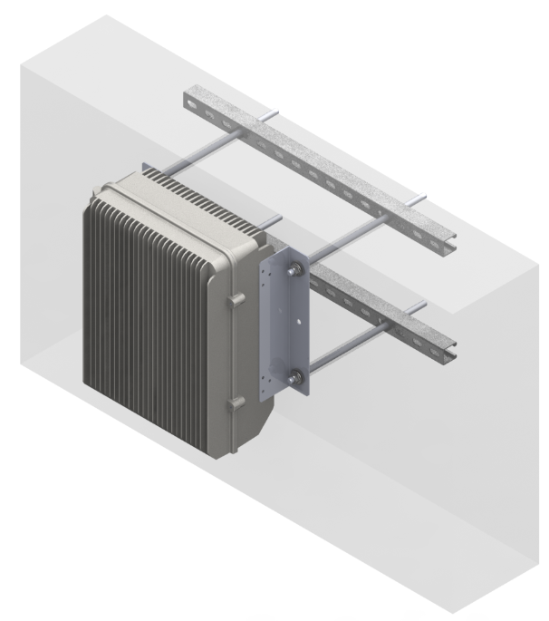
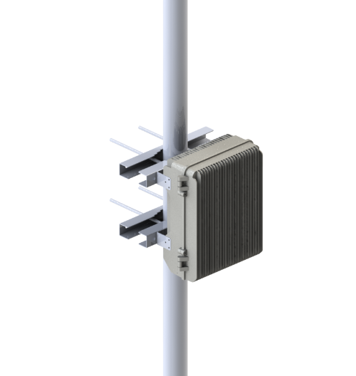
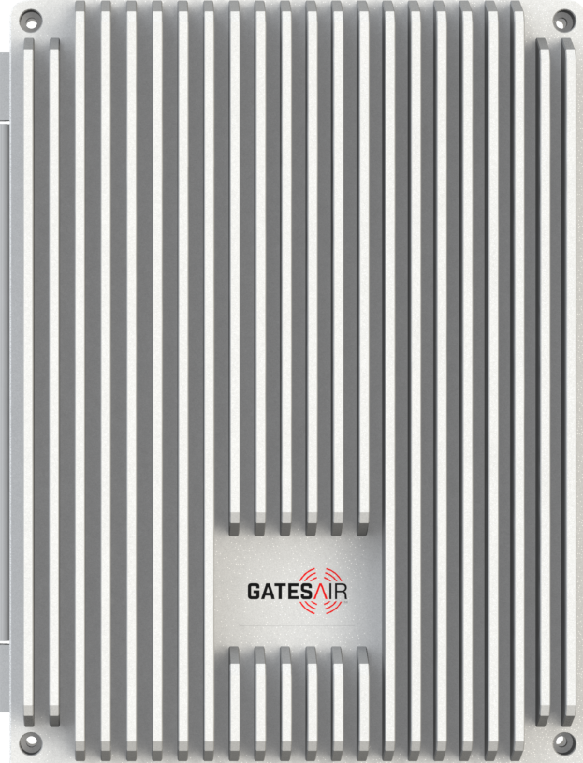
Installation Flexibility!
Mount “anywhere” design
Wall / Side of Building
Tower/Pole Mount
Top of Building
Notes:
For this unit we can provide the installation kit that allow to install the box in every surface, pole, tower etc..

Slide 27
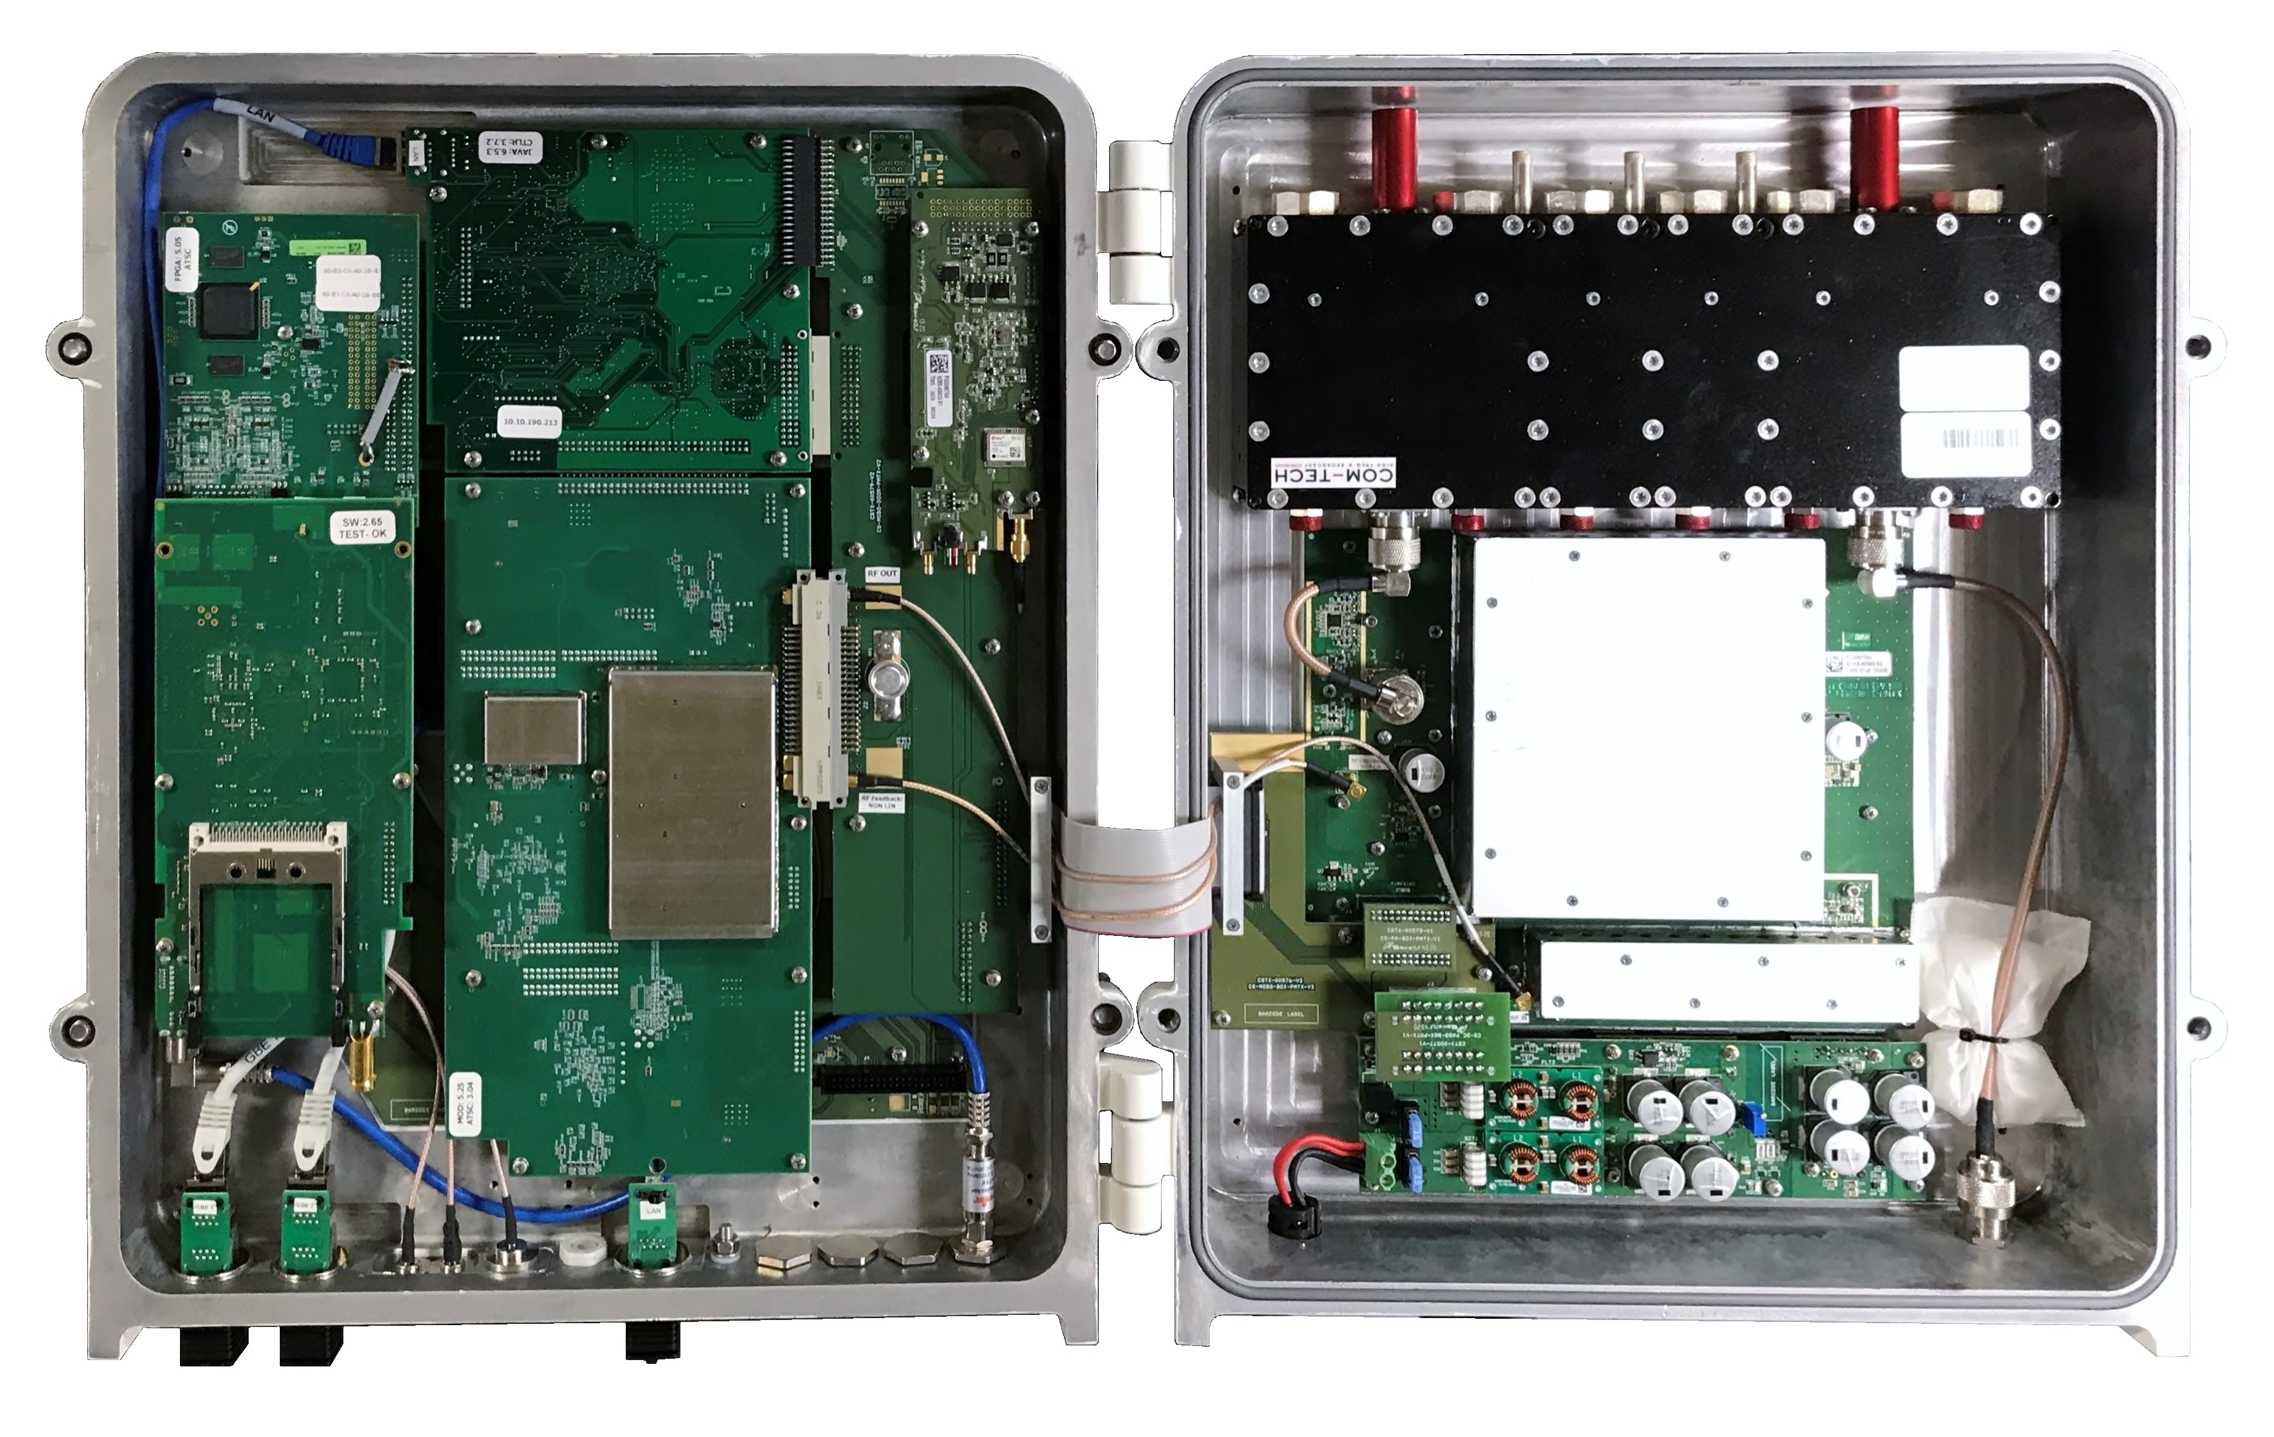
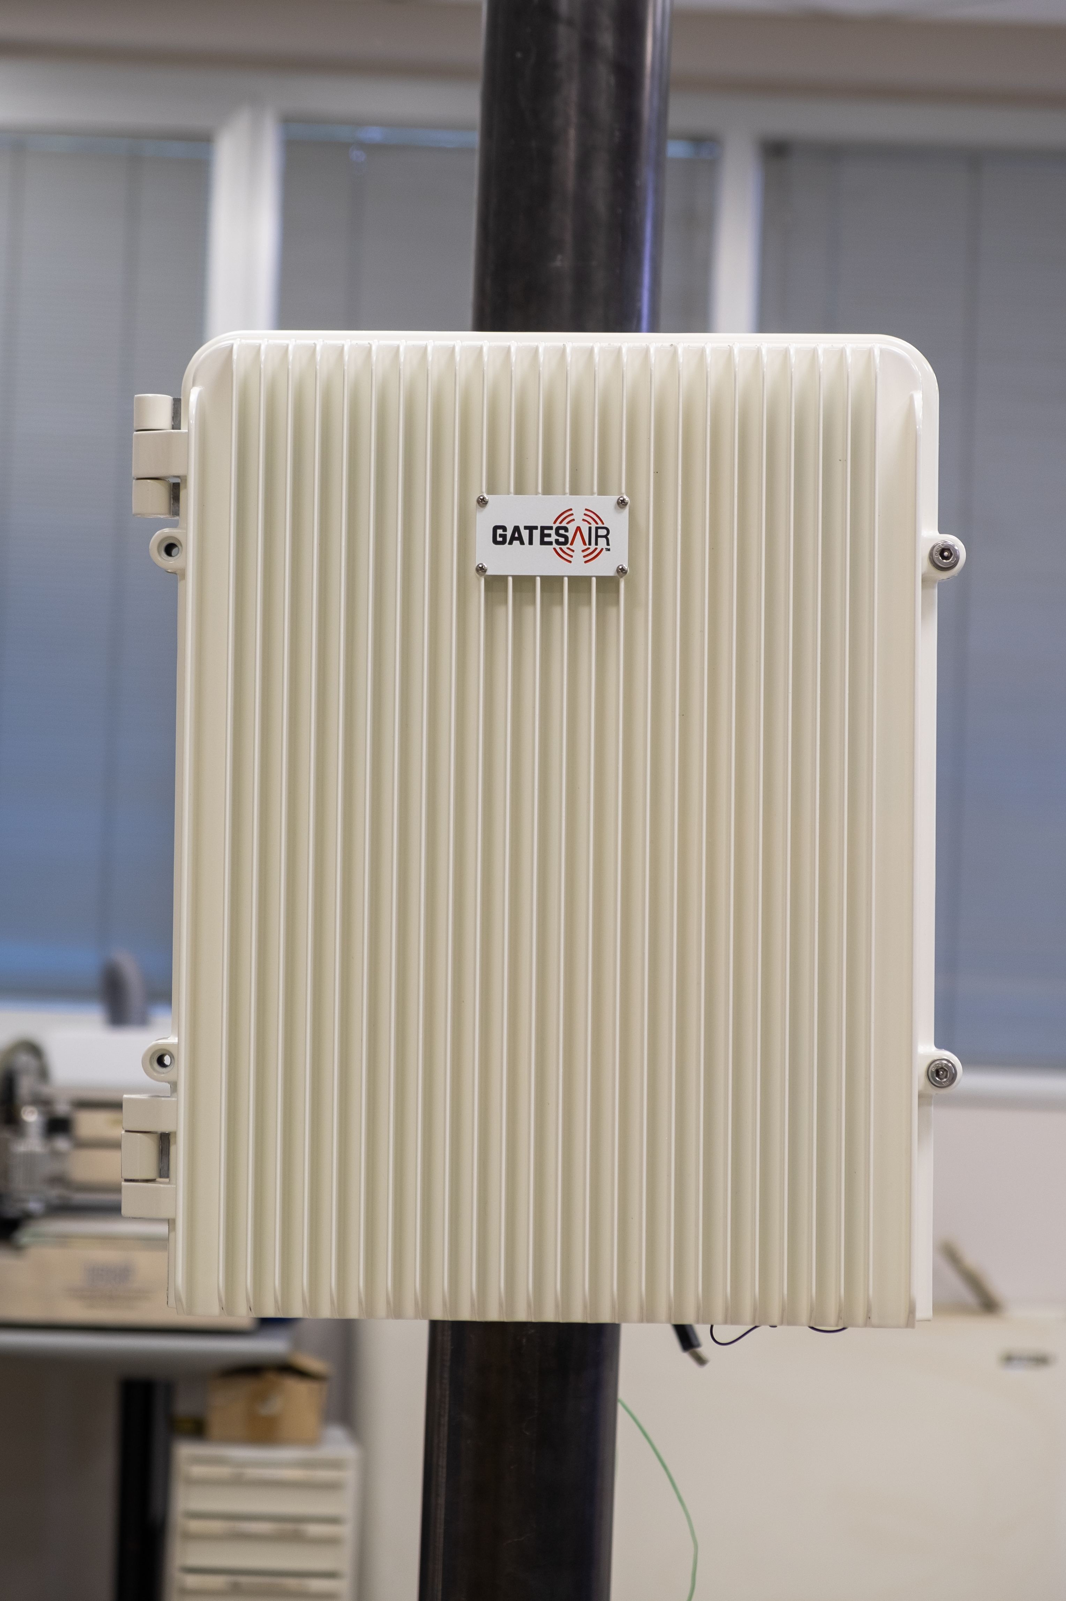
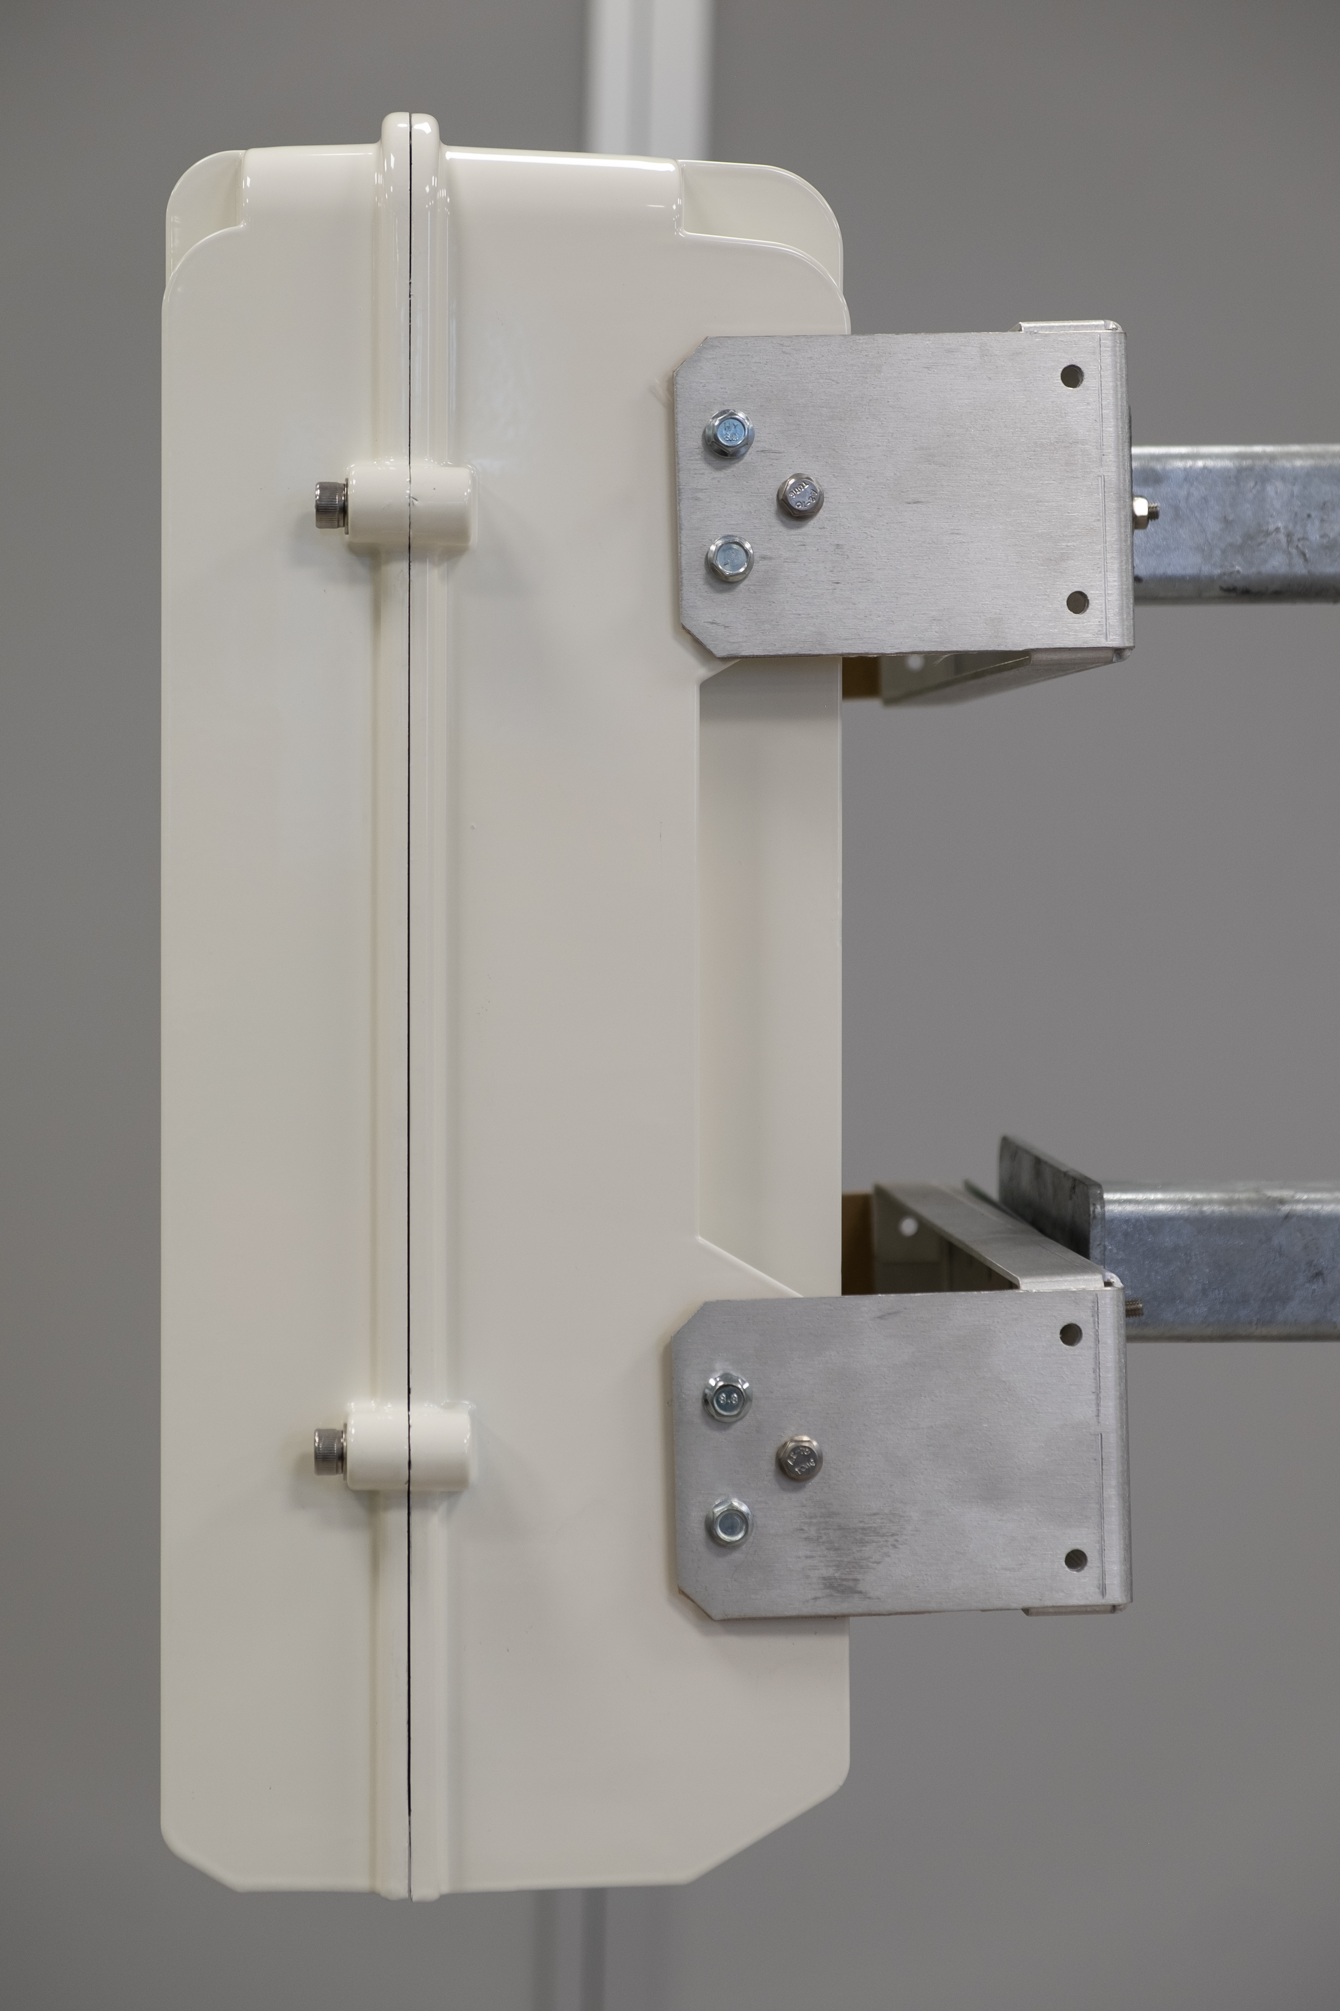
PMTX-1 Components
Interconnect Board
Filter
Controller
Input
Board
Power Amplifier
Interface for Sat Rcvr
Modulator
GPS
DC Supply
Notes:
Opening the box we can see how was the integration of each component.
The box is become the heat sink.

Slide 28

Technical Characteristics
Basic Configurations
  Transmitter / Transposer / On-Channel Gap Filler
  Integrated Mask Filter
  Up to 50W TPO average DTV after filter
    or 100W Analogue
  Modulations: DAB/+, T-DMB, ATSC-1, DVB-T/T2, ISDB-T, Analogue
  GPS - Option
Inputs & Options
  1 x TS (ETI / EDI / BTS / ASI / SMPTE-310M) + 1 x GbE (TSoIP) - Included
  Off-Air Receiver (Regenerative or Direct Conversion) - Option
  Satellite Receiver DVB-S2/S2X - Option
Power source
  External DC: 36V to 72V
  External AC to DC Power Supply - Option
Notes:
The system can work in different configuration like transmitter, transposer, on channel gapfiller.
And also in different standard.
Is able also to transmit in SFN with the integrated GPS.
DAB is one of our last implementation standard in this unit, the input can receaive is ETI and EDI.
The power supply is DC.

Slide 29
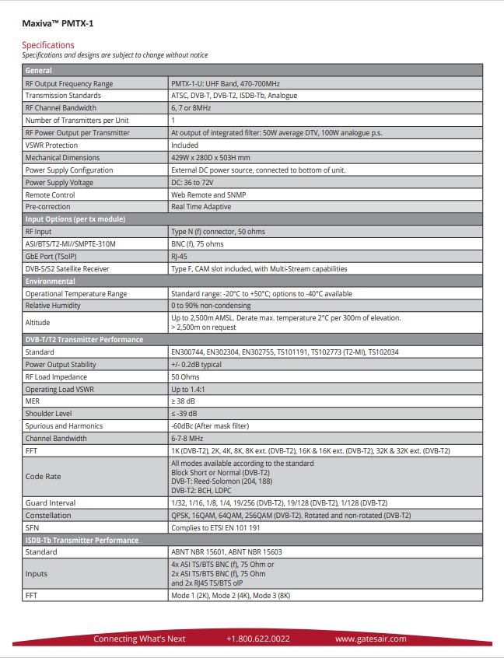
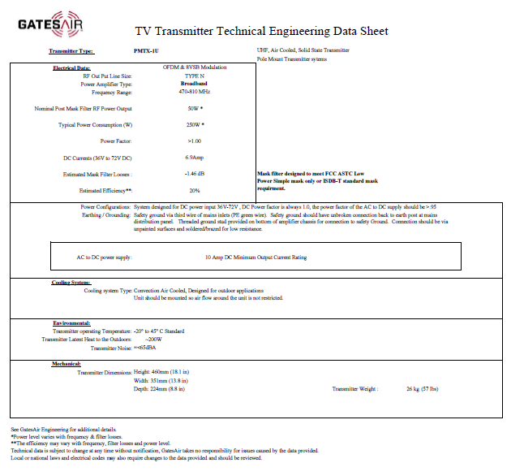
Technical Characteristics
Environmental
  Ambient air temperature range:
    -20°C to +45°C (standard)
    -40°C to +50°C (optional)
  Weatherproof, sealed enclosure
Performance (Adaptive correction is included):
  MER ≥ 34dB
  Shoulders ≤ -37dB
Remote Control
  GPIO (parallel remote)
  Full-featured HTML-5 Web Remote GUI
  LTE Module (option)
Technical Engineering Data (TED) Sheet
Brochure Specifications
Notes:
The system can work between -20 to 45 degree, outdoor temperature, it’s water proof and sealed enclosuee.
For the remote control can be GPIO, WEB, SNMP and in the future LTE.
Concluding we always provide new solution for the broadcasting to improve and reduce their transmission cost and coverage

Slide 30

THANK YOU
www.gatesair.com
Notes:
Thanks every one

