Slide 1
Securing the future of Radio with DAB+
Bernie O’Neill, Project Director, WorldDAB
ABU DBS 2023
Notes:
Hello and welcome everyone
It’s great to be back together again for another edition of the ABU DBS – we’ve missed seeing everyone over the past few years.
There has been much progress and many developments over the past few years, and we’re delighted to be here to share some of those with you today.

Slide 2

Our vision is that every person
can enjoy free-to-air digital radio
on the move, at home or work
with DAB+ at the heart
of this listening experience
Notes:
But before going into what’s new,, I just wanted to take a few momenets to remind ourselves about who WorldDAB is want what our aims are.
Mission statement:

Slide 3

Members from across the radio ecosystem
Notes:
Our membership has grown over the past few years, and we now have 112 members from 33 countries
The most recent members joining were…
DESAY SV (Singapore) – Tier 1 / antenna
FIH Mobile Limited – (Chinese Taipei) – Tier 1 / antenna
Lotus Group (Germany) – OEM
Radio Screen – (France) – metadata distribution platform for DAB+, RadioDNS Hybrid Radio and Internet radio stations

Slide 4
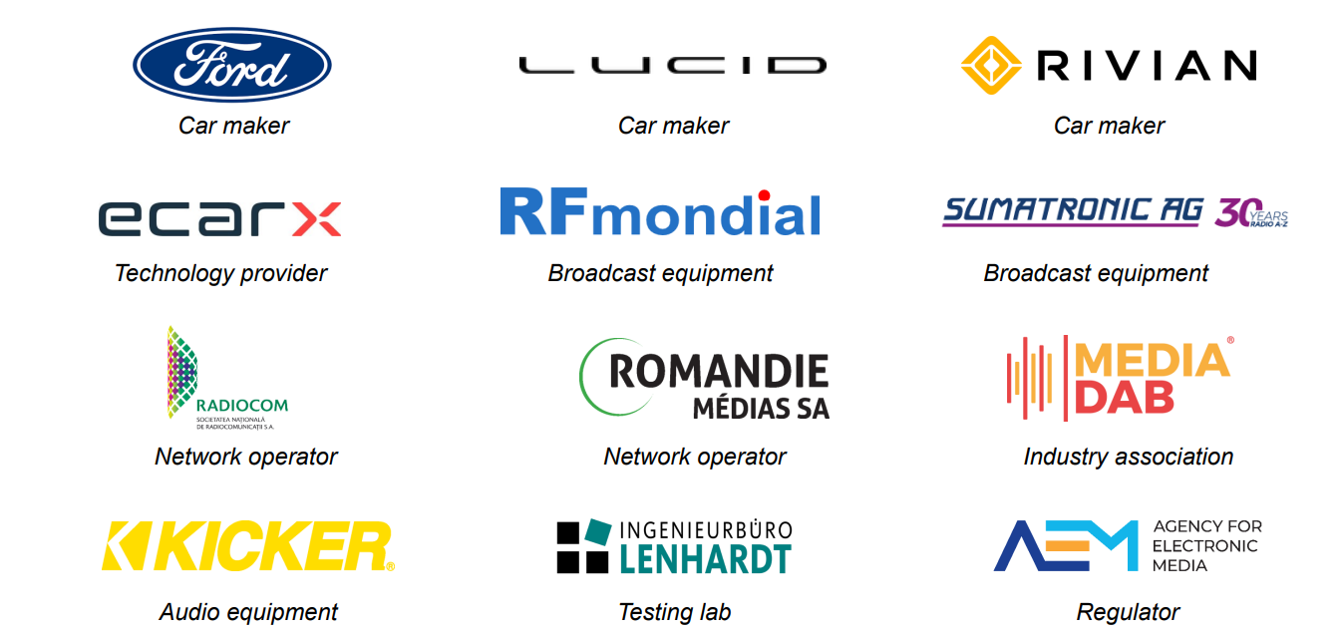
Our membership is growing
112 members from 33 countries

Slide 5





Working with regional partners
Notes:
Steering Board oversee the operational and financial management of the organisation, implementing strategic measures to ensure the successful rollout of DAB+.
Technical Committee oversees the DAB technical standards, and future proofing broadcast radio equipment for broadcasters and manufacturers.
Spectrum and Network Implementation Committee provides guidance on DAB network implementation including how to build a transmission site, multiplexing and sound processing, monitoring and signal distribution and data service implementation. This Committee also monitors and lobbies to ensure frequency availability for DAB+.
Automotive Working Group brings together the broadcast and automotive industries to collaborate on the optimum deployment of DAB+ digital radio in the car. Asia Asia Pacific Technical Group provides guidance on the technical aspects of implementing DAB+ digital radio, with help and advice that is tailored specifically to the needs of the region.
Marketing Group
The Marketing Group helps broadcasters develop a DAB+ marketing strategy by sharing resources, case studies and best practice.

Slide 6

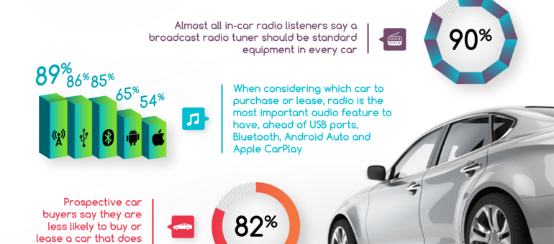
We provide information, factsheets and resources
www.worlddab.org/resources
Notes:
For RX makers it is a key to have a worldwide market
This is the only way to offer radios for a solid price and to continue the evolution of radios
We are still having too much hesitations, it would be beneficial for the industry to have a common European approach, DAB/DAB+ implementation everywhere, consolidated definition of radio types (e.g. WorldDMB profiles) and similarity on the transmitted information and data

Slide 7
WorldDAB committees and working groups continue to be active
Marketing
Technical
Automotive
Share best practice
Maintain / refine standards
Optimise in-car experience
Spectrum & Network Infrastructure
Asia Pacific
Technical
Help new players get started
Support for Asia Pac region

Slide 8
Why DAB+?
Listener & broadcaster benefits
Notes:
The UK
Norway
Denmark
Switzerland
And don’t forget Australia which launched in 2009

Slide 9
For listeners, DAB+ offers greater choice
On average, seven times as many services
National radio services
Source: WorldDAB, industry bodies
Notes:
DAB addresses these limitations
In particular, by offering a significant expansion in choice
Up to six times as many services as on analogue

Slide 10











For broadcasters, DAB+ offers opportunities to innovate and extend reach
Brand extension
London to national
Audience tripled:
1.7 million (Q1 12) to 5.1 million (Q2 22)
Analogue London radio - audience 2014: 1.1 million
Analogue plus digital National audience today: 3.3 million
Source: RAJAR
Notes:
Absolute has launched six new digital-only stations
In seven years, their audience has more than doubled

Slide 11

Incremental reach drives commercial revenues
UK radio advertising revenues, £ million
+34%
Source: Radiocentre
Notes:
Again the UK provides an excellent case study
Once critical mass is achieved, commercial revenues follow
In the last four years, UK ad revenues are up 26%
In 2018, radio in the UK is the fastest growing radio – even ahead of online
This growth is being driven, in particular, by national commercial services
Worth noting – these services have had significant appeal to younger audiences in the 15-24 age range

Slide 12
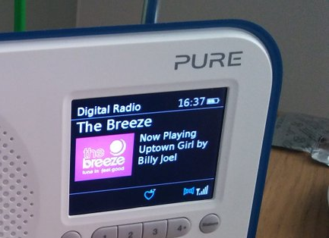

DAB offers “now playing” info, station logos and voice control
Information about song and artist
Station logos
  different sizes
  important in cars
DAB stations can be chosen via voice commands using phonemes

Slide 13

Three macro reasons for DAB+
Economics: costs of distribution lower than FM
Environment: energy requirements lower than any other platform
Emergencies: resilience – especially out of home
1
Economics
2
3
Environment
Emergencies
Notes:
Three E’s — economics, environment and emergencies — will drive the case for DAB+ adoption

Slide 14

Economics: cost per service far lower than FM
Annual cost to broadcasters of transmission per service¹, US$k
-80%
-80%
Source: Total operating costs sourced from broadcasters and network operators
Note (1) Operating costs for DAB+ assumes 18 services on multiplex; opex includes site and tower leases, power, telco, maintenance, monitoring and support costs
Notes:
DAB+ offers lower costs of distribution than FM, coupled with lower energy requirements, and greater resilience in emergencies, especially out of home

Slide 15
Economics: lower-cost options with DAB - additional savings
So-called “small scale” DAB
Lowest cost functional approach to DAB
  open source software
First adopted in UK, Switzerland, Denmark
Easier to access DAB
  Small stations in developed markets
  Expansion of existing networks
  New countries taking first steps

Slide 16

Environment: DAB+ is the green solution
DAB+ consumes significantly less energy than FM
BBC study: DAB 33% more efficient than FM¹
German study (BLM): similar results
https://www.bbc.co.uk/rd/publications/research-393-energy-footprint-bbc-radio-environment-impact-sustainability
https://www.blm.de/aktivitaeten/forschung/green-radio.cfm

Slide 17




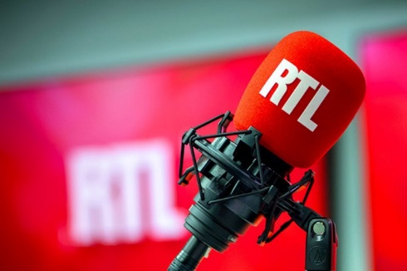
Energy consumption: a key factor in switch-off decisions
Norway: 2017
Partial switch-offs
Germany
South Tyrol
Italy
Long wave
France
Switzerland: 2024
Expect more of these in next five years

Slide 18

Emergencies – DAB+ is resilient
Broadcast radio - reliable in times of emergency
Mobile services less robust

Slide 19
Global developments with DAB+

Slide 20

Australia – DAB+ established, and growing
66% population coverage
Regional DAB+ expansion
Commercial DAB+ stations reaching record audiences
Over 7.5m DAB+ receivers sold
79% new cars DAB+ as standard

Slide 21
Asia Pacific markets continue to run trials
Established
On the move
Trials
Turkey
Asia Pacific
Kuwait
Tunisia
Algeria
Thailand, Vietnam, Malaysia, Indonesia
Bahrain, Jordan, Oman, Qatar, Saudi Arabia, UAE
South Africa

Slide 22
Africa and Middle East have seen a step change in interest
2021
Tunisia
Algeria
On the move
Trials
Requests for info
Jordan, Kuwait, Oman, Qatar, UAE, Bahrain
South Africa

Slide 23
Africa and Middle East have seen a step change in interest
2023
Tunisia
Egypt
Algeria
On the move
Trials
Mauritania
Requests for info
Jordan, Kuwait, Oman, Qatar, UAE, Bahrain
Senegal
Kenya
Uganda
Tanzania
Zimbabwe
ASBU and ATU
playing key role
South Africa
Lesotho

Slide 24
DAB+ established as core future platform for radio in Europe
Established
On the move
Trials
Finland
Norway
Sweden
Estonia
Latvia
DK
Lithuania
Ireland
UK
NL
Bel
Germany
Poland
Czech
Slovakia
Ukraine
Austria
Hungary
France
CH
Slovenia
Romania
Croatia
Serbia
Italy
Montenegro
Bulgaria
N Macedonia
Portugal
Spain
Greece

Slide 25



Major markets are growing – and innovating
UK: record digital listening (68%)
Rolling out small-scale DAB
Germany: rapid growth in DAB+ services and transmitters
Proposing DAB+ as critical part of emergency warning infrastructure
France: extending national and regional DAB+ coverage
Major marketing campaign in 2023
Source: RAJAR Q2 2022

Slide 26

Switzerland: preparing for FM switch-off
FM services to be switched off by end 2024

Slide 27
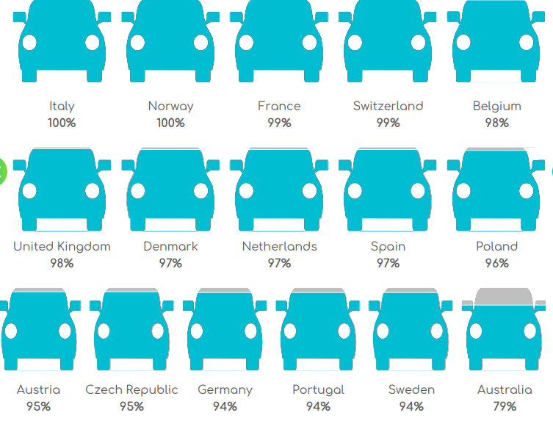
Almost all new cars now have DAB+
New cars with DAB+ as standard, Europe (2022)
Source: JATO, WorldDAB, industry sources

Slide 28
% of new consumer radios with DAB almost doubled in 4 years
New consumer radios with DAB as standard
Source: GfK

Slide 29
Summary
1
Established DAB+ markets continue to develop and innovate
Economics, environment and emergency driving the adoption of DAB+
Priority: deployment of DAB+ in Asia Pacific, Africa and Middle East
2
3
Notes:
For RX makers it is a key to have a worldwide market
This is the only way to offer radios for a solid price and to continue the evolution of radios
We are still having too much hesitations, it would be beneficial for the industry to have a common European approach, DAB/DAB+ implementation everywhere, consolidated definition of radio types (e.g. WorldDMB profiles) and similarity on the transmitted information and data

Slide 30
Thank you

