Slide 1
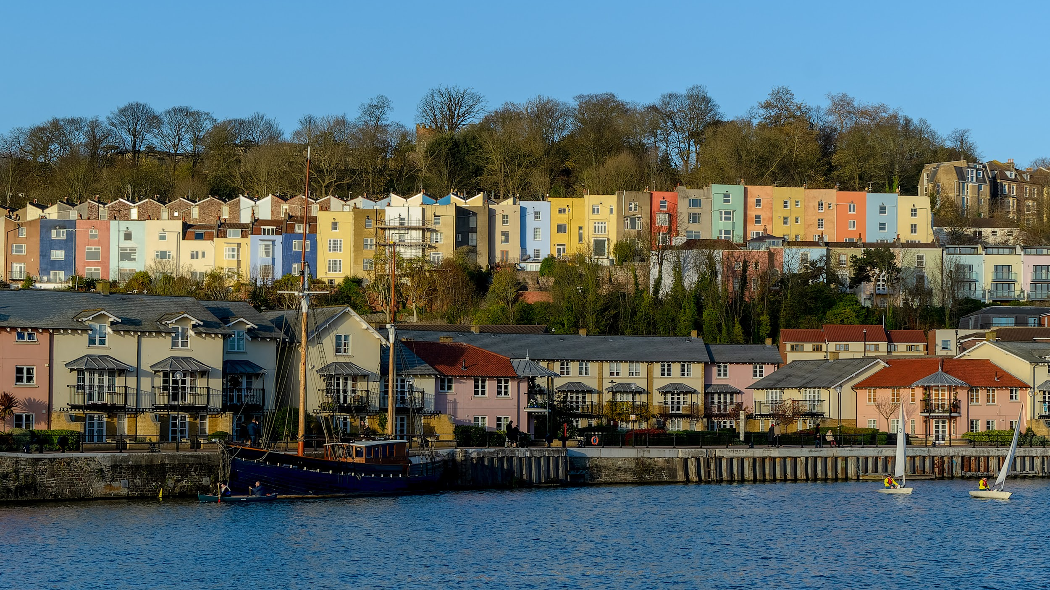
Small Scale DAB+ in Bristol, UK
Nick Piggott, Bristol Digital Radio
Photo credit: Velodenz @ Flickr
Notes:
DONALD
We've been asked to share with you how community radio stations in Bristol, in the West of England, have collaborated to win and build small scale digital multiplexes as a business that will return profits to the community radio sector

Slide 2
A Little History
Notes:
DONALD
To help explain the story of Small Scale DAB in the UK, and our plan in Bristol, it helps to have some history and context

Slide 3
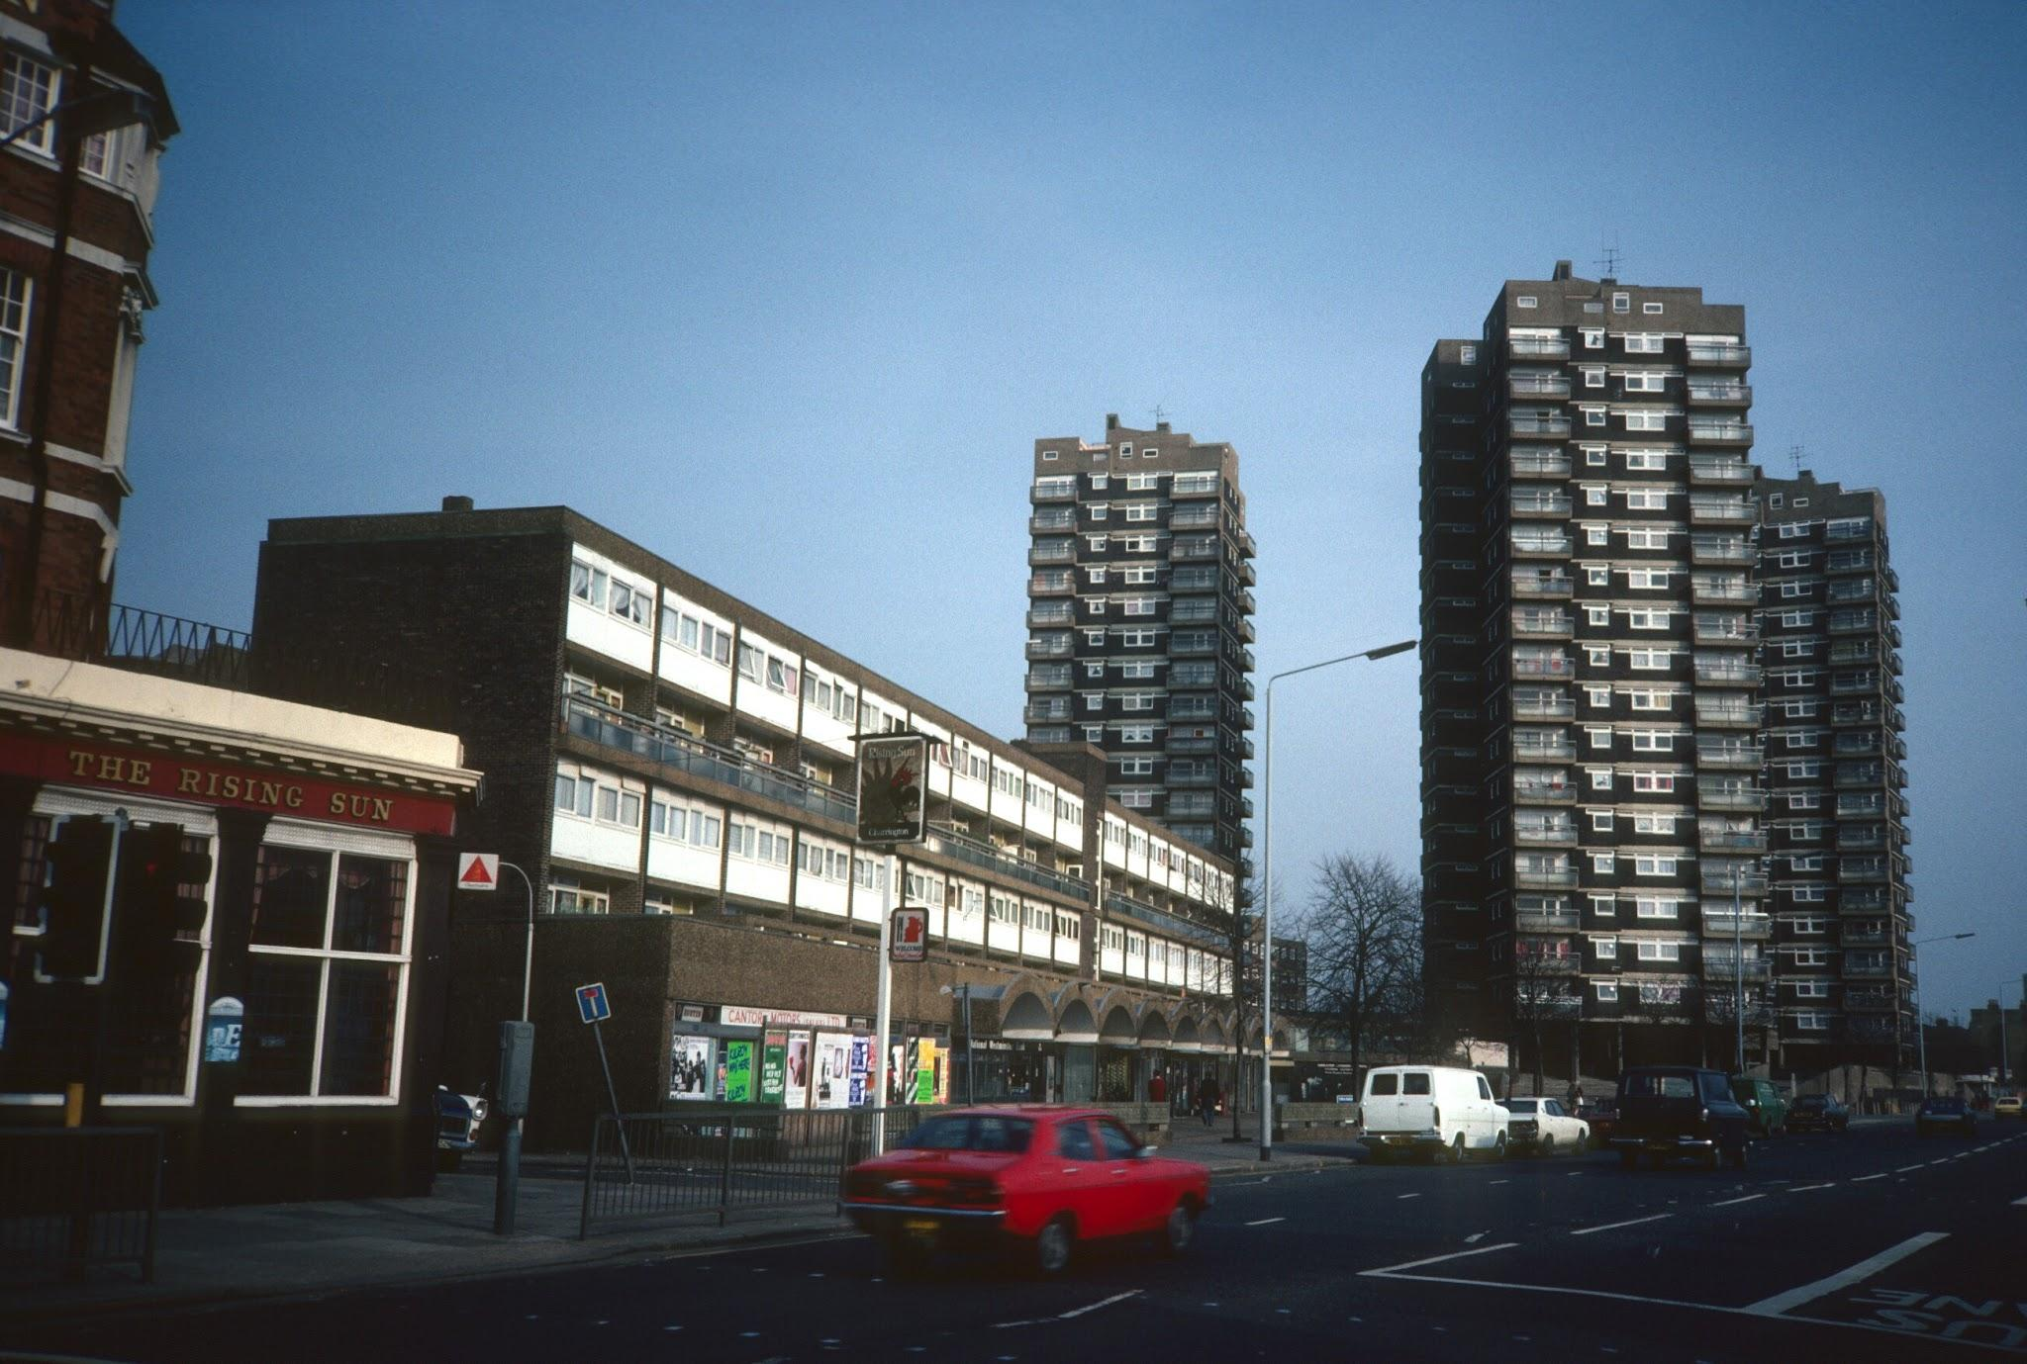
Photo credit: Prof. Miles Glendinning / The Tower Block Site
Notes:
DONALD
British cities in the 70's - 90s had only one commercial music radio station, and two "popular" music stations from the BBC. But they had a vast array of pirates of got themselves on-air by not following the rules, in many good and bad ways. They knew that getting a mast on a tower block in the middle of the city got them could get them coverage of a huge number of potential listeners. They just had to go knock on doors (and maybe copy a few keys) to make it happen.

Slide 4
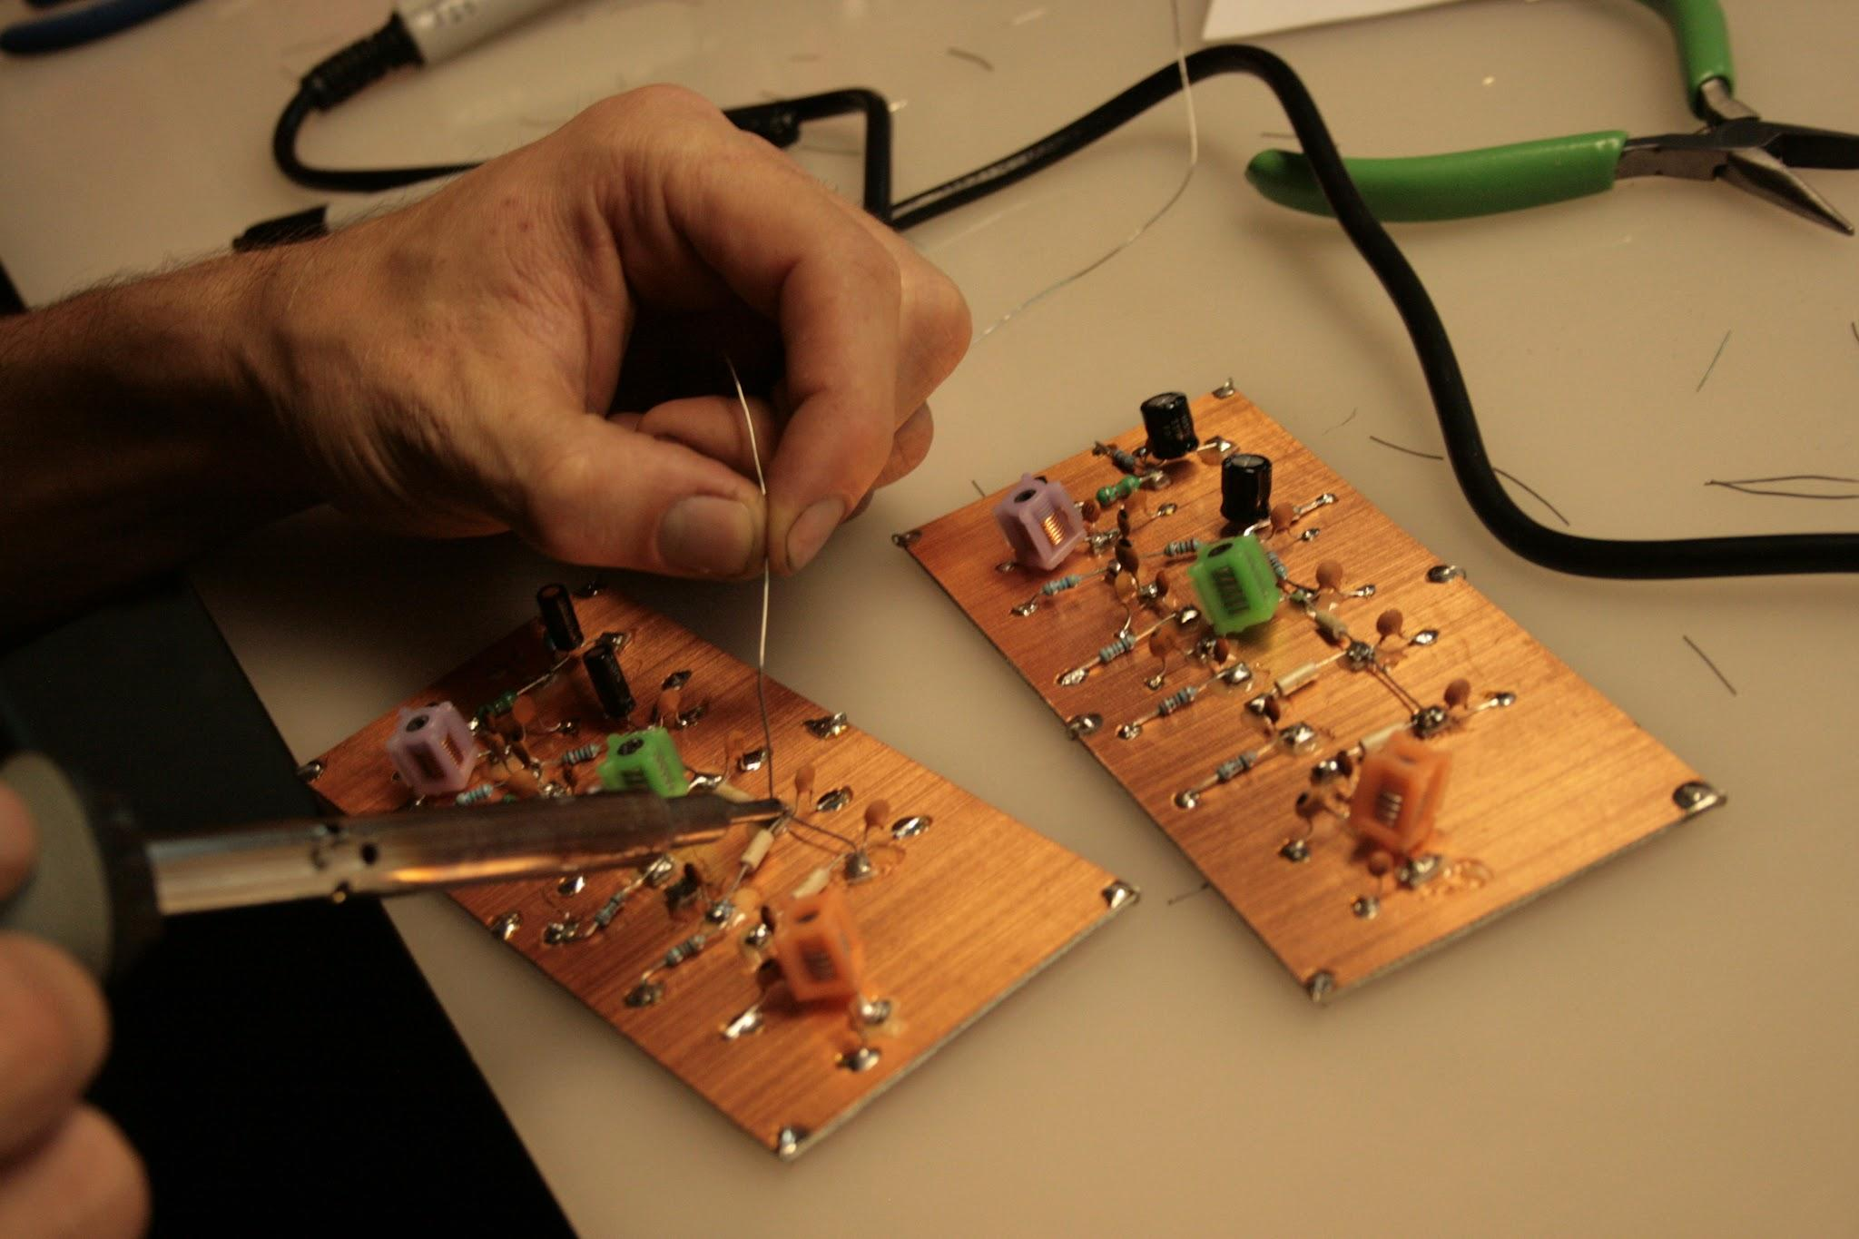
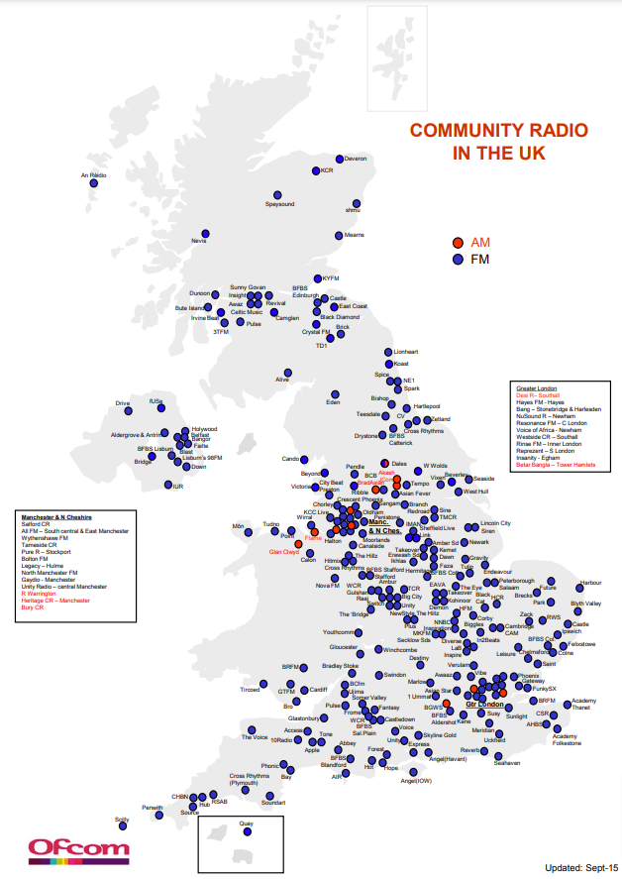
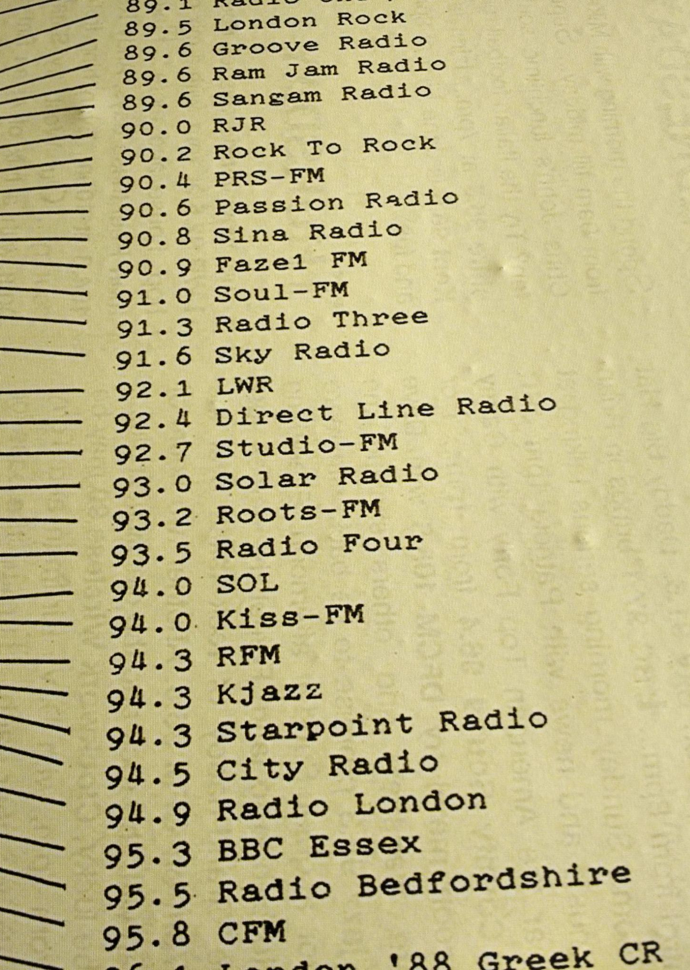
Photo credit: Tin Can Studio @ Flickr
Notes:
DONALD
This "do it yourself" approach (which also applied to building your own transmitters and link equipment) created ecosystem of broadcasters that could not be ignored or silenced, so sensibly, the regulator created a pathway to legitimate existence through community licences. But the transmitters stayed on the tower blocks, and the broadcasters still operated on the basis of getting on-air and staying on-air as cost effectively as possible.

Slide 5
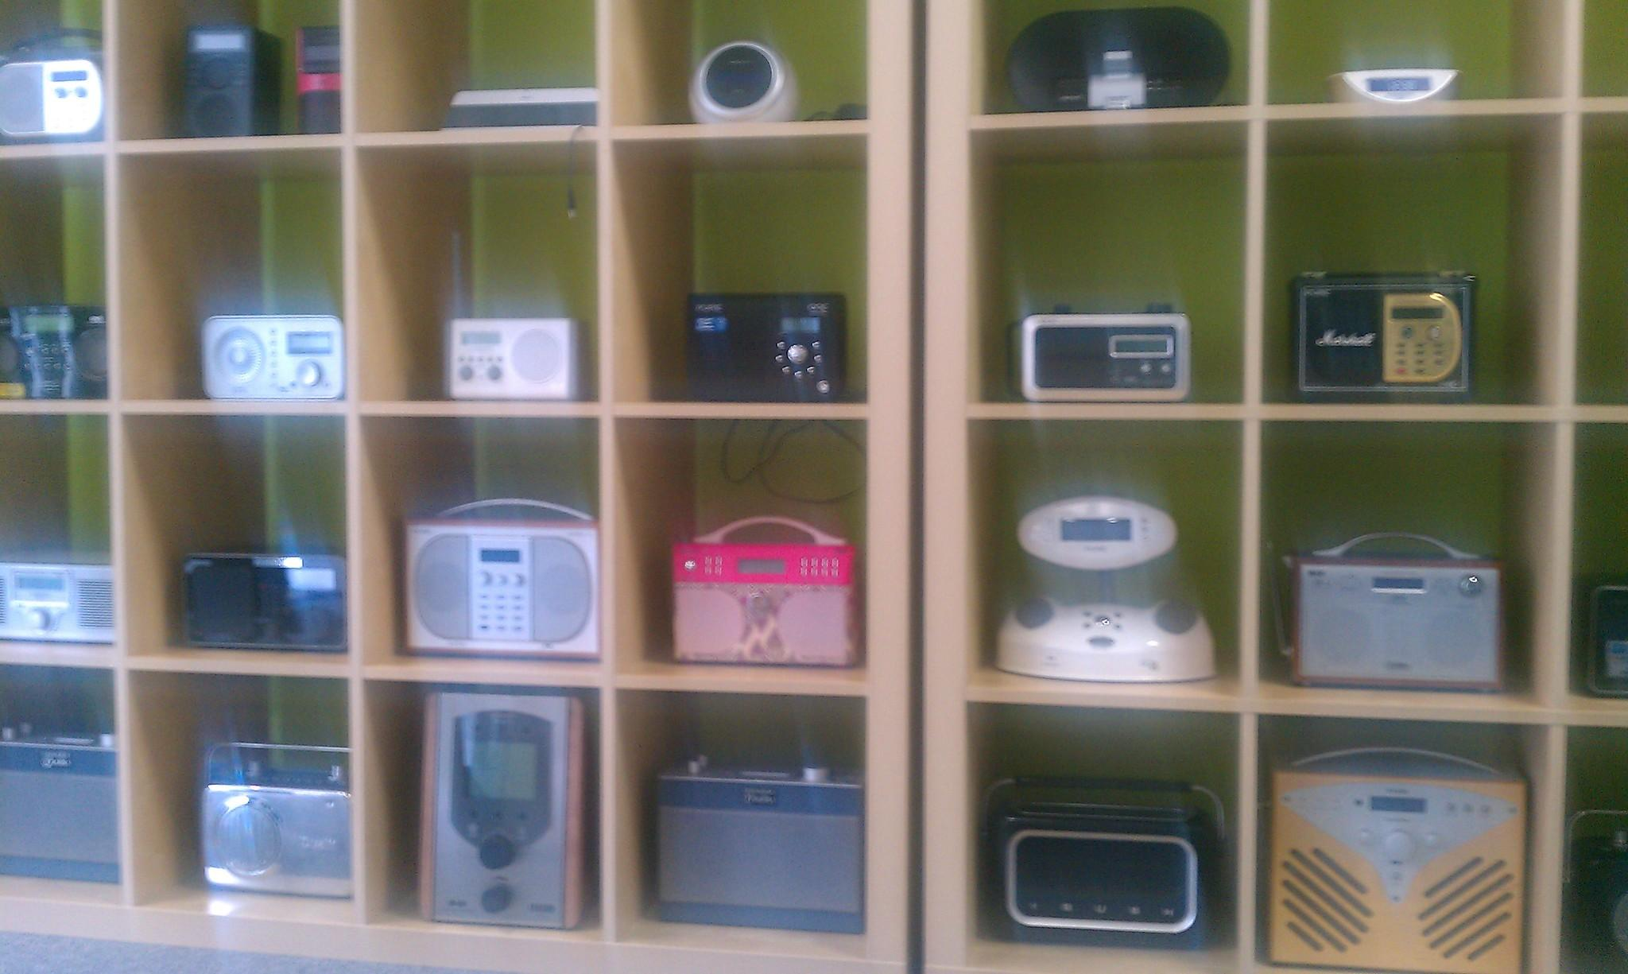
Digital Radio
Photo credit: msdeegan @ flickr
Notes:
NICK
So that brings us to Digital Radio - how does that history translate to digital broadcasting?

Slide 6
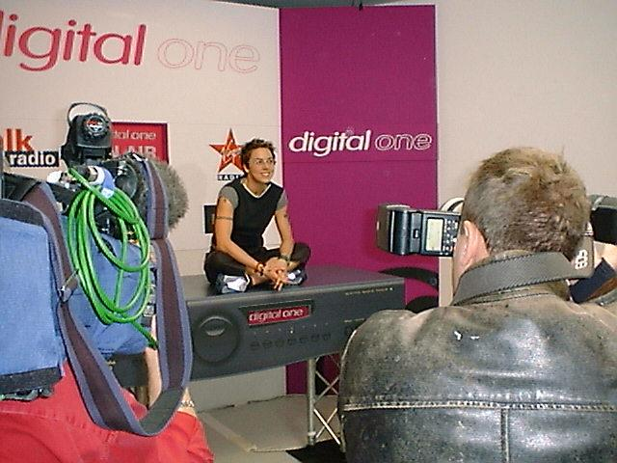
The Launch of Digital Radio - "A New Era"
Same small number of established providers
Utilising the same infrastructure
Complicated, constrained, expensive
Little innovation beyond "more audio"
Notes:
NICK
The launch of digital radio in 1999 was expansive and expensive. There was essentially a monopoly provider of transmission systems to the commercial radio sector, and as a new technology and in the absence of any good comparative technologies or approaches, the costs were high. Very high. And the rollout was wrapped up in a very conservative technical culture that created costs beyond those strictly necessary to get on-air. It was not, to use a current descriptor, a Minimum Viable Product - it was a fully kitted luxury vehicle.

Slide 7
The Weight Of Process
Suffocates Innovation
Notes:
NICK
But that conservative culture smothered any ideas of using digital to "do it differently" - in terms of functionality or engineering approach. We got the heavy inertia of analogue radio applied to digital broadcasting, and the "costs" of doing anything meant that pretty much nothing other than digital audio through existing sites.

Slide 8
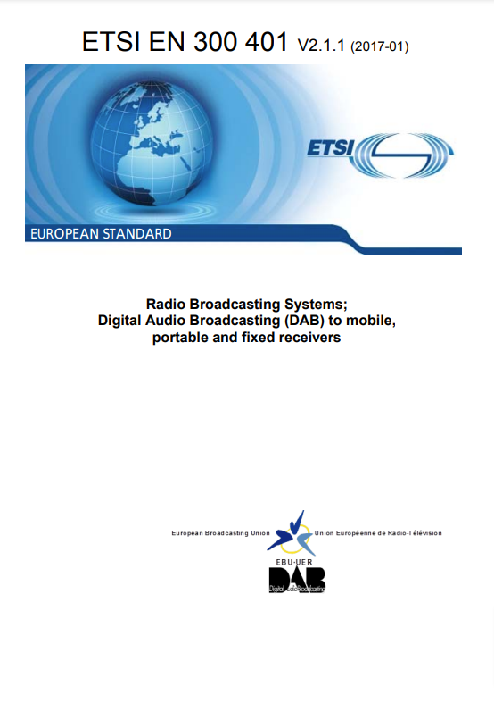
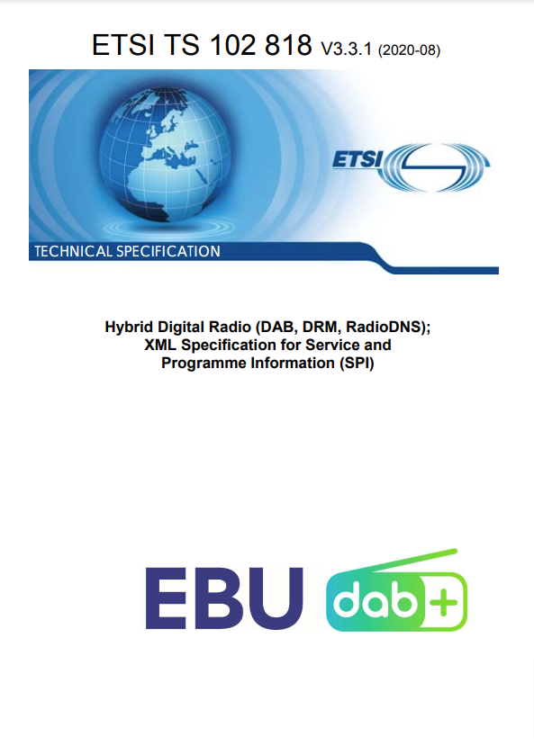
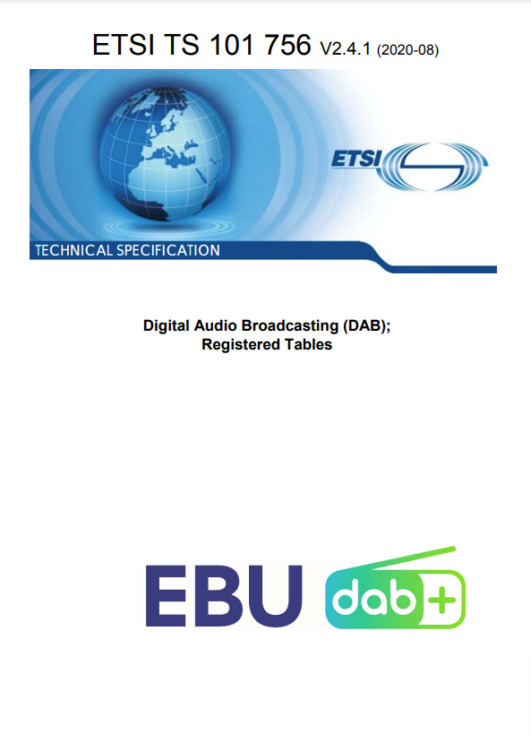
Open Technical Standards

Slide 9

Small Scale DAB+ Tests
Rashid Mustapha at Ofcom organises a test of Open Digital Radio on a tower block in Brighton
"The experiment demonstrated that a stand-alone Software Defined Radio approach to DAB multiplexing and transmission can deliver high availability and high quality results at costs that are near to parity with an FM transmitter system carrying a single service."
Notes:
Rash Mustapha is a very unconservative radio engineer, and he set up a trial to show that software defined digital radio from a tower block in a town creates an identical experience for listeners, and doesn't disrupt existing dab transmissions. His confirmation of what had been informally shown elsewhere informed government policy about how to move small and community radio to digital radio.

Slide 10
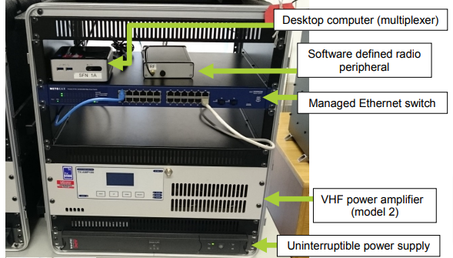
Small Scale DAB+ Works
Open Source Software developed collaboratively over many year
UK trials proved it can co-exist without disrupting existing DAB services
Equipment and operation can be like established community radio - Small, and community based
Trial DAB Multiplexer & Transmitter
Photo credit: Ofcom
Notes:
NICK
The UK trials proved that low cost DAB works. It's run in water tank rooms and lift rooms and schools and tower blocks. It sits on boring broadband. It works identically - or even better than - any commercial multiplex product, and listeners get the same (or better) experience of digital radio. The TRIAL multiplexes with the FIRST in the UK to really deploy slideshow and EPG at scale.

Slide 11
The
Fear
Uncertainty &
Doubt
Was Not Real
Notes:
NICK
The Fear, Uncertainty and Doubt that was created from established participants turned out to be not real. Doing it differently doesn't disrupt established digital radio infrastructure, not is it a degraded or second-rate experience for listeners.

Slide 12
Bristol, UK
Photo credit: Velodenz @ Flickr
Notes:
DONALD
This is what the community radio stations in Bristol have done to take advantage of the opportunity of small scale DAB

Slide 13
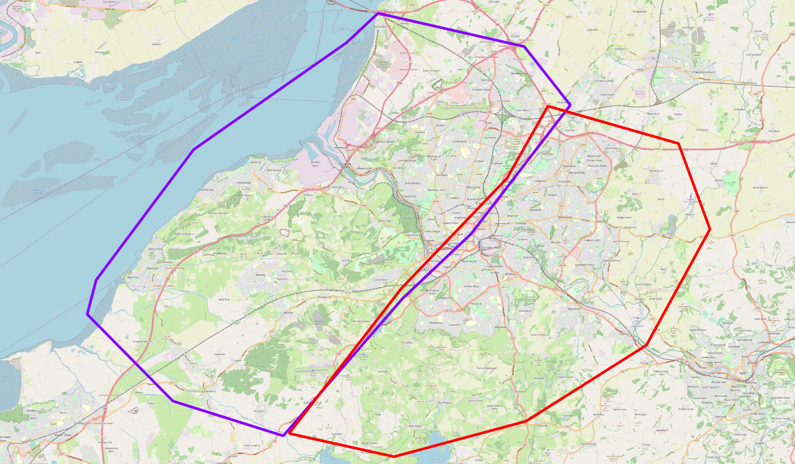
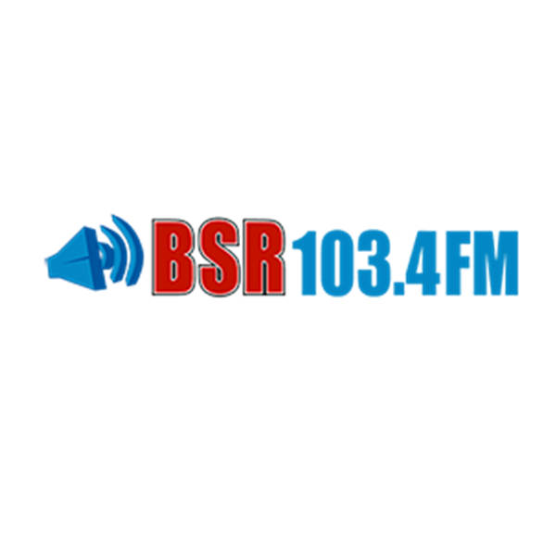
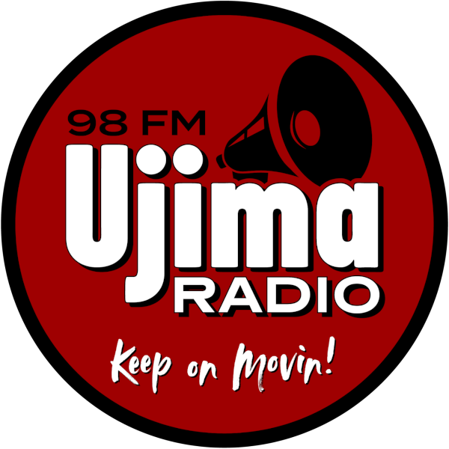
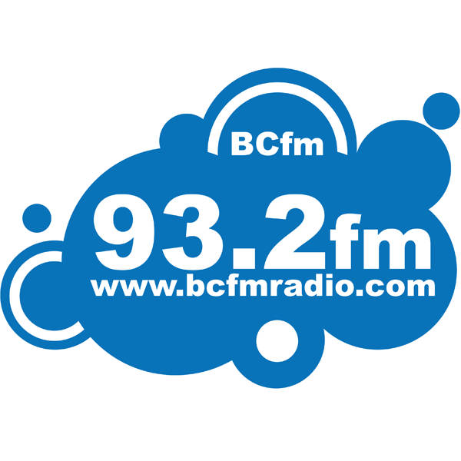

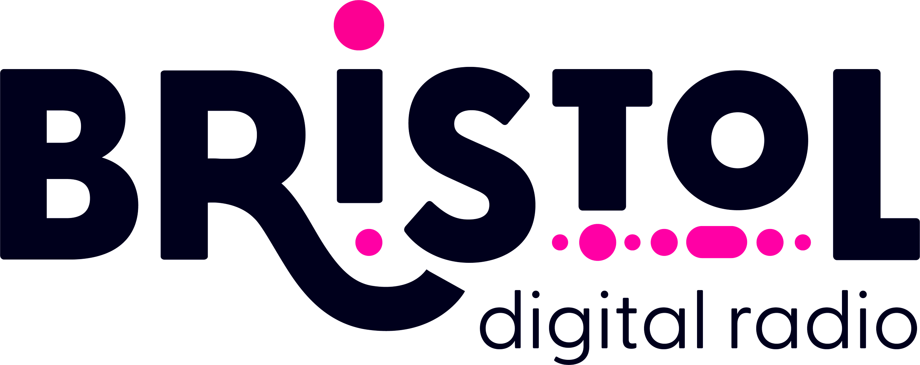
536,000 people covered by
TWO multiplexes
(regulatory requirement)
Notes:
DONALD
Ofcom are advertising small scale DAB licenses across the UK. We talk about this being "small scale DAB", but that's only because the incumbent multiplex operators successfully lobbied to cap the size of new entrants at 40% of the coverage of existing operators. So it's only "small" because it was made small. Bristol is divided into two multiplexes, which are controlled by different community stations, but we take a co-ordinated approach to technology (within the regulatory limits)

Slide 14
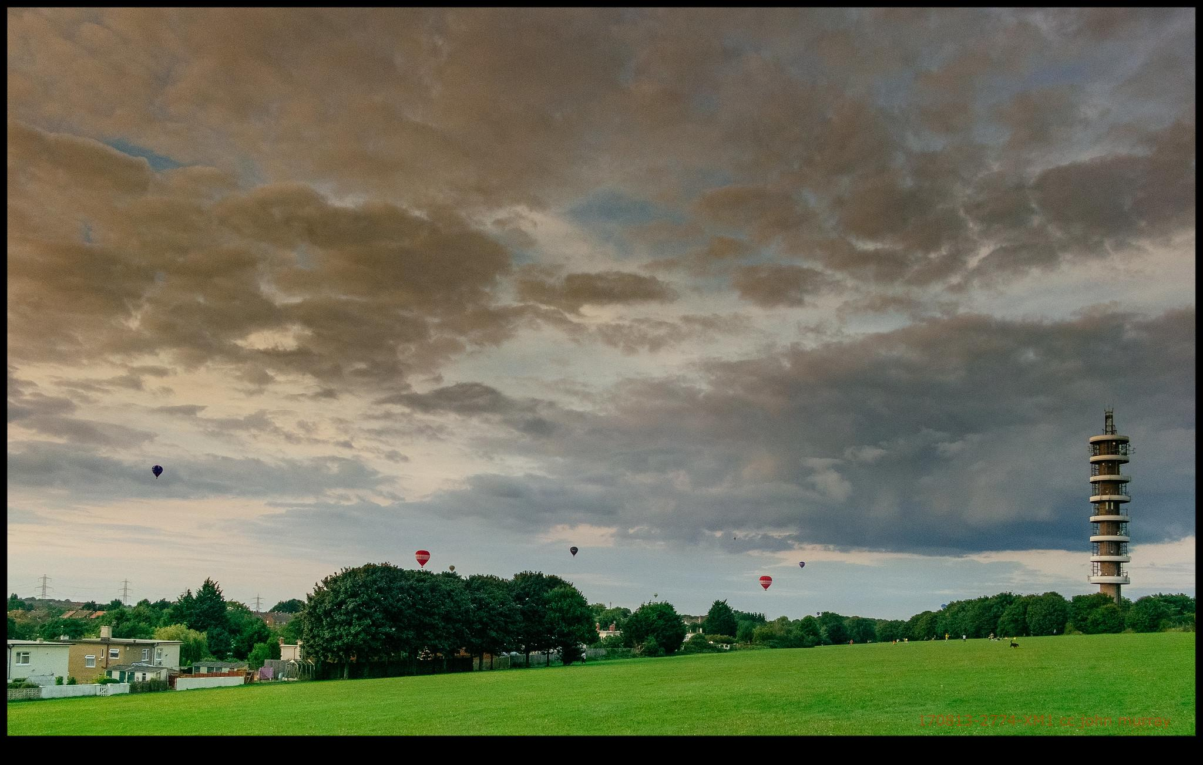
Photo credit: Hopeless128 @ Flickr
Notes:
NICK
Bristol is a lovely city, and as a very hilly city, has a few relatively impressive transmission towers. Impressive in size, impressive in design, and unfortunately, impressive in cost.

Slide 15
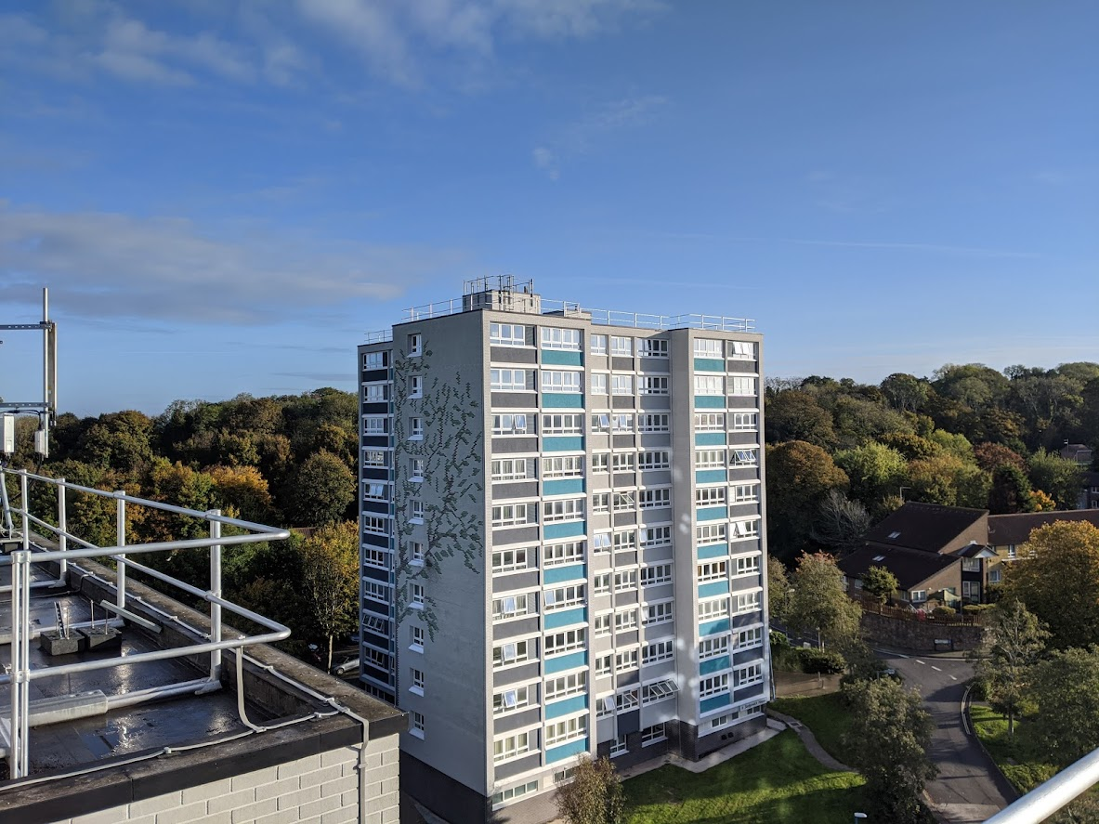
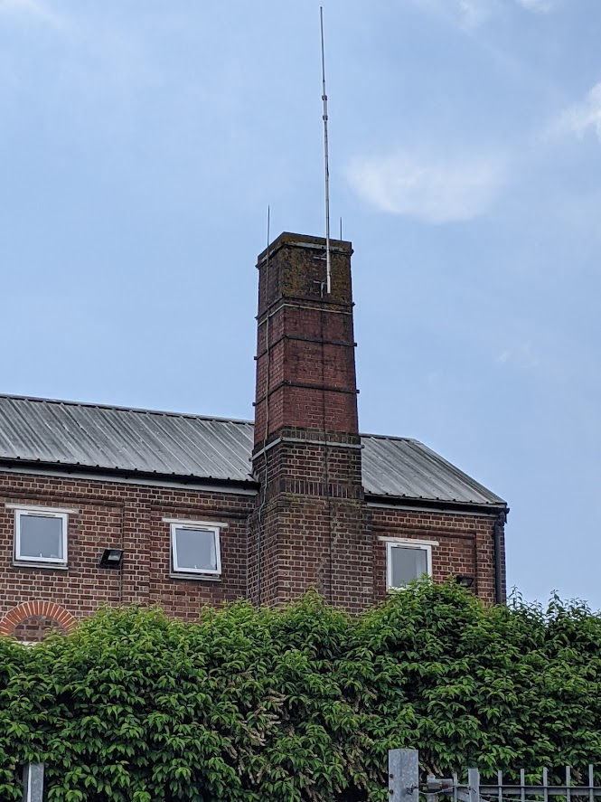
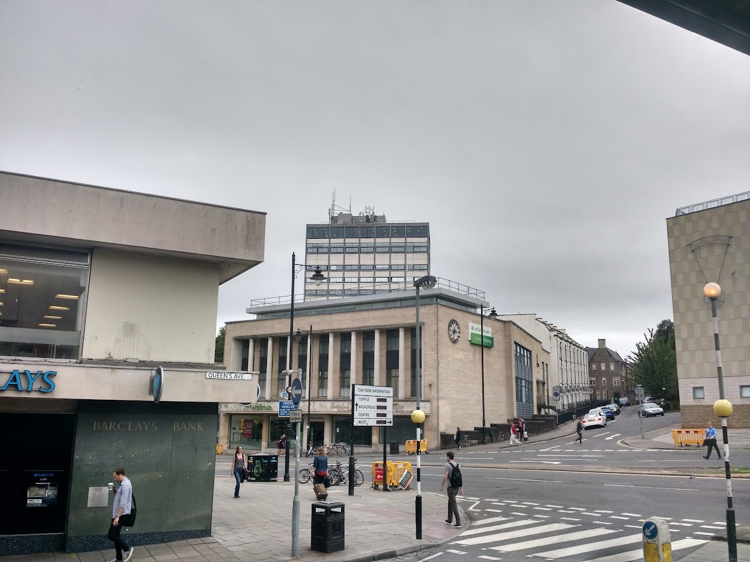
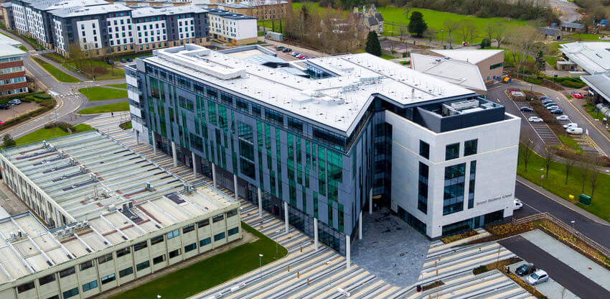
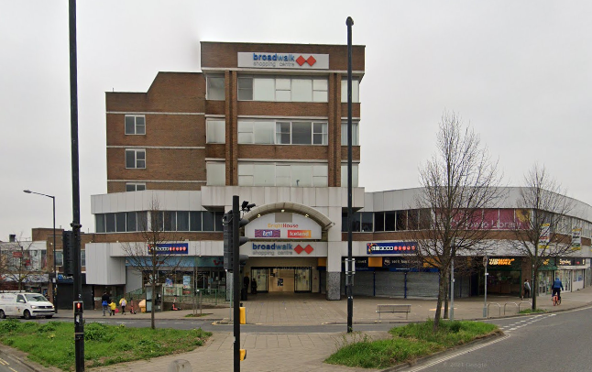
Notes:
NICK
So we've looked elsewhere - council tower blocks, refurbished industrial buildings, office blocks, university buildings, shopping malls. Sites in the cities, close to the populations. Some engineers will express anxiety that this approach could cause "blocking", where one nearby transmitter effectively deafens the out-of-town transmitters. But with planning and and thought and actual measurement on the ground, it just doesn't happen. Theoretically a problem, practically not (or at least, very easy to avoid).

Slide 16
"Small Scale" DAB+ Planning
Nationwide DAB+ - 3 multiplexes
Local DAB+ - 42 multiplexes
New "small scale" DAB - ~150 multiplexes
~7 frequency blocks available (within Channels 7/8/9)
No "small scale" multiplex may cover more than 40% population of the equivalent local multiplex
VERY dense reuse of blocks across areas - maximum outbound interference, 38dBµV/m²

Slide 17
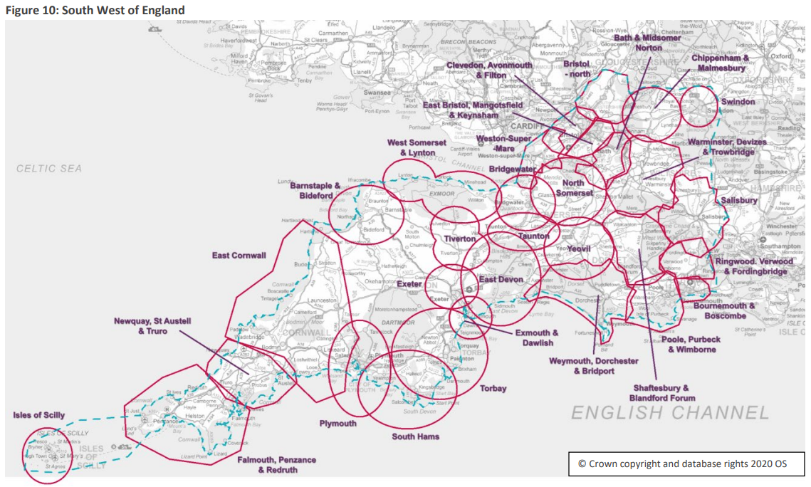

Slide 18
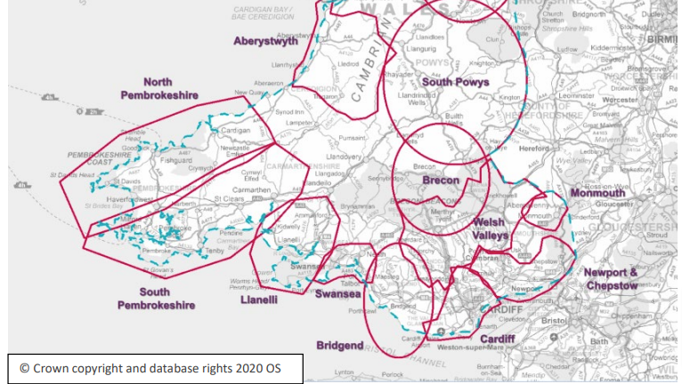

Slide 19
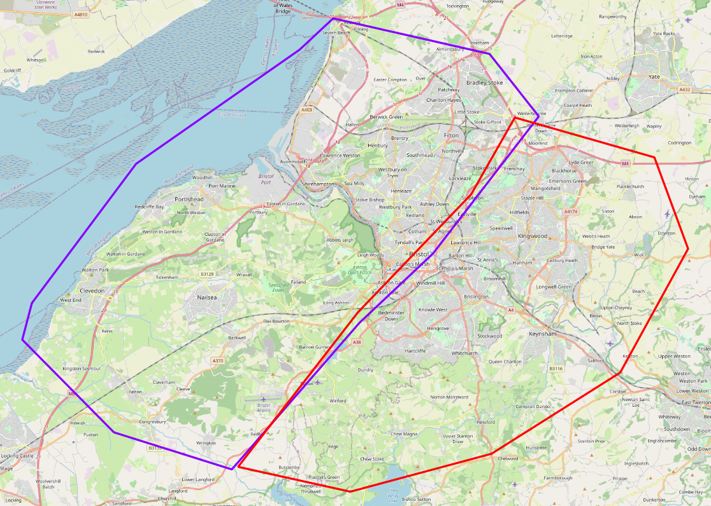
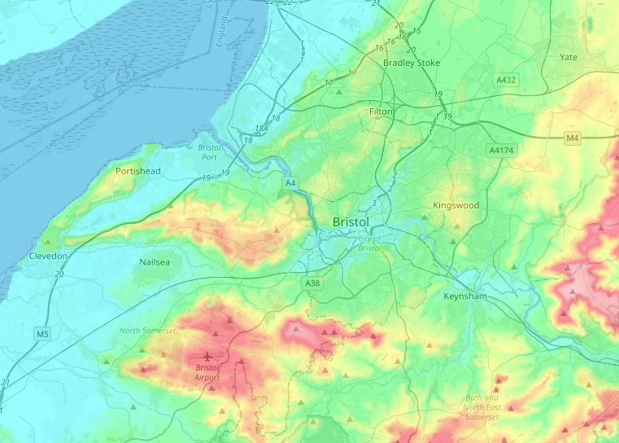
Planning Approach
The original areas don't match the terrain
We cannot exceed 362,000 coverage in either area
The RED area is an area of very high ground
The YELLOW area has dense urban clutter, and a population of 80,000 people "outside" the RED (East) Polygon
The ORANGE area also has population of 80,000 people "inside" the RED (East) Polygon
We decided to outspill the RED polygon to work with the terrain to get a very high (>72dBuV) signal in the dense urban, but "transfer" the people in the ORANGE zone to the PURPLE polygon

Slide 20
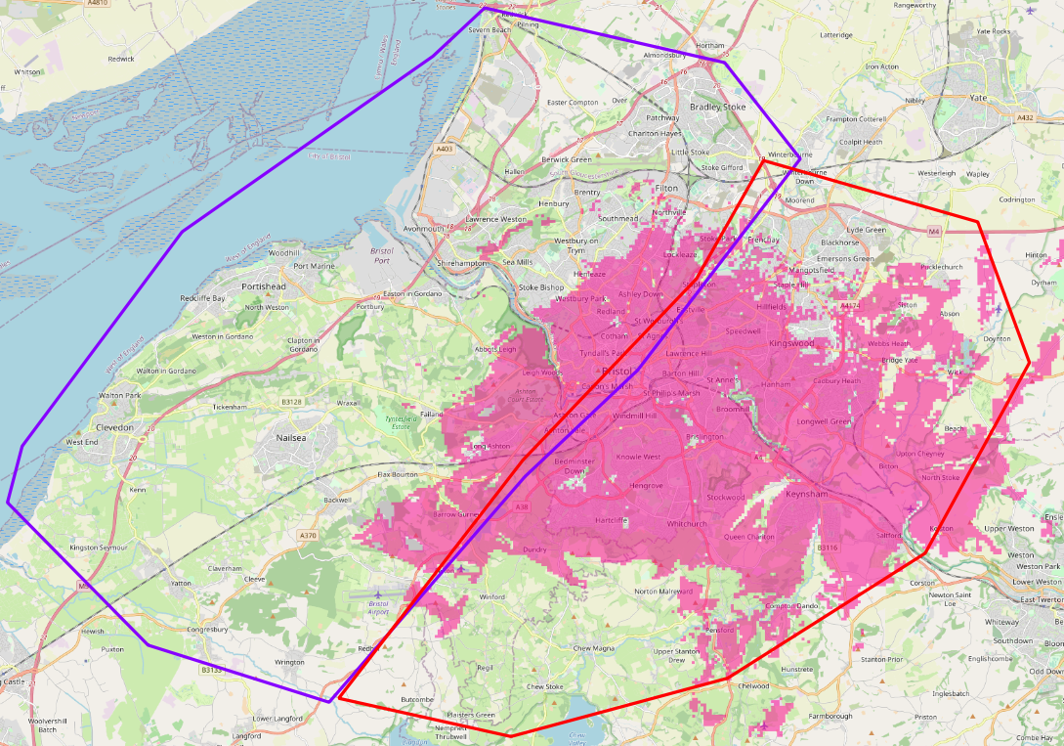
East (Red) Polygon
Three low power transmission sites in an SFN (Channel 9B) covering 362,000 people (exactly)
We had to reduce power to keep within the 362,000 people limit
Clifton
65m office block
18W ERP
Knowle
30m shopping centre
15W ERP
Keynsham
20m Chimney
60W ERP
Clifton
Knowle
Keynsham

Slide 21
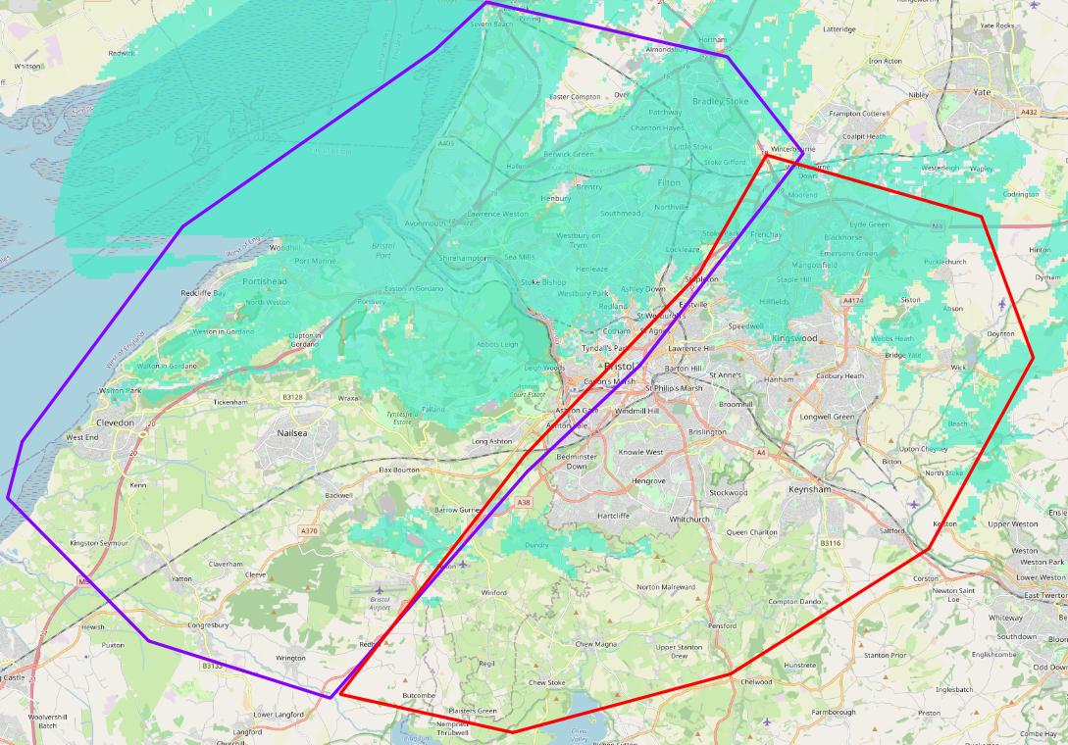
West (Purple) Polygon
Two medium power transmission sites in an SFN (Channel 12B) covering 255,000 people
We had to reduce power to avoid interference to neighbouring blocks
UWE
35m University Building
100W ERP
Kings Weston
30m tower
80W ERP
Kings Weston
UWE

Slide 22
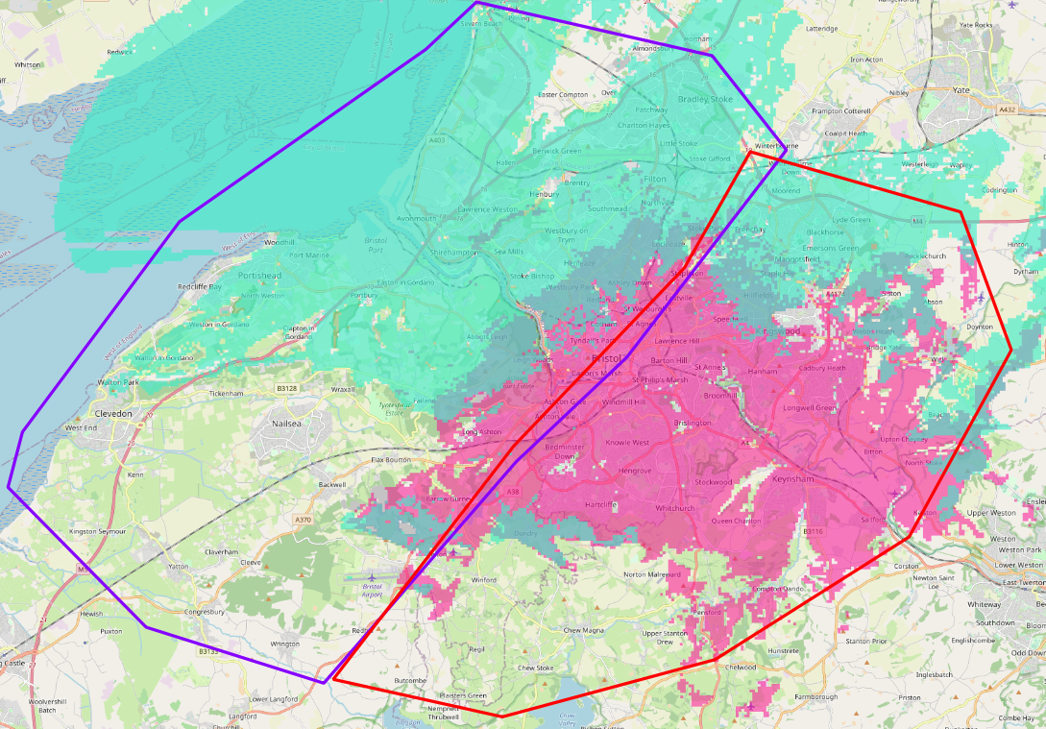
Both Polygons
Five sites
Aggregate coverage, 536,000 people
Overlap ~80,000 in the most dense / cluttered part of the city
Kings Weston
UWE
Clifton
Knowle
Keynsham

Slide 23
Planning versus Actual
Actual coverage seems to match planning quite well
Planned using:
UK Ordnance Survey Terrain @ 50m resolution
UK DEFRA / Ordnance Survey Clutter @50m resolution
Deygout 94 algorithm
Inclusion of fresnel effects
Target FS - >70dBµV in "dense urban", 63dBµV for "urban"
Coverage below 63dBµV is not considered for population count

Slide 24
Appropriate Technology
Notes:
NICK
We also take pains to choose appropriate technology, not best-in-class technology. This is Minimum Viable Product approach, not luxury car. We can always upgrade later

Slide 25
Open Source Multiplexer
https://github.com/opendigitalradio
Fully featured, entirely compliant, DAB+ multiplexer in software
Audio encoding, PAD encoding, EDI tools etc.
Runs on Linux (Debian / Ubuntu)
Configured in a similar way to apache webserver or nginx
Telemetry and monitoring using munin
Takes about 60 minutes to install / configure an entire multiplex from scratch

Slide 26


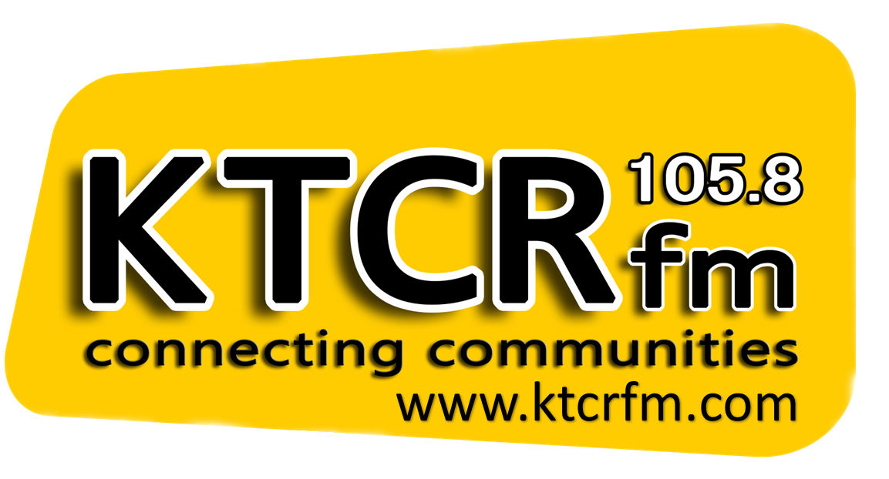
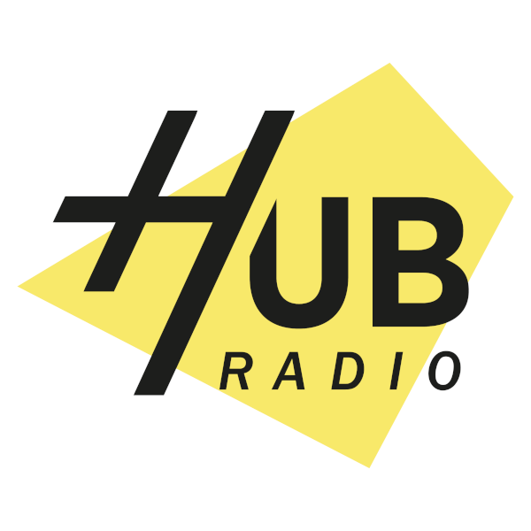
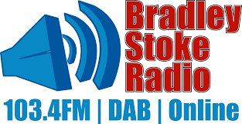

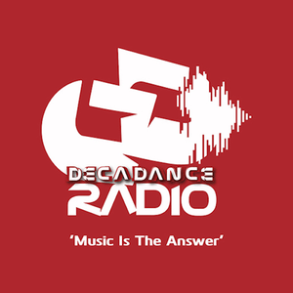
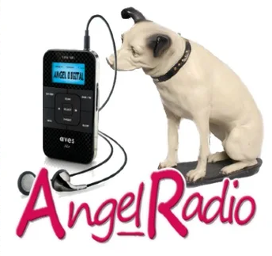




Open Source Multiplexer
We transmit 13 DAB+ radio services
We also transmit
Slideshow
DLS / DL+ Text information
DAB SPI (EPG) for station logos in cars
All audio is sourced from internet streams and transcoded to DAB+

Slide 27
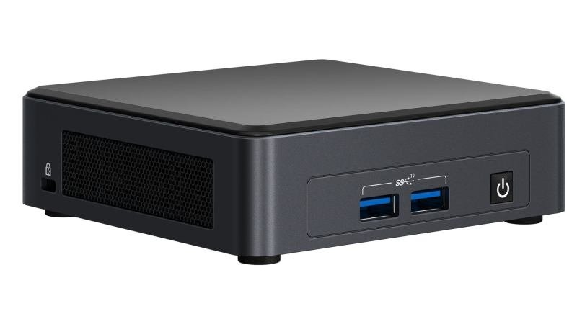
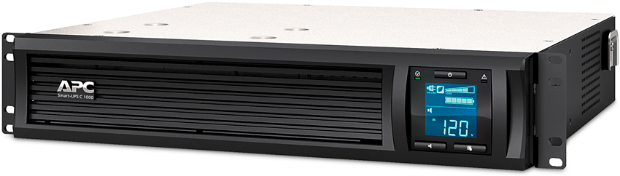
Multiplexer Hardware
We use Intel NUC i5 PCs with 8GB RAM and 1TB SSD drives
Very small footprint device
Coupled with APC UPS devices for both
multiplexer and transmitter

Slide 28
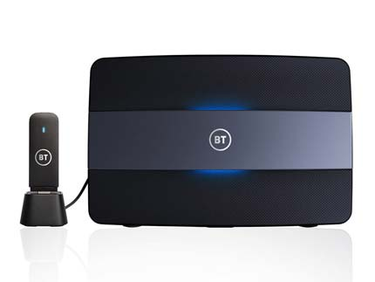
Connectivity
We use "SOHO" (Small Office Home Office) grade broadband, over fibre, copper or 4G ("hybrid" broadband)
We have run DAB transmitters quite successfully on 4G
connections (in less "congested" areas)

Slide 29
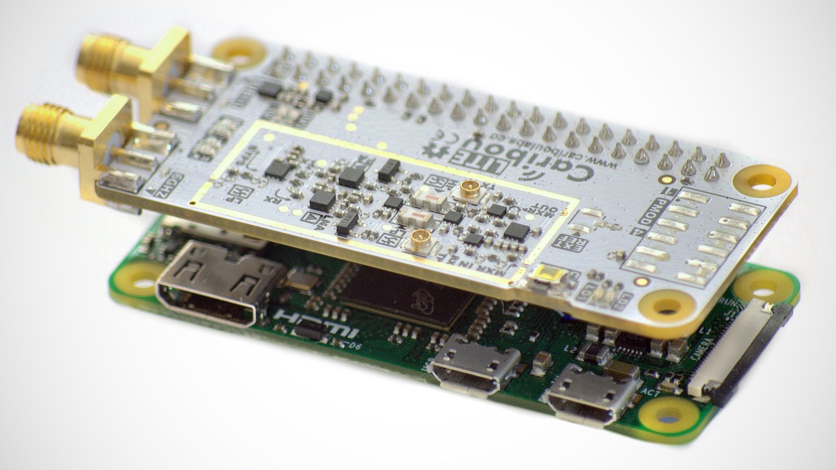
Transmitters, Filters, Antennas
We use commercial transmitters and filters, but you can use SDR devices + Power Amps
CaribouLite SDR costs USD160 and works with a Raspberry Pi 4 and OpenDigitalRadio*
^{https://www.cariboulabs.co/}
* Can't yet be used in an SFN (Single Frequency Network)

Slide 30

Network Architecture
We don't use "The Cloud"
Multiplexers are run at "core" TX sites, and provide backup to each other.
Each transmitter site has a transmitter, filter, Intel NUC i3, VPN and internet connection with 4G backup
Multiplex signal distributed using EDI/TCP
~5 seconds buffering to handle inconsistent IP bandwidth
UWE
main: SDR
backup: BDR
Kingsweston
TX only
Internet
Clifton
main: BDR
backup: SDR
Knowle
TX only
Keynsham
TX only

Slide 31
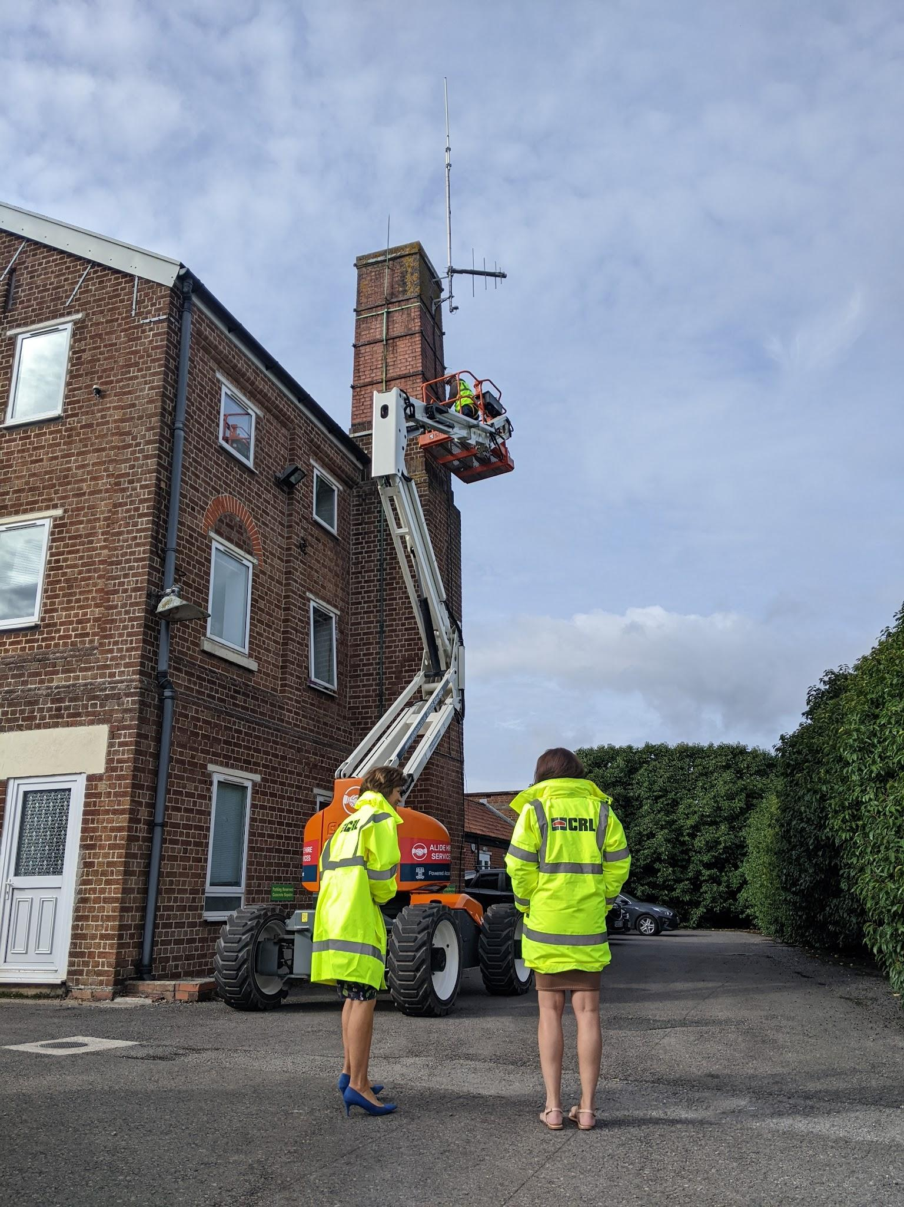
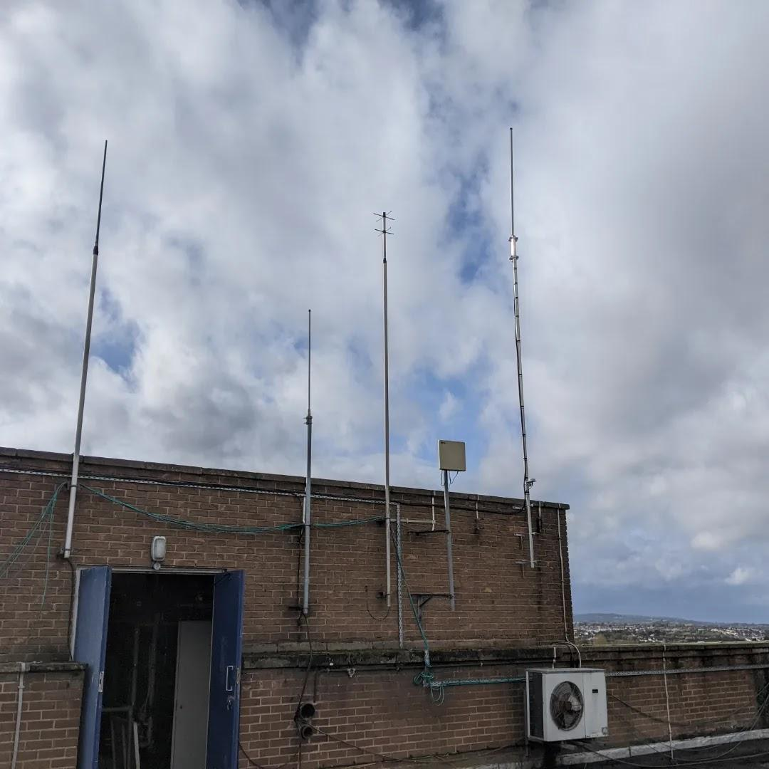
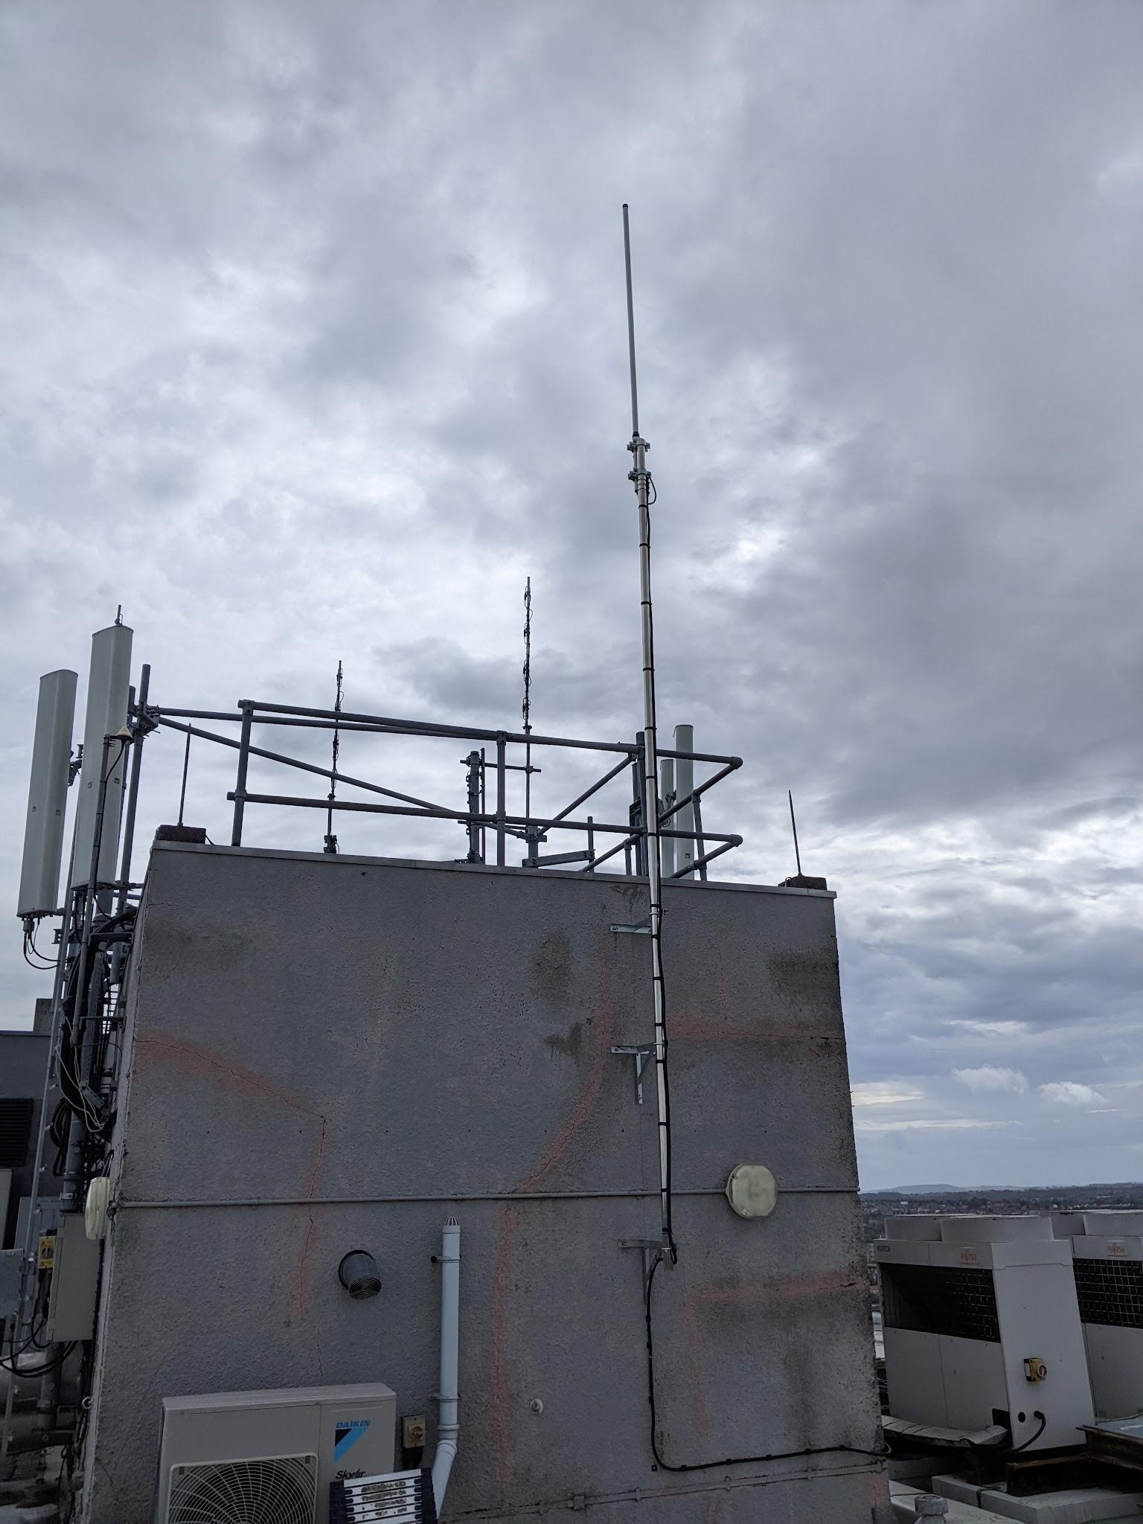
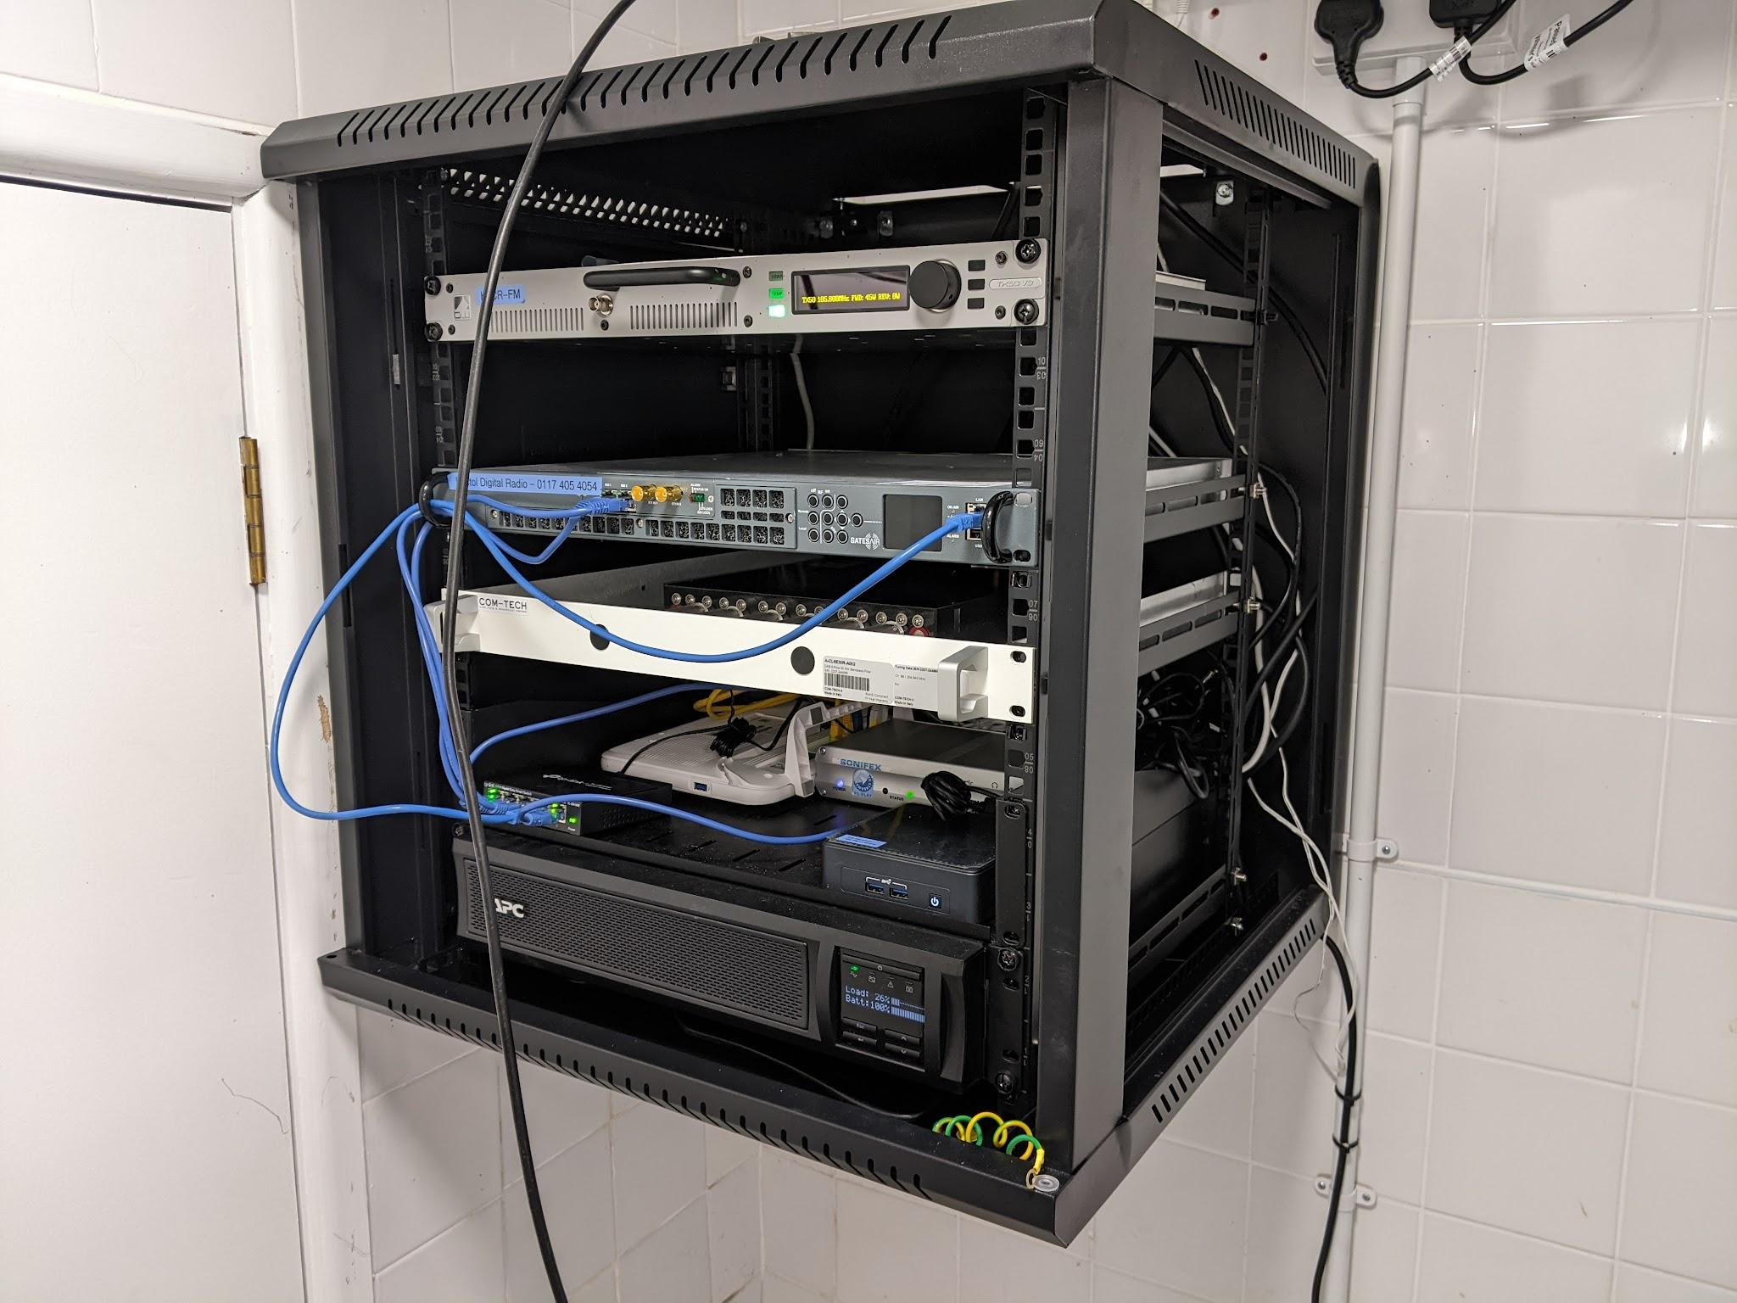
Sites and Antennas
We use office blocks and apartment blocks as transmitter sites
We use our local "TV" installer to put up masts for us
Simple colinear or yagi-style antennas
Small racks of equipment located inside the buildings
DAB co-sited with FM
Notes:
NICK
We will use the free, open source, open digital radio multiplexer. We'll simply pull radio station's existing (and usually very high quality) internet streams and rebroadcast those. We use commercial transmitters and filters, because that's more critical. We'll hook everything up using broadband or 4G, and just tolerate a long time delay in the entire system. It's the cheapest functional approach to DAB

Slide 32
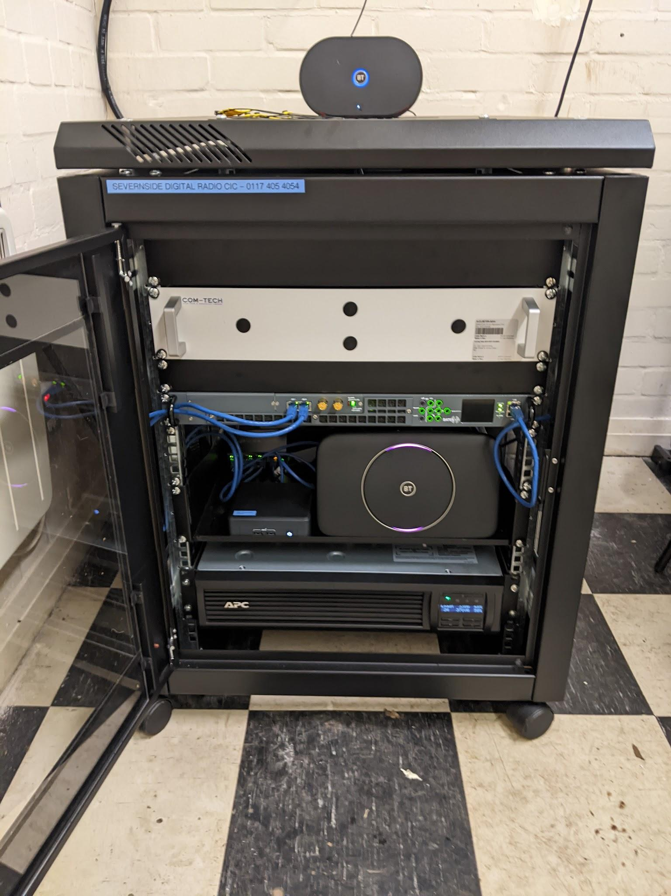
Everything fits in 9U - 12U
4G Backup
Critical Mask Filter
DAB Transmitter
Network Switch
Multiplexer & Management PC
Broadband Modem
750VA UPS

Slide 33
Our Costs (Per Site)
Typical transmission equipment ~USD 11 000
Typical cost of installation ~USD 4 000
Typical cost of "paperwork" ~USD 3 000
Total setup cost per site: ~USD 18 000
Total operating cost ~USD 6 000 / year
(Rent, power, telecoms)
Notes:
NICK
This is what it looks like in costs. I promise you, there's no missing zeroes, no hidden costs, no "mates rates" deals here. OK, so it's not *fully* redundant and massively backed up, but we know from the trials we're likely to get "four nines" (99.99%) uptime from this, which is pretty damn good. We had to build 5 sites because of regulatory constraints, and the one commercial site we're using accounts for 40% of our build and operating costs.

Slide 34
Open Source DAB is not just about getting more digital radio on-air, and giving more stations the chance to thrive digitally.
It's about flexing innovation and using different thinking to overturn the old expectations of digital radio, and to prove that it can be done in a fundamentally different way.
Notes:
DONALD
I'll leave you with this. We have been given the chance to do digital differently, and we're going to take it and make it work.

Slide 35
Small Scale DAB+ in Bristol, UK
Nick Piggott, Bristol Digital Radio
Photo credit: Velodenz @ Flickr
Notes:
This is my case study. I helped the community radio stations in Bristol win two small scale DAB licences. So this is their / our story so far.

