Slide 1

///
Presentation DAB Head End Architectures
Hermann ZENSEN, Head of Sales and Marketing
March 2023
Notes:
1

Slide 2
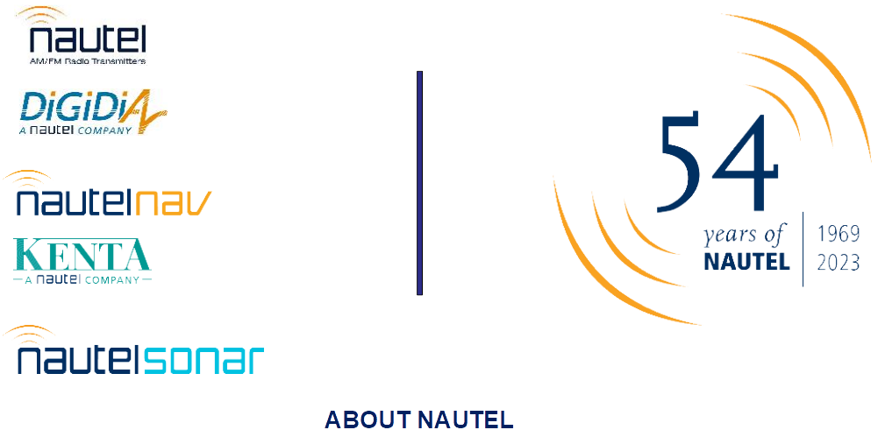

Slide 3
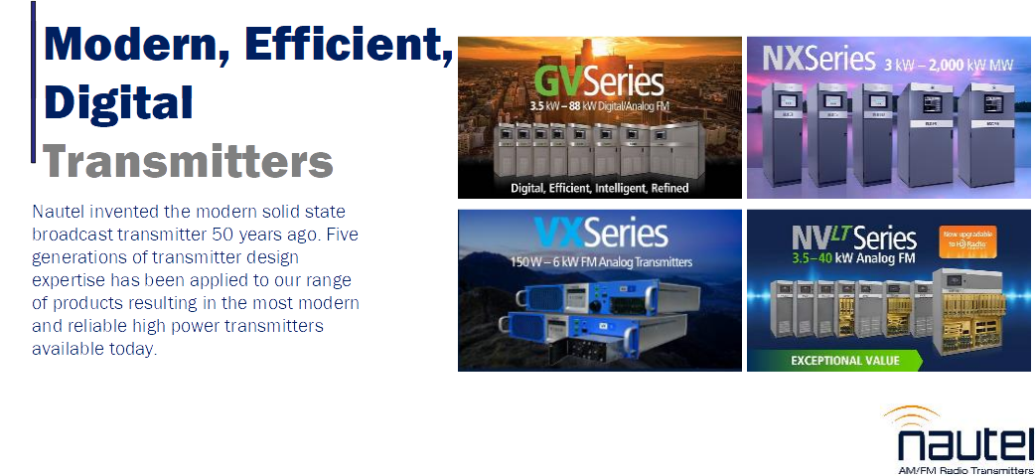

Slide 4
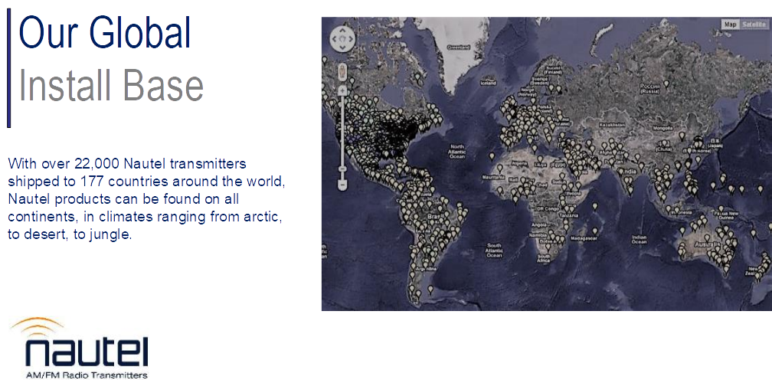

Slide 5

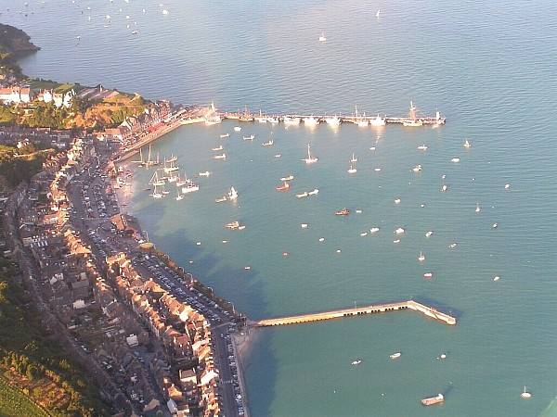
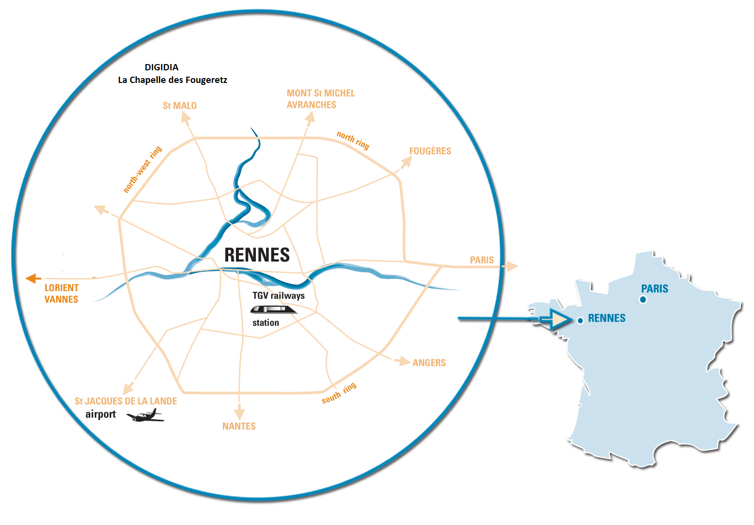



Based in Brittany
Notes:
5

Slide 6
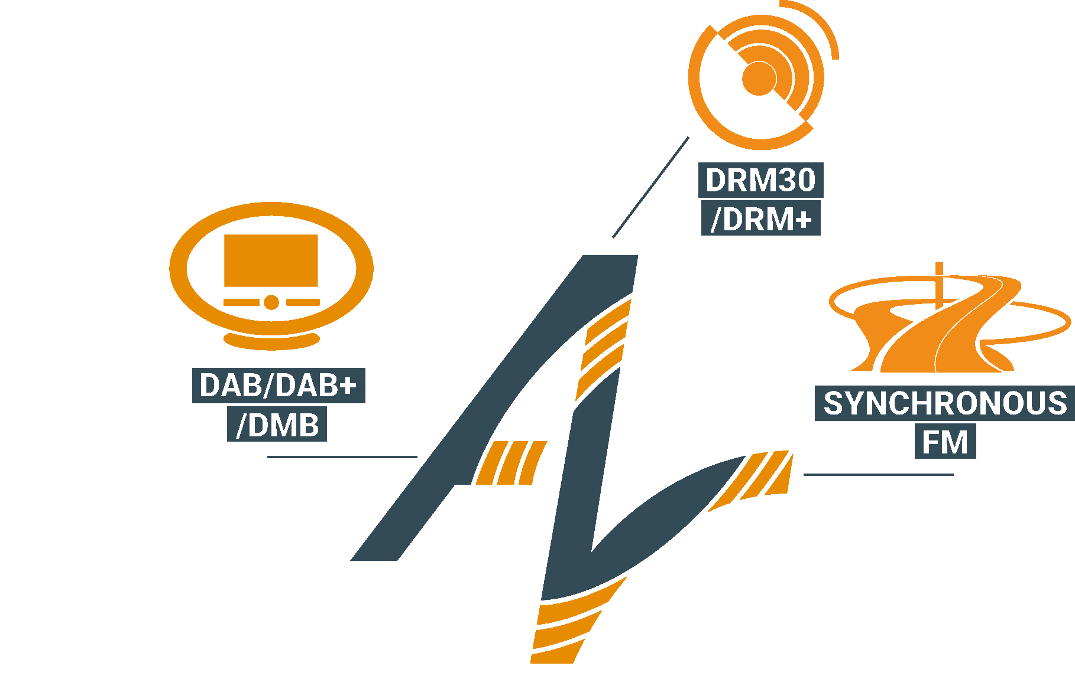
/// DIGIDIA at a glance
More than 16 years of Innovation, On-going Investment and International Presence
Founded in 2005 by digital radio experts
Since February 2021: DIGDIA part of NAUTEL Group
R&D Oriented:
  All products (HW & SW) are developed and designed internally
Skill domains:
  HW and SW Engineering
  Digital Signal Processing
  Embedded real time software (on PC or dedicated platform)
  Sofware Defined Radio (SDR) Expertise
  Expertise in modulation / demodulation COFDM/FM/AM/MFSK etc.
  Expertise in IP based technologies
  High Level Graphical User Interfaces (IHM, PC SW)
Notes:
6

Slide 7


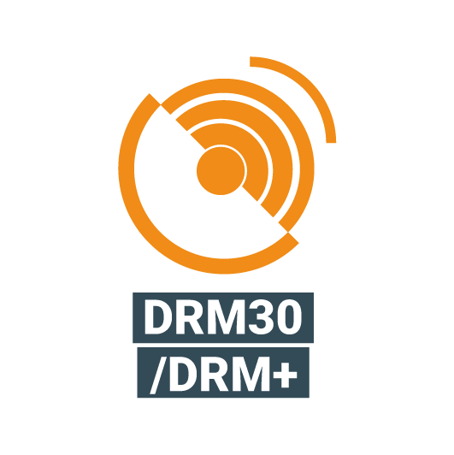
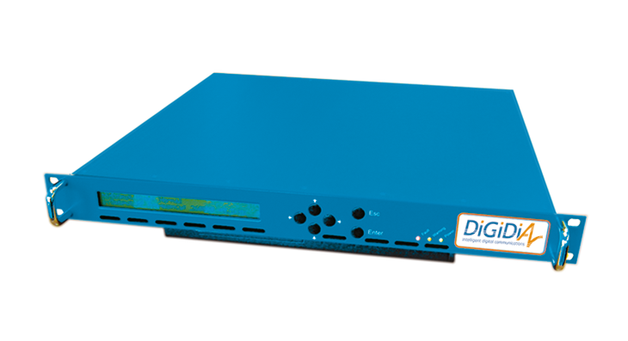
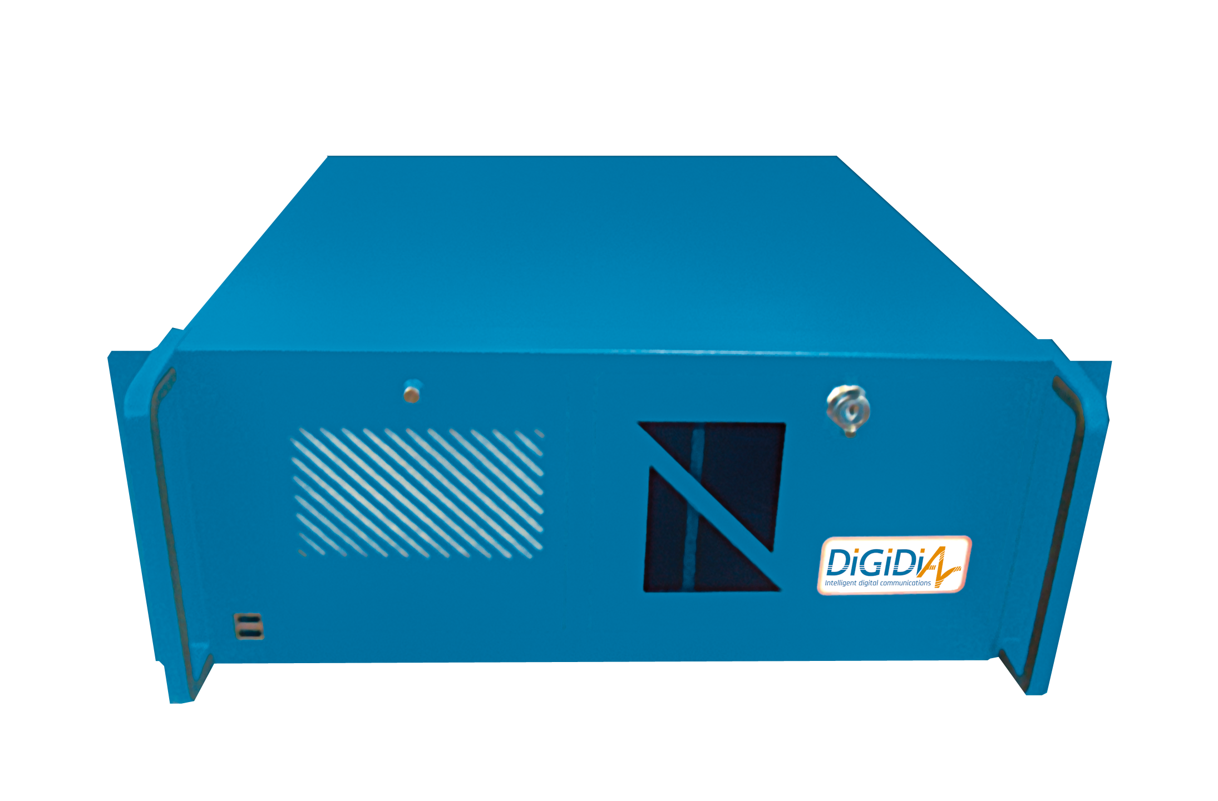
“Very Compact &
Straight Forward Products”
Key Products
///
Head-end Platform;
Decoder/Digital Exciter
SYNCFM: Synchronous FM Decoder & FM Digital Exciter
SPANFM: Synchronous FM Head-end
Encoding & Multiplexing Platform
IP Gateway
Professional Receiver
FLEXIDAB: DAB/DAB+/DMB Head-end System
EASYSPY: DAB/DAB+/DMB RF/EDI/ETI Monitoring Receiver
Content Server
Modulator/Exciter
ALTO: DRM/DRM+ Content Server
SOPRANO: DRM/DRM+ Modulator/Exciter
Tunnel Break-in System
DAB-BI 2.0: DAB/DAB+/DMB Tunnel Break-in System
“Control & Monitoring
By WEB & SNMP”
///
Notes:
7

Slide 8
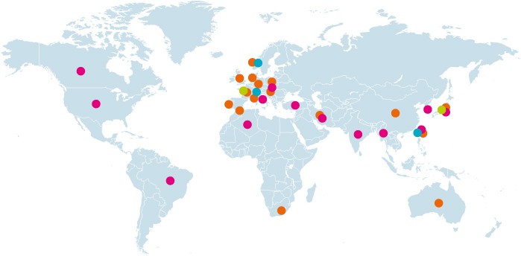
///DAB Head End:
“More than 50 DAB multiplexers and 400 DAB encoders”
Worldwide Sales
///DAB Tunnel break in:
“More than 160 in products“
Tunnel Break-in
DAB/DAB+/DMB
DRM/DRM+
Synchronous FM
GMDSS
/// DRM:
“More than 100 DRM content servers
and 100 DRM modulators”
/// “Synchronous FM:
More than 50 head ends and 700 exciters”
Notes:
8

Slide 9
Overview
Head End Architectures
- Centralized Architecture
- Distributed Architecture
Examples of DIGIDIA’s Head End Realizations
Conclusion
Notes:
9

Slide 10
DAB Head End Architectures
Notes:
10

Slide 11
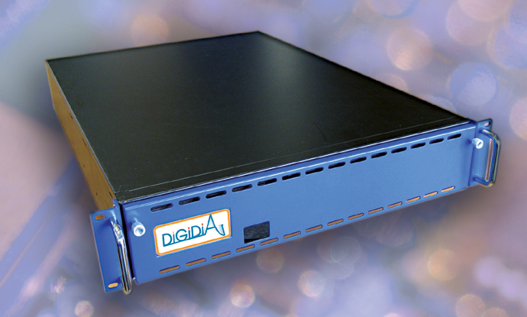
Multi -Multiplexing and
Multi Encoding
Encoder 1
Encoder 2
Encoder n
Multiplexer 1
Encoder 1
Encoder 2
Encoder n
Multiplexer m
Notes:
11

Slide 12
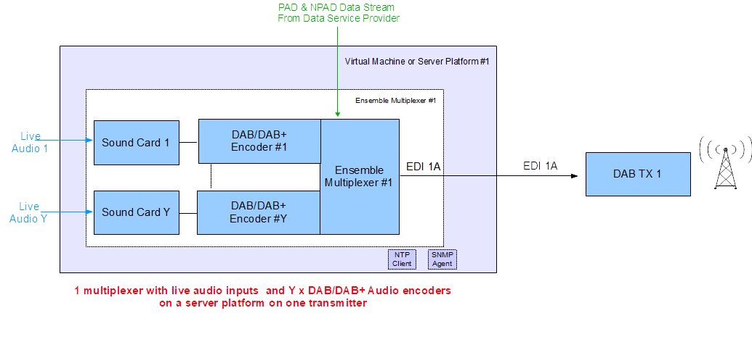
The Minimal System
Notes:
12

Slide 13
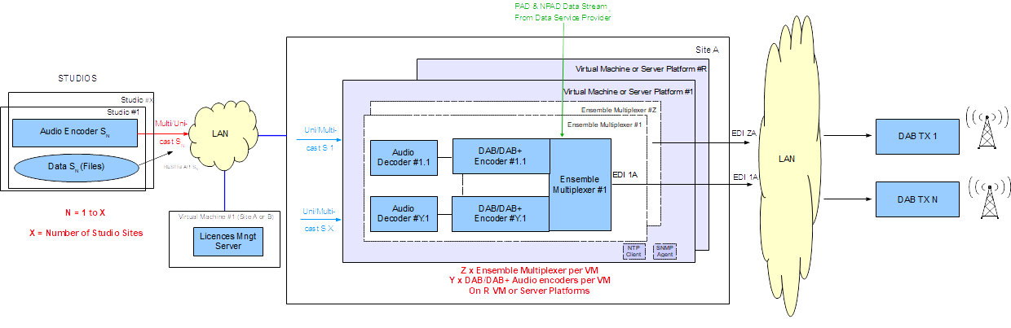
Simple Centralized System
Standard Audio Codecs:
AES 67,
MP3 over Icecast (incl. Metadata for PAD),
MP3 or AAC over RTP,
MP3/AAC over MPEG-TS and RTP
FLAC….and many more
Notes:
13

Slide 14
Smart Audio Multiplier
Notes:
14

Slide 15
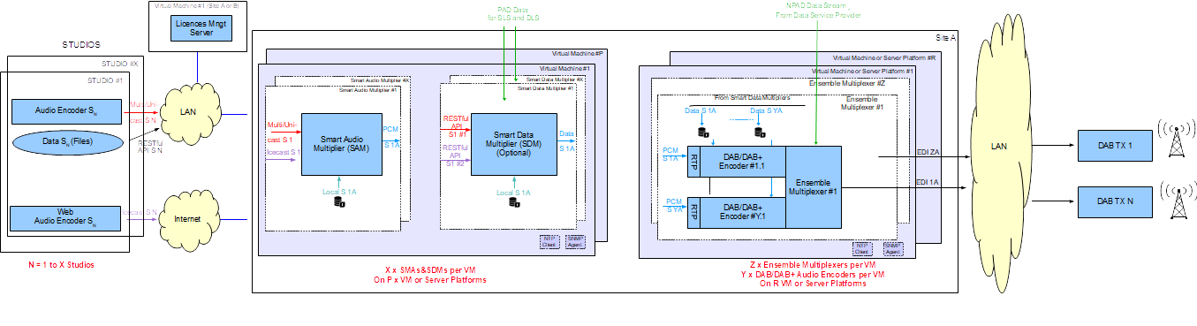
Centralized System
with Audio Input Redundancy
Notes:
15

Slide 16
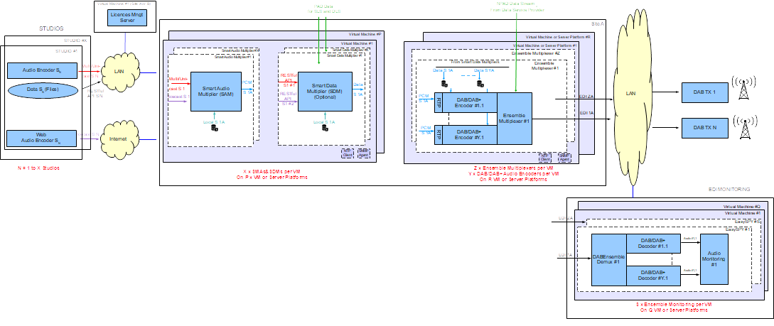
Centralized System with Input Redundancy
and Monitoring
Notes:
16

Slide 17
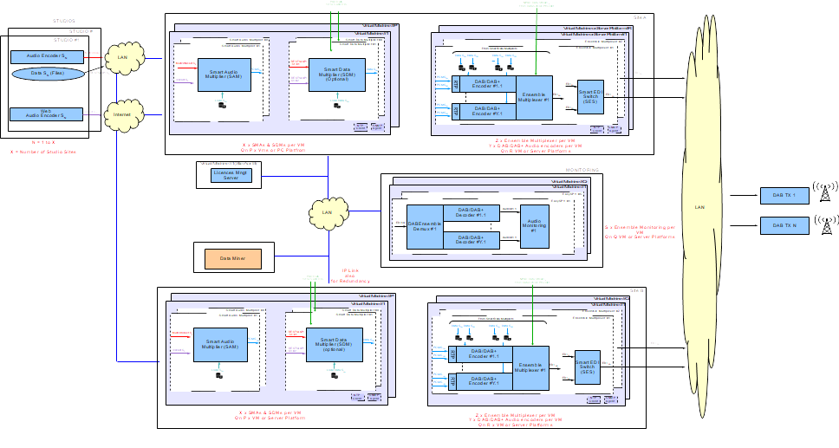
Redundant Centralized
Architecture
Notes:
17

Slide 18
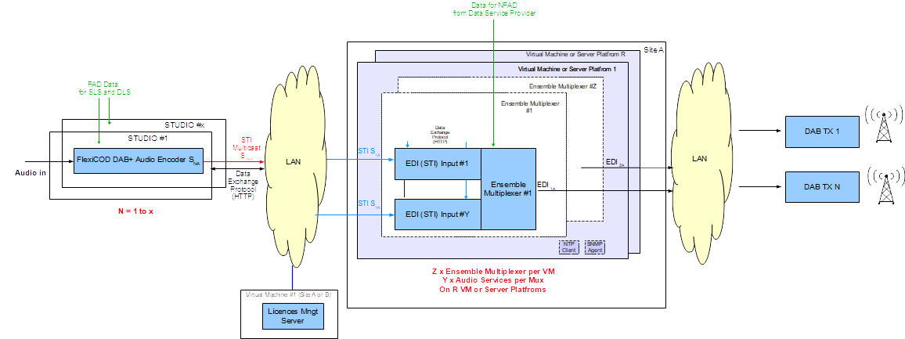
Simple Distributed Architecture
Specific DAB Encoders
Notes:
18

Slide 19
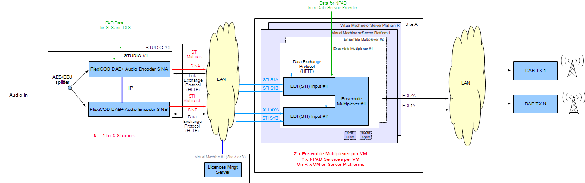
Distributed Architecture
with STI Redundancy
Notes:
19

Slide 20
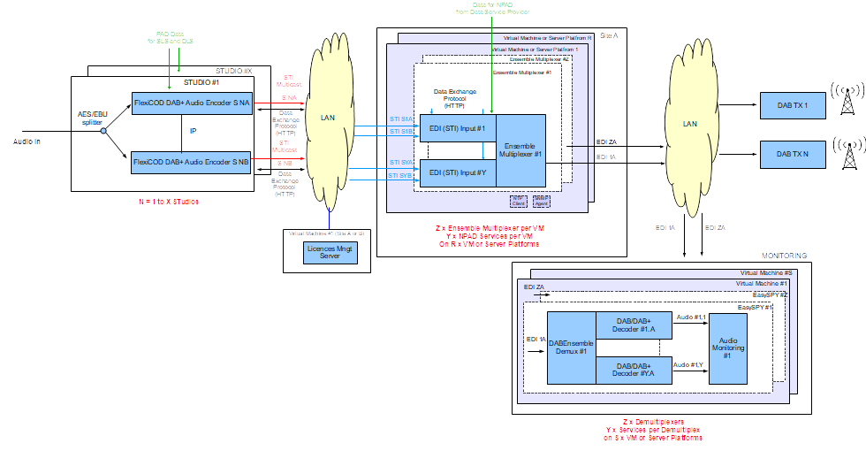
Distributed Architecture with STI Redundancy
and monitoring
Notes:
20

Slide 21
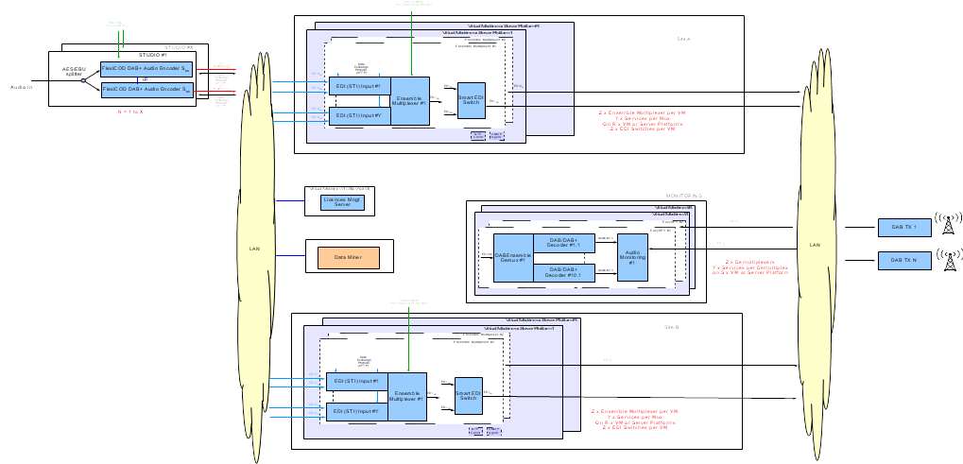
Redundant Distributed Architecture
Notes:
21

Slide 22
Examples of DIGIDIA’s Realizations
Notes:
22

Slide 23
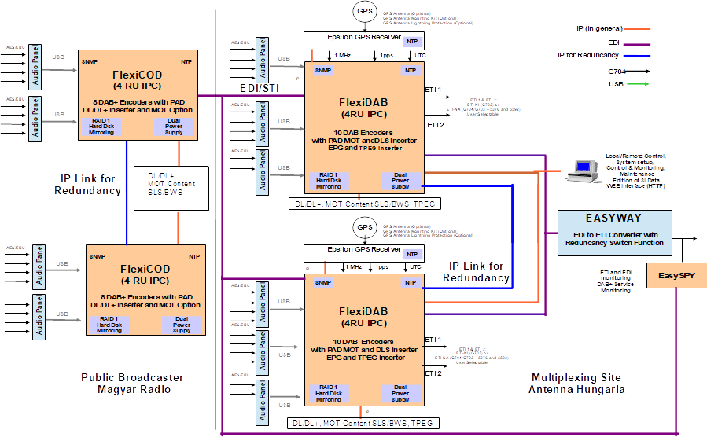
Architecture
Antenna Hungaria
Notes:
23

Slide 24
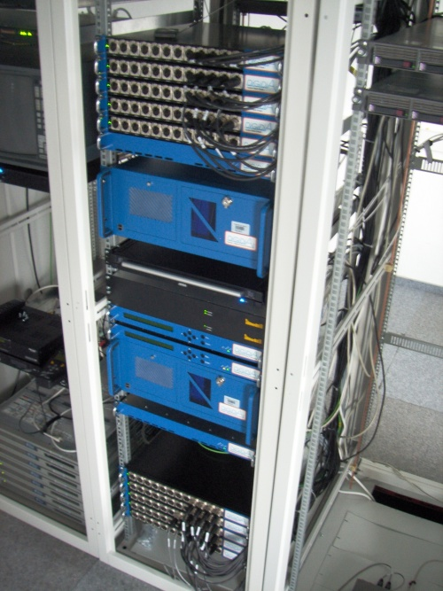
System Antenna Hungaria (Hungary)
5 Audio Panels for 18 Services
Master GPS Receiver
Master FlexiDAB
Master FlexiDAB
18 DAB+ Audio encoders
18 PAD DLS inserters
18 PAD MOT Inserters
1 EPG NPAD inserter
1 TPEG NPAD inserter
1+1 automatic redundant system
EasyWay EDI/ETI Switch (1 cold spare)
Slave FlexiDAB
Slave GPS Receiver
5 Audio Panels for 18 Services for the Slave FlexiDAB
Notes:
24

Slide 25
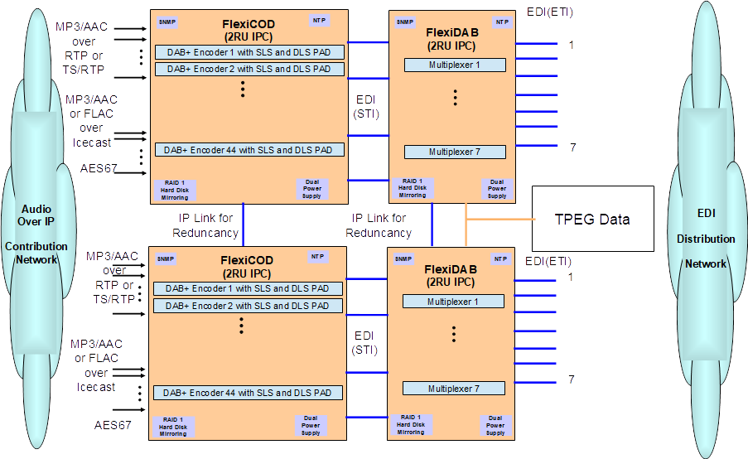
Architecture TdF (France)
Notes:
25

Slide 26
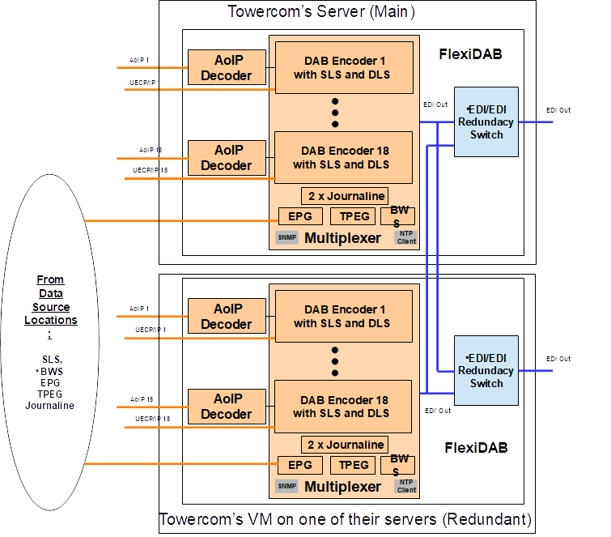
Architecture
Towercom
(Slovakia)
Notes:
26

Slide 27
Conclusion
Notes:
27

Slide 28
Conclusion
Modern DAB Head ends are completely software and IP based and therefore compact, easy to install and maintain (even remotely)
Modern contribution and distribution networks are IP based and special care has to be taken for the quality of the IP networks
Easy virtualization or set up on customer’s servers, even for complex architectures.
It is possible to start very quickly cost efficient trial systems with one(or more transmitters) on a DAB head end.
A DAB roll out is today much easier than 10 years ago.
Notes:
28

Slide 29
///
Z.A. le haut Danté
6, rue du Bocage
F-35520 La Chapelle Des Fougeretz
T +33 299 146 332
F +33 299 145 883
@ contactdigidia@nautel.com
Notes:
29

