Slide 1
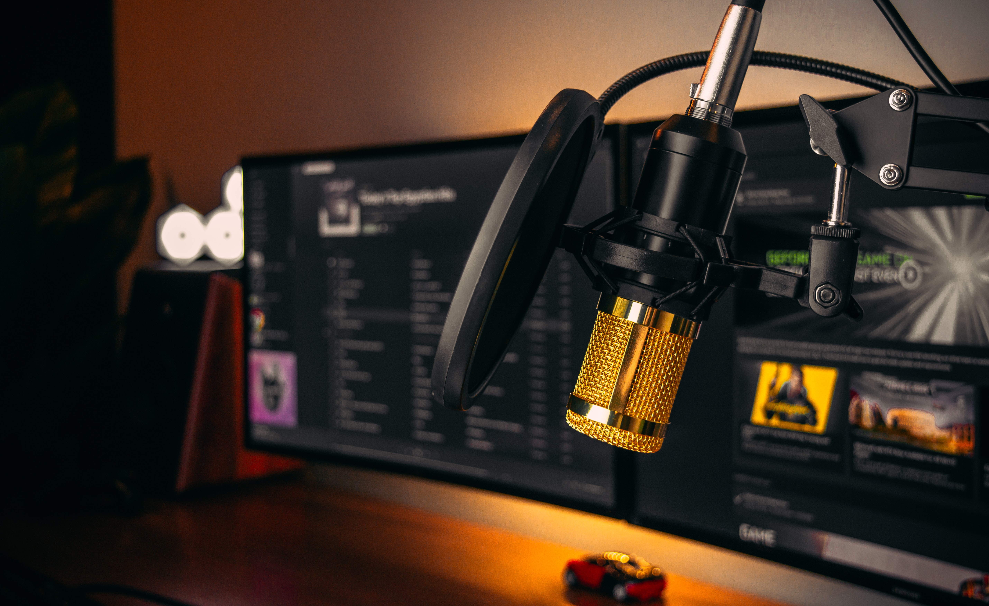


DAB HEAD-END SYSTEMS
WARNING SYSTEMS
Lars-Peder Lundgren
Working with DAB since 1997
Notes:
Working with DAB since 1997, so almost from the very beginning.
I will first say a few words about Paneda, and our DAB head-end solution, and also a new system that uses DAB for emergency warning.

Slide 2

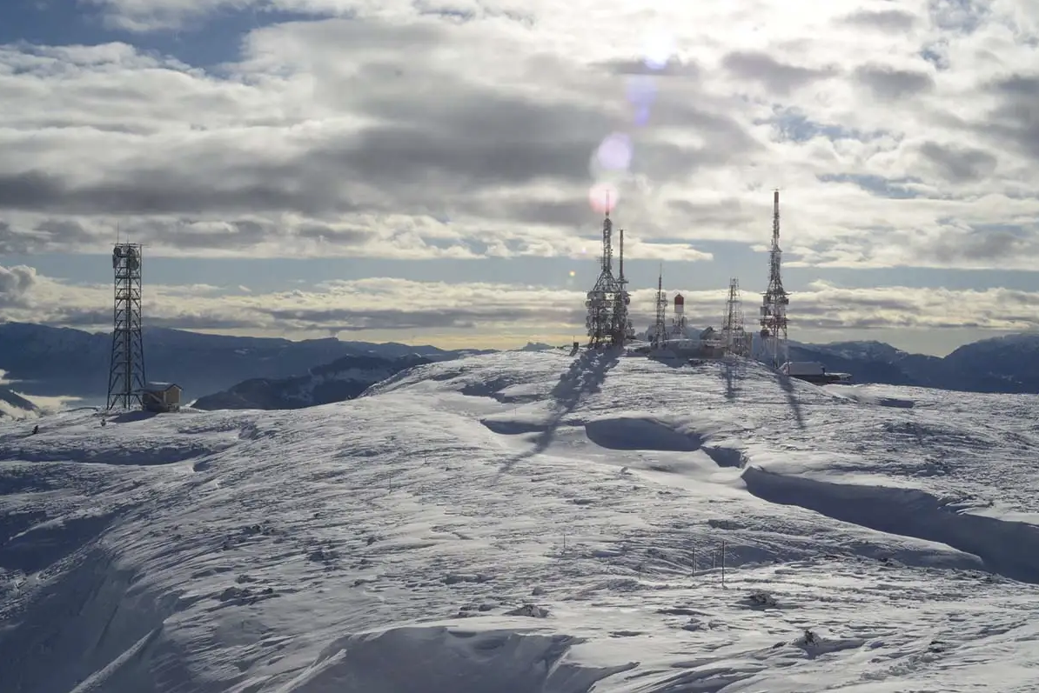
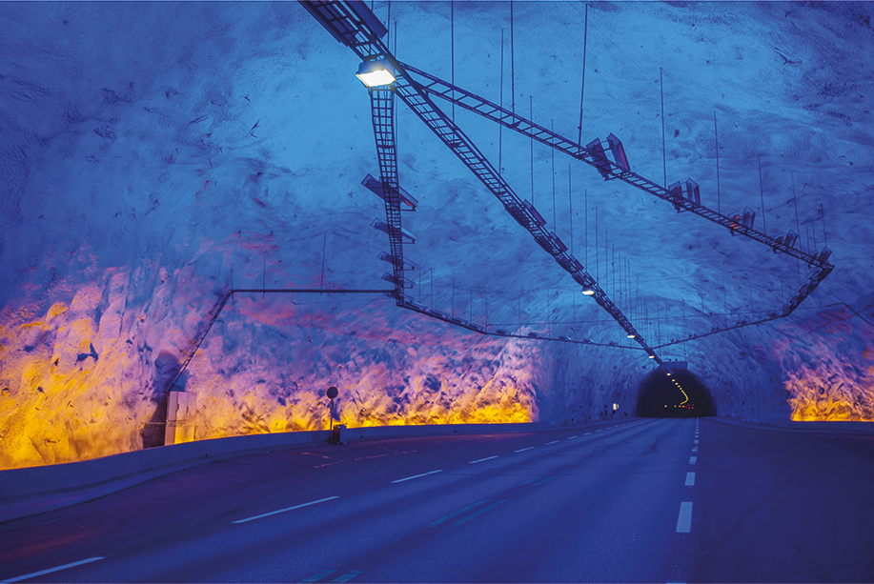
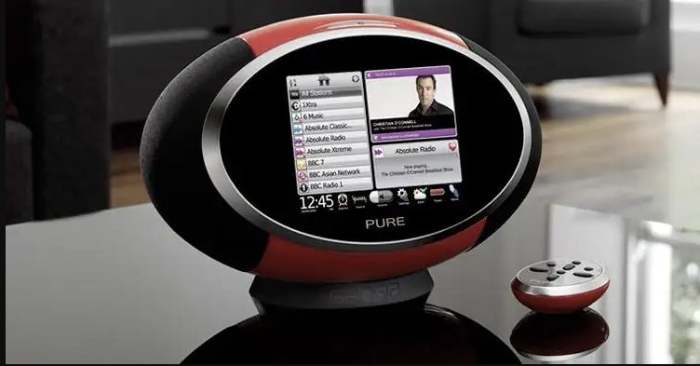
Owns and operate its own DVB-T2 network in Norway with 100+ transmitters
Radio Break-In systems for road tunnels, over 250 tunnels equipped with a Paneda solution
Leading supplier of DAB Head-End systems with over 120 systems in operation world-wide
TV NETWORK
TUNNEL SYSTEMS
DAB HEAD-END
Notes:
Paneda is an Scandinavian company, head-offcie in Norway and development and sales office in Sweden.
We are active in 3 areas, TV network, Tunnel Systems, DAB Head-End system. World leading supplier

Slide 3








PROUD SUPPLIER
+60 MULTIPLEXERS
400 Radio services
8 MULTIPLEXERS
56 Radio services
2 NATIONAL
20 REGIONAL
Notes:
Just to mention a few Paneda users, we are proud supplier of complete DAB systems to
Arqiva in UK, the world largest DAB operator, operating 60+ multiplexers and 400 radiostations in their platform
Australia, National public broadcaster ABC and SBS using Paneda systems for their national multiplexers
France, with towercast, the network operator and multiplexer operator, both for the national multiplexer with the public broadcaster Radio France and 20 regional multiplexers

Slide 4

DAB HEAD-END SYSTEM
HEAD-END
DAB+ ENCODER
MULTIPLEXER
AUDIO
DAB+ ENCODER
NON COMPLICATED
Notes:
So, what is a DAB head-end system?
That is what we need to start with DAB broadcast!
We need Audio Encoders that encode your audio and metadata to DAB+, Multiplexer that combines all services to one single stream on the output.
Together, this is what we call a head-end system, and today, things has become so easy to deploy

Slide 5
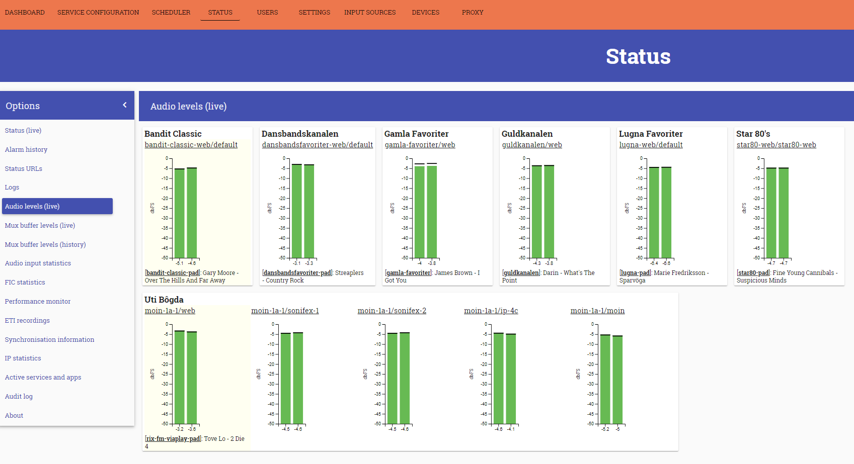
DAB HEAD-END SYSTEM
DAB HEAD-END
PLATFORM
AUDIO
​
EDI-IP
​
AUDIO
​
Notes:
A modern DAB system of today doesnt focus so much on audio encoding and multiplexing, they are combined and encoding is an integrated part of the platform, it can be seen as one single platform, where we insert audio, EDI output from transmission.
So, just One single platform, complete systems, and today its just a software, managed by a single webinterface. Zero complicated.

Slide 6

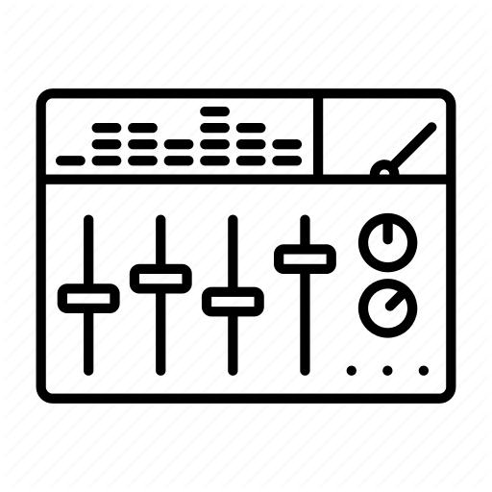

CENTRALIZED
MULTIPLEXER
DAB + ENCODER
AUDIO
​
DAB+ ENCODER
Notes:
In general, we talk about to main types of typical setups, Centralized setup, where the encoding and the multiplexing part is installed at the same place.
For audio, using audio contribution. This is also the most common and recommended setup, for a number of reason that I soon will explain.

Slide 7
DE-CENTRALIZED
MULTIPLEXER
DAB+ ENCODER
Notes:
De-Centralized setup, where you break-out the DAB encoding and perform the encoding at studio.
Intends to be more complicated, and has some disadvantages, for example as it requires a ”return-channel” for management of encoders.
DAB only setup, Vendor lock in..and some more disadvantages.
The centralized aproach and de-centralized can of course be combined!

Slide 8



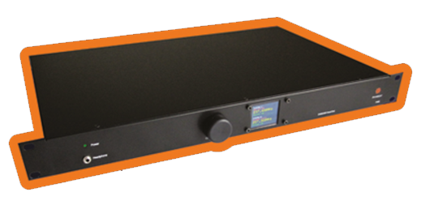
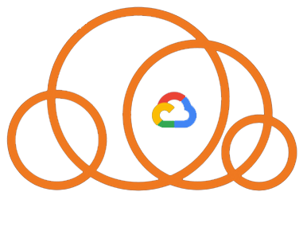

DAB HEAD-END SYSTEM
COMPLETE DAB SOFTWARE SOLUTION
80%
10%
10%
SERVER PLATFORM
VIRTUALIZED
VMWARE
DOCKER
DEDICATED PANEDA HARDWARE
COMPLETE HEAD-END
REMOTE ENCODERS
CLOUD SYSTEMS
GOOGLE
SMALL-SCALE DAB
Notes:
Today, a DAB system is basically just a piece of software, which can be deployed in several typical kind of setups:
Most common is that we install the DAB system in customers own datacenter, using virtual machine on a server platform, Vmware or docker.
Paneda also offers dedicated hardware, used as complete head-end or only as Encoder.
Cloud systems mainly for Small Scale DAB applications, community radio, student radio and others without any hardware investments.
Paneda offers both OPEX and CAPEX for all kind of setups.

Slide 9
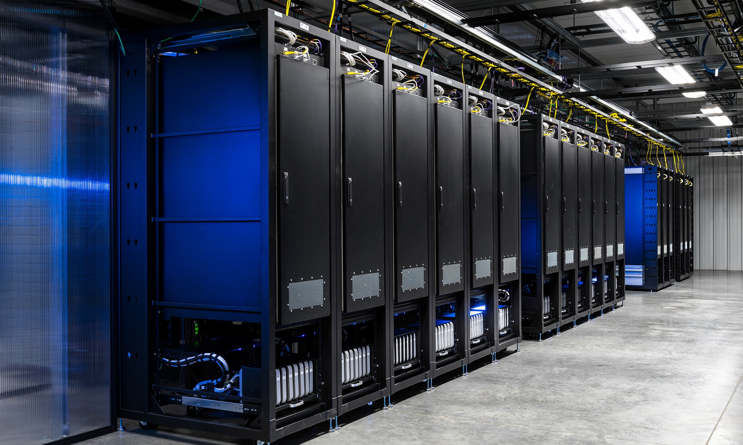
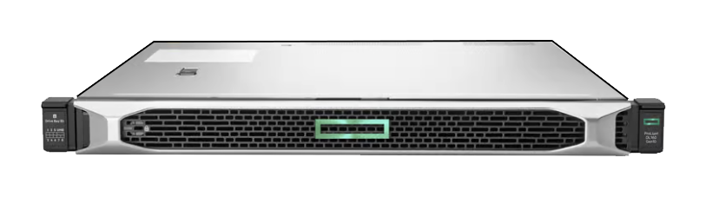

CENTRALIZED
CENTRALIZE ALL MULTIPLEXERS AND ENCODERS IN ONE LOCATION
Maintenance
MULTIPLEXER
Support
DAB + ENCODER
Upgrades
Cost efficient
DAB+ ENCODER
Scalability
Notes:
Coming back to an centralized aproach.
Based on experience, we reccomend this setup as the best aproach, and its also most easy to deploy.
Just install the DAB head-end platform including audio encoders and multiplexers on a server based envoirenment, using virtualization.
The benifits are many, less maintenance, easier support, easier upgrades, cost efficient, easy to scale up/down by just starting up a new system in the same platform with a few mouse clicks.

Slide 10

CENTRALIZED SERVERS
MUX 1
MUX 2
MUX 3
MUX 4
MUX 5
MUX 6
MUX 7
MUX 8
Notes:
So, an centralized setup is scalable, you can start with one multiplexer, and start deploying your transmission network, and you can expand with more systems at any point.
In this example, one single server provides DAB to 8 regions. In one single small standard 1U server

Slide 11

AUDIO CONTRIBUTION
MUX 1
MUX 2
MUX 3
AUDIO SERVER
MUX 4
AUDIO
MUX 5
STUDIO
-INTERNET
-DEDICATED
MUX 6
MUX 7
MUX 8
MUX 9
MUX CENTER
Notes:
Once you have the DAB head-end platform centralized, how do we insert audio?
One great solution is audio contribution.
From studio, use contribution, using standard and open protocols, even Internet may be used.
Same audio feeds many multiplexers

Slide 12

Example AUDIO SETUP
Audio input
2WCOM IP-4C
AUDIO SERVER
E-aptx (ex)
MUX 1
AES67 (IP)
PCM (ex)
MUX 2
ALL RADIO STATIONS FEEDS THE SAME AUDIO SERVER
EACH REGIONAL MUX HAVE ACCESS TO ALL AUDIO
EACH STUDIO DECIDE FORMAT BETWEEN STUDIO-SERVER
Notes:
As an example, 2Wcom has a great solution with hardware studio IP encoders, feeding an centralized audio decoder server (installed in the same DAB head-end platform)
Each studio decides the format at their output, from raw PCM to any other efficient codec, as APTX. The Audio server auto detects the format, but will always provide PCM at the output to the DAB system.

Slide 13
2WCOM & PANEDA
Partners in many projects
Selected supplier for Arqiva with 60+ multiplexers and 400 radio stations
Supplier of the Australian national DAB system
Complete solution from studio to transmitter

Slide 14
CONSIDERATIONS
DAB encoders at each studio?
Install large number of de-centralized multiplexers
Mix of suppliers
Choose a skilled partner, not a supplier!
Notes:
A generic advice:
In most cases, its not prefered to install hundreds of dedicated DAB encoders de-centralized, will be a challenge for problems for maintenance, support and management as well as complicated IP networking.
Same for multiplexers, will be complicated support and maintenance
Avoid several players here, choose one partner that can take ownership of all support.
Mistake to purchase a system on price only, its more important to get a system with support and robust over time as well as future proof.
Dont think too much about supplier, instead choose an experienced partner that can take responsibility of a complete solution, and support.

Slide 15

Areas of focus
VIRTUALIZED
SECURITY
SMART REDUNDANCY
SMART REDUNDANT TRANSMISSION OUTPUT
SMART PROVIDER HANDLING
AUDIO HANDLING
METADATA
MONITORING
Notes:
Paneda has a high focus on the areas of virtualization, security, redundancy and more…
I just want to highlight o few of them

Slide 16

PANEDA UNIQUE FEATURES
VIRTUAL PROVIDERS
SMART CONTENT SWITCH
AUDIO HANDLING
SECURITY
Notes:
Just to highligt a few of thiese unique features in a Paneda Head-End system:

Slide 17
VIRTUAL PROVIDERS
DAB HEAD-END
PLATFORM
284kbs
512kbs
384kbs
PROVIDER 1
PROVIDER 2
PROVIDER 3
Notes:
The Paneda virtual providers allows sharing the same platform,, where each provider can be granted a secure login to the platform and manage their own capacity.
The principle is that each provider is given a capacity slot in the platform, but still 100% independent from each other
Also provides an great business model, based on the principle to sell capacity slots.

Slide 18
SMART CONTENT AWARE SWITCH
MAIN MUX
RADIO 1
RADIO 2
CONTENT SWITCH
RADIO 2
RADIO 1
REDUNDANT MUX
RADIO 1
RADIO 2
CONTENT SWITCH
ALWAYS BEST POSSIBLE OUTPUT
Notes:
When having a redundant system, on a failure within in one or the other system, instead of a complete switchover between systems in redundancy, The Paneda system uses what we call SMART content aware switch. Which is a built-in feature, with a seamless switch before the output in each multiplexer. The two (or more redundant system are aware of the content and communicate with each other, using services from either systems, combining them to always providing BEST POSSIBLE OUTPUT
For example, the RADIO 1 has failed in the main system, correspondingly, Radio 1 will be hand over to the main system, and both system can provide an error free output.
The system also covers the error case with multiple errors, and still providing en error free output, always based on best possible output.

Slide 19



AUDIO HANDLING
1.AUDIO INPUT
AES67 (IP)
SERVICE
AUDIO SOURCE
2.AUDIO INPUT
3.AUDIO INPUT
SERVICE ORIENTED
MATRIX OF AUDIO INPUTS
Notes:
About audio, The Paneda system is service oriented, means that the focus is on creating services, you dont have to think so much about encoders, these are created for you automatically behind the scene.
Using a matrix of audio sources, with priority.
In a redundant system you can have different audio inputs, all to provide a higher audio uptime-

Slide 20

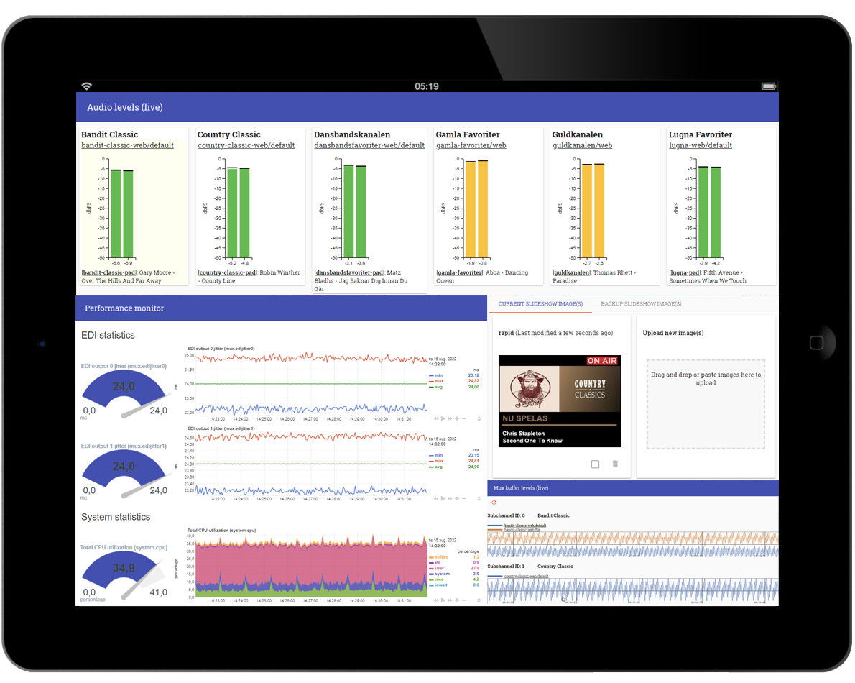
IT SECURITY FOCUS
PERSONAL LOGIN
USER RIGHTS
2 FACTOR AUTHENTICATION
HTTPS (TLS) ENCRYPTION
A+ RANKING
Notes:
Paneda has high focus on IT security, we support 2factor, encryption everywhere its possible.
We have been ranked as A+ security in recent tests by users.

Slide 21

EXAMPLE SETUP 2x HEAD-END
AUDIO SERVER MAIN
EDI (IP)
SAT
SFN
STUDIO
HEAD-END 1A
HEAD-END 2A
STUDIO
EDI
INTERNET
SFN
AUDIO SERVER RED
STUDIO
HEAD-END 1B
HEAD-END 2B
STUDIO
Notes:
Complete example setup
4 studios, each studio with X number of services, feeding an centralized audio server (decoder)
Internet or dedicated IP links may be used.
Redundancy can be used
At each studio, en generic IP encoder is used, for example the popular IP-4C from 2wcom, in redundancy or not.
Each studio decide by them selves the format from the encoder to the audio server, and he audio server auto detect the format. PCM, APTX or others are supported.
In the same platform, the DAB head is installed, in redundancy of course.
For fallback, the DAB head-end system can use IP streaming formats (as Shoutcast) can be used, for example if we loose the connectivity to a studio.
At the output in this example, we present 2x EDI, plus redundancy
For distribution, we uses seamless EDI switches, which also acts as format converters, for example to ASI for SAT distribution.
So, here we have a complete end-to-end setup with 2 DAB ensembles for two areas in SFN

Slide 22

When the unexpected happens
Notes:
Next topic, Warning systems!
We all know that the number of unwanted situations has increased the last 10years, we talk about weather related things, we have war in our part of the world,
So, how can we be more prepared and utilize different technologies in the best way?

Slide 23
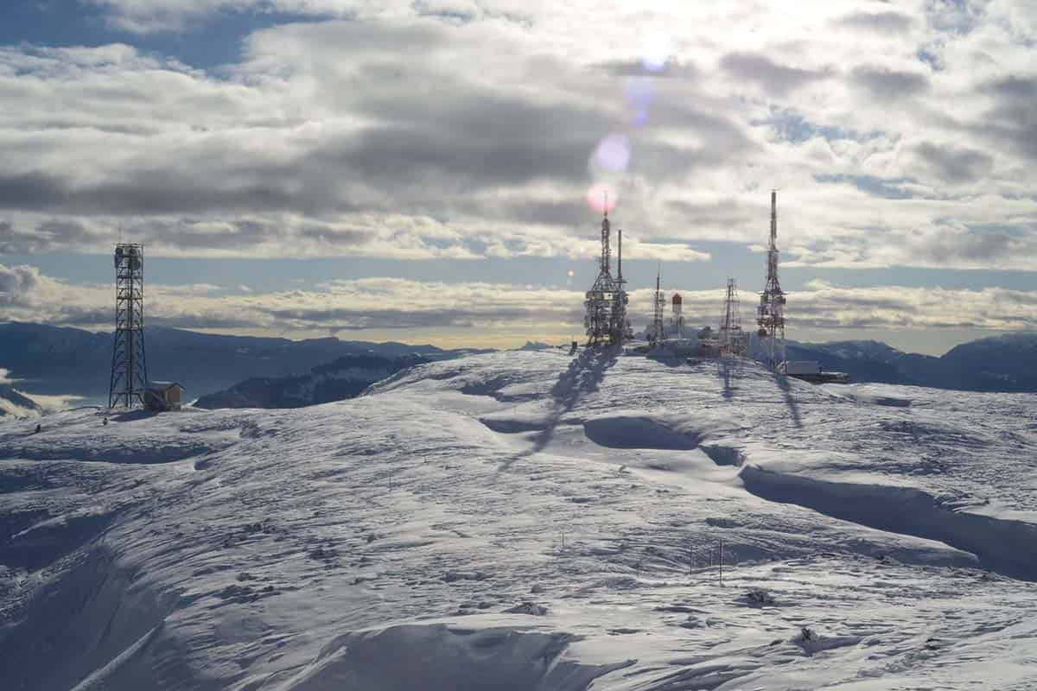
Can the broadcast networks have a role to play for increasing preparedness?
How?
Notes:
Paneda joined a public founded project in Norway some years ago, where the main question was if the broadcast networks could play an role in different kind of crises? If so how? The background here was that it was clear that broadcast networks are very robust.
There have been many cases where mobile networks and internet were down, but never DAB or FM.

Slide 24

when a critical event occurs
Public Broadcasters have a responsibility to reach out with important information on radio
Authorities have a responsibility to reach out to the population with important information
The time it takes to get information out is essential
All platforms play a role and are important
Notes:
Different responsibilities, but all platforms are important.
DAB Alarm announcement, disadvantage that its not addressable.
SMS, Cell broadcast, efficient, but takes time and sometimes mobile networks are down, (or must be shut down in case of a terrorist attack for example)
Loudspeakers, Siren system often used by authorities.

Slide 25
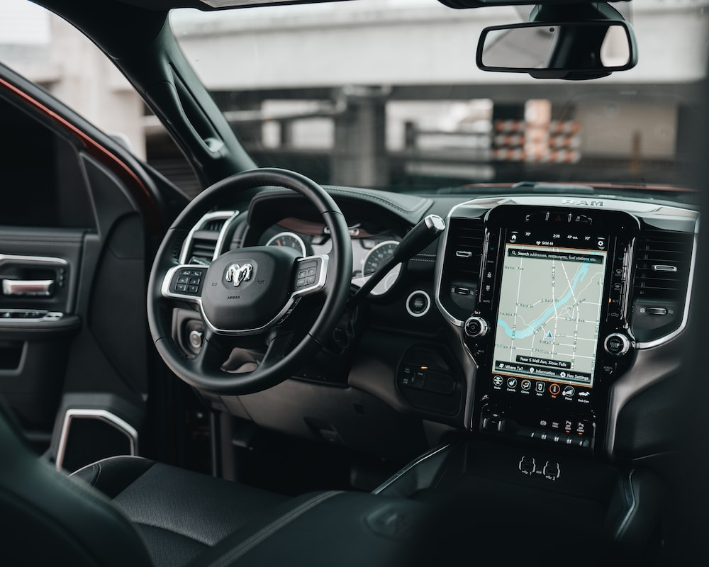

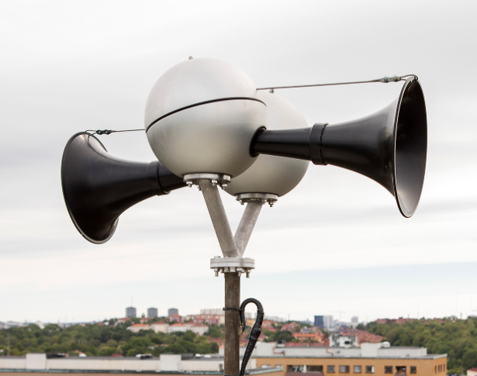
EXISTING PLATFORMS
Mobile Networks with SMS, Cell Broadcast, Native applications and more
National Siren systems, Loudspeaker system..
Broadcast Networks reaching radio listeners, often public broadcasters that have the responsibility
Social Media
Notes:
To reach radio listeners, that's easy, and in combination with for example Alarm announcement.
Mobile systems, SMS, Cell broadcast, efficient but not always in time
Siren systems, more used for national events, war situations etc,
Social Media, fake news, uses mobile networks.

Slide 26
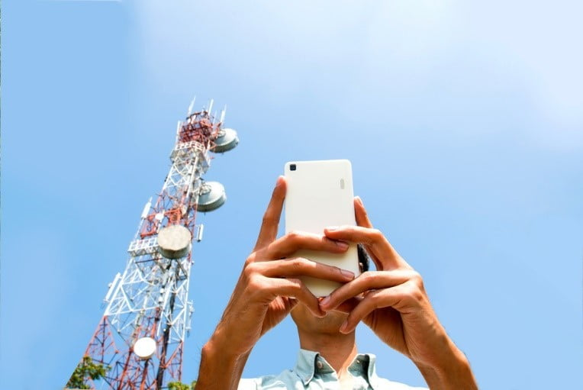

But!
Mobile Networks may be down
Can we trust the veracity of social media?
Broadcast Radio has high uptime, but reaches only radio listeners
Notes:
In some situations, Mobile network are shut down on purpose
Fake news
Broadcast networks are most reliable, 99.9% uptime as minimum. But Radio only reach listeners!

Slide 27
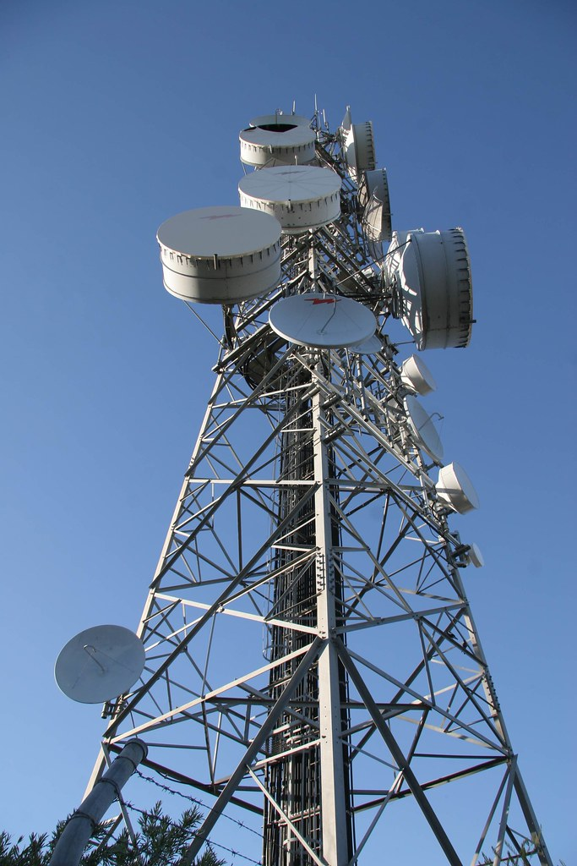
BROADCAST
are independent of the internet and are self-contained systems
is existing and can thus be used for warning systems without major investments
broadcast has a built-in protection against hacking
usually uptimes over 99.9%
Notes:
The major benefits of broadcast!

Slide 28
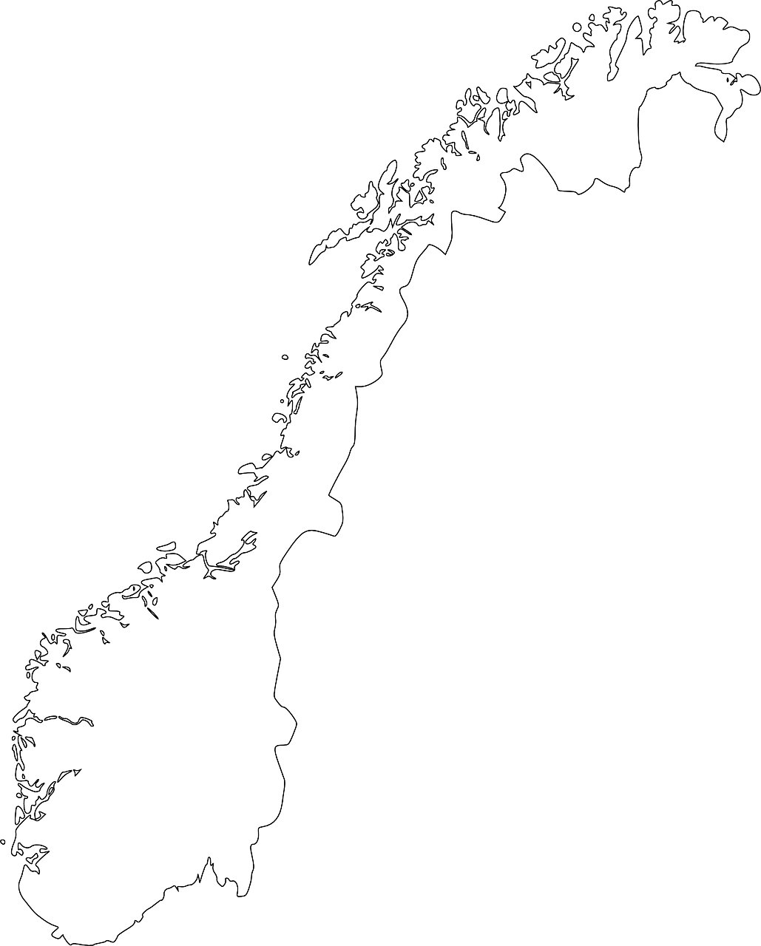
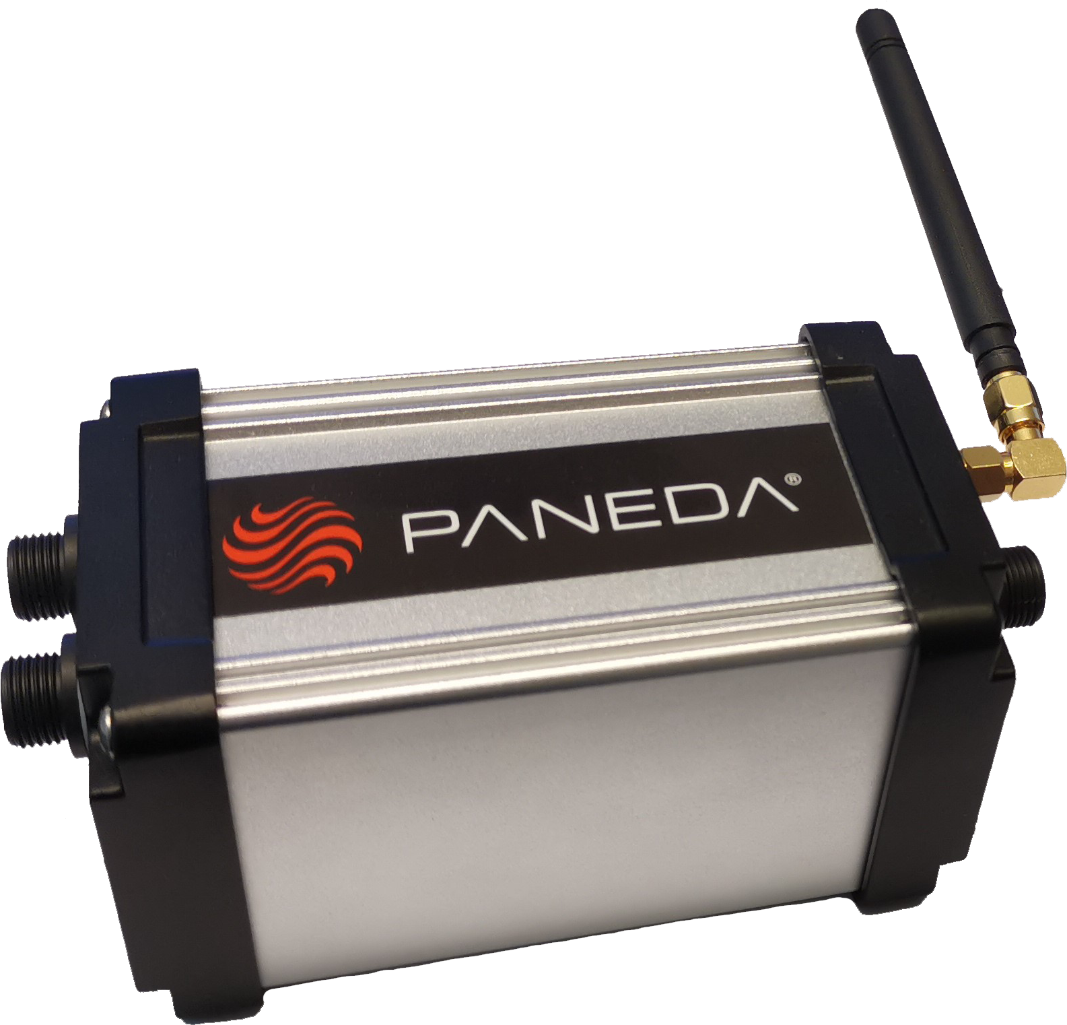





PANEDA WARNING SYSTEM PWS
A complete eco system that uses the DAB network
The basic principle is to insert a digital hidden code in the DAB network that activates special receivers to perform pre-defined actions. It may be to activate critical infrastructure such as siren system, play sound in speakers, presenting graphics/sound on existing screens, control mechanical things like closing/opening barriers, vehicle barriers and more..
10101
10101
10101
10101
10101
Each receiver is unique and addressable
- - - > 1 SEC TRIGGER TIME < - - -
Notes:
Complete Machine-Machine system

Slide 29
PANEDA PWS RECEIVER
IP 67
MULTI USAGE
ADRESSABLE
-100dbuV
RETURN CHANNEL
BATTERY OPERATED

Slide 30

The FLOW
10101
10101
10101
10101
10101
10111
11101
10101
10101
11111
DAB MUX
SCENARIOS
LOCATIONS
TERROR
OSLO
EARTHQUAKE
BERGEN
TSUNAMI
TRONDHEIM
INFORMATION
- - - > 1 SEC TRIGGER TIME < - - -

Slide 31

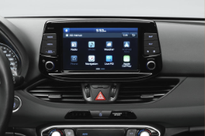
CONCLUSIONS
MOBILE NETWORKS
Reaches people having instant access to a device
Are in a coverage area
Mobile network in operation
RADIO BROADCAST
Public Broadcasters are responsible for “Emergency population warning”
Reaches people listening to radio
Majority of listening is in cars
Notes:
SMS and Cell broadcast, its nice, but only works if the network is up, it takes time, and it only reaches people that actually have their handheld device on hand
Radio reaches listeners only; most users listen to the radio in the car

Slide 32
PWS
REACH MORE PEOPLE
SAVE LIVES
FAST!
Does not compete with other systems
Does not require Internet or mobile networks
Notes:
A system where DAB is used ensuring the most robust network, used for activating loudspeakers, mechanical machinery, screens and more.
AND, working without Internet or mobile network
Note, this system doesn’t address radio listeners, many other system already does that, we address and cover all the others, people on the street for example, disabled people, by using both signs, loudspeakers.

Slide 33

Thank you
Lars-Peder Lundgren​​
Lars-peder.Lundgren@paneda.se​
www.paneda.no​
Notes:
Im here at the WorldDAB pavilion and feel to drop in for more information about our systems.

