Slide 1
Digital Radio in the Arab Region: Challenges, Future and opportunities
WorldDAB General Assembly
3 November 2020

Slide 2
Current Challenges
FM Saturation & congestion:
  90 to 100% in main cities and urban areas
  50 to 70% in Rural areas
  Interference in co-channel and adjacent channels, mainly in hot season
Regulatory Issues
  lacks of regulatory framework to launch the Digital radio in the Arab region

Slide 3
Current Challenges
Stakeholder inter connectivity
  Need to create in each Arab country a steering committee for the implementation of digital radio and coordination between the different stakeholders (Only Tunisia & Saudi Arabia has started the creation of such committees)
Receivers availability
  The receivers are not yet available in the Arab region with the exception of Saudi Arabia, which has around 2% of new cars fitted with digital radio. Cars & Portable receivers Manufacturers are invited to approach the territory with an aggressive marketing campaign, Tunisia working on law for Tax Exemption for the receivers.
Broadcasters readiness
  Arab Broadcasters do not lack the well to go digital.
  Huge work awaits broadcasters to speed up the introduction of digital radio in their countries
  Close and rational coordination is required between the various stakeholders
  Additional action and Big efforts are needed for: Marketing Issue, Commercialisations.

Slide 4
Future and Opportunities
Digital radio (DAB) Benefits
Progress of DAB+ in the arab region
Marketing Issue
Commercialization.

Slide 5
Digital radio (DAB) Benefits
New options for DAB transmission networks allow for network design flexibility
Advancements in energy efficiency help reduce long term operating costs
Multiple options can allow for cost effective redundancy for transmitters and links
More configurations and modulation capabilities could improve network deployments

Slide 6
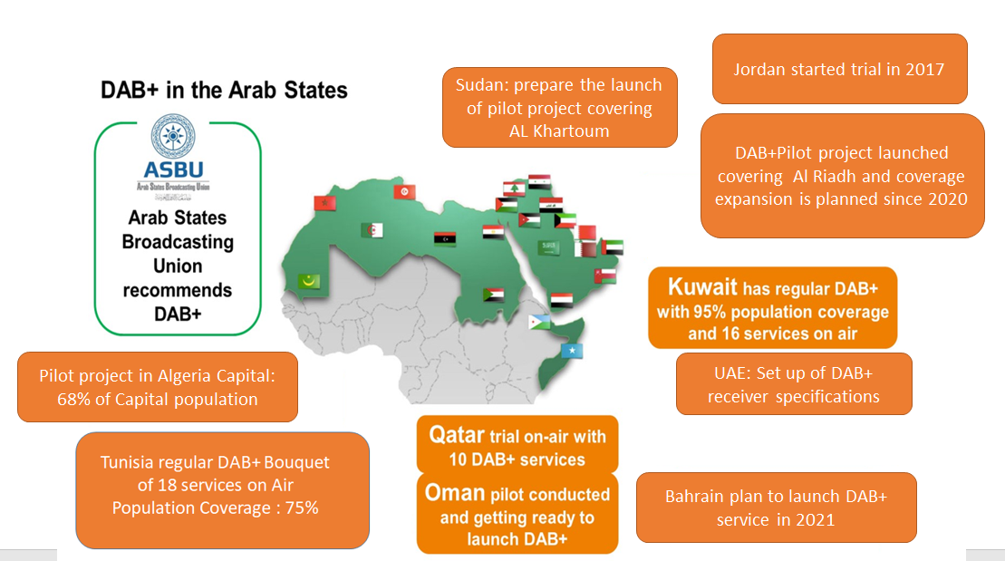
DAB+ progress in the Arab region

Slide 7
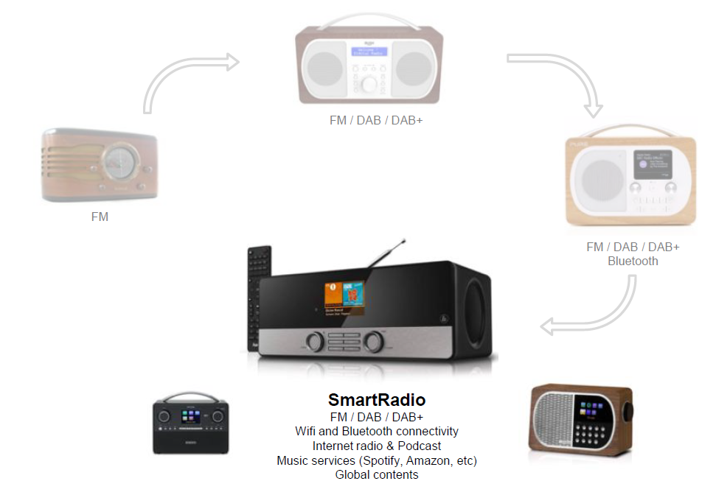
Marketing Issue
Radio market evolving, with consumers wanting more from radio products

Slide 8
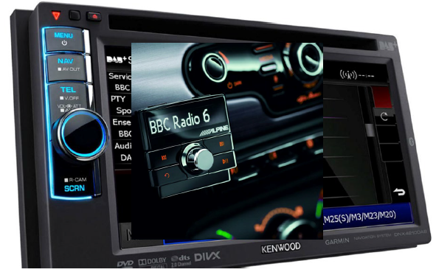
Marketing Issues
Enrich the radio program schedules with new thematic programs of entertainment, culture and sport, advertisement, etc.
Promoting the automotive Market
Promoting communication to advertise the introduction od digital radio and sensitize the listener about the Digital Radio Benefits and New Features

Slide 9
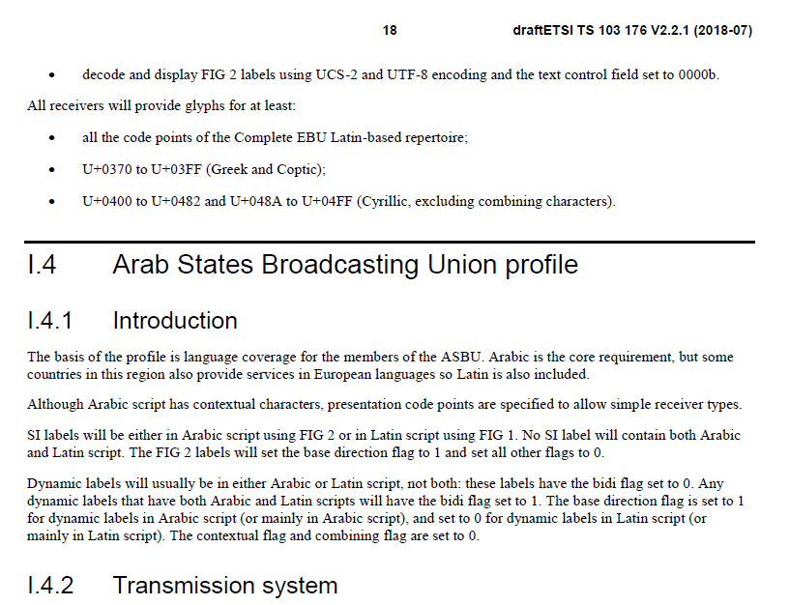
Commercialization
ASBU has contributed immensely to promoting the commercialization of radio receivers through
  the establishment of specifications for radio receivers
  Arab Fonts specification in the receivers in coordination with DAB-TC
  the implementation of a recommendation, in coordination with the ASMG (Arab Spectrum Regulator) to equip the new car park with digital radio receivers starting from 2020.
Complementary actions are needed from the different stakeholders to promote the commercialization of Digital radio in the Arab Region

Slide 10
Commercialization: success indicators
Wide selection of home receivers available for consumers, across different categories, form factors, price points
Price of receivers continue to reduce, with more features being offered, making them attractive for consumers
Receivers evolving to offer consumers both broadcast and on-demand contents

Slide 11
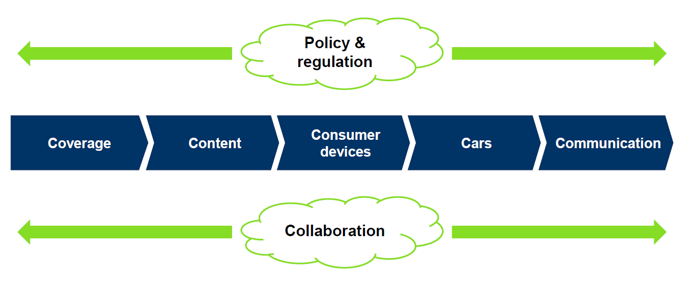
Conclusion: Key of Success is Collaboration &Coordination between stakeholders

Slide 12
Thank you

