Slide 1
ABU DBS 2023 – WorldDAB workshop
What is Small Scale DAB?
Dr Les Sabel
Chair, WorldDAB Asia Pacific Technical Group
6 March 2023
Notes:
Welcome
In this presentation I will provide some background on what Small Scale DAB is and how it came about.
Next, Nick Piggott will provide further details of real world experiences with SS-DAB particularly in the UK.

Slide 2
ABU DBS 2023 - WorldDAB workshop
AGENDA
What is SS-DAB?
A bit of history
Where, how and why?
System architectures
Licensing, coverage and cost
Support
Conclusions

Slide 3
What is SS-DAB?
Small Scale DAB is the delivery of DAB+ multiplexers to small areas at very low cost in the UK.
It is also used in several countries in Europe to provide commercial and community broadcasting using Open Digital Radio (ODR) Software Defined Radio (SDR) implementations
This allows small broadcasters such as community broadcasters to enter the DAB+ digital radio market
As radio continues with digitisation and analogue switch-off, it is increasingly important to be part of the DAB+ landscape
Notes:
We note that this type of DAB approach to implementation is called "Small Scale DAB" in the UK because of the statutory coverage limits to limit competition with the existing multiplex operators. It's not a fundamental characteristic of the technology. Perhaps a better nterm would be ODR-DAB but we will stick to SS-DAB for this presentation

Slide 4
A bit of history
Year | Activity
2002 - 2008 | Canadian Communications Research Centre (CRC) develop of the original mmbTools Demonstrated by Mathias Coinchon in Switzerland
2009 | CRC opens the source code OpenDigitalRadio. wiki created
2010 | First licenced broadcast using mmbTools in Switzerland / DAB+ encoder
2011 | Testing and demonstrations gain wide interest
2012 | Creation of Opendigitalradio NFP in Switzerland / SFN capabilities added
2013 | Digris in Switzerland develops pilot transmissions in Geneva & Zurich UK OFCOM publishes Brighton trial results by Rashid Mustapha
Notes:
So we see that from humble beginnings as a tool for experimentation and improvement the ODR tools gradually became open source for all to use and contribute

Slide 5
A bit of history
Year | Activity
2014 | ODR support increases, Italy contributes MOT and ETI tools Regular transmission in Geneva start, then Zurich and Marseille, France
2015 | SFN field trials, tools improvements
2016 - 2018 | Continues functional development & field testing in UK, France, Denmark Regular operations continue in Switzerland
2019 | UK OFCOM publishes a proposed way forward
2020 | UK 1st round of applications
2021 | UK 1st round awards, 2nd round of applications
2022 | UK 2nd round awards, 3rd round applications
Notes:
Now we see widespread use of SS-DAB in UK, Switzerland

Slide 6
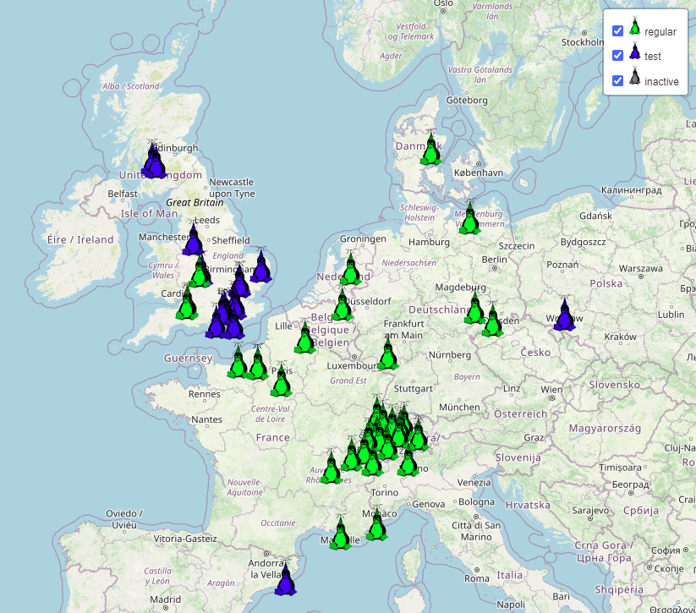
Where, how and why?
SS-DAB is now established as regular DAB transmissions in the UK, Switzerland, the Netherlands, Denmark, Germany, France
In Europe SS-DAB allows low budget community broadcasters to be part of the digital radio ecosystem
SS-DAB can be provided at very low cost
Low cost does have it own challenges
Equipment capabilities
Restricted coverage areas, e.g. the UK
Source: www.opendigitalradio.org
Notes:
Note that this map is indicative only and is a few years old and as such does not capture all current activity, especially in the UK where SS-DAB is advancing rapidly.

Slide 7
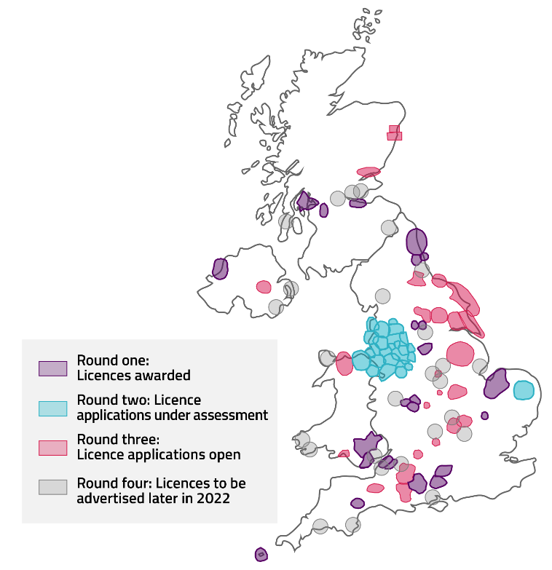
In the UK
The idea caught on in the UK with a licensing scheme being developed and an auction method to select suitable multiplex areas, operators and participants.
That licencing process is now in its forth round with over 40 SS-DAB multiplexes having already been awarded in the UK
Source: www.ofcom.org.uk
Notes:
We are now up to round 4, which will be followed by round 5, Nick will provide more specifics about this.

Slide 8
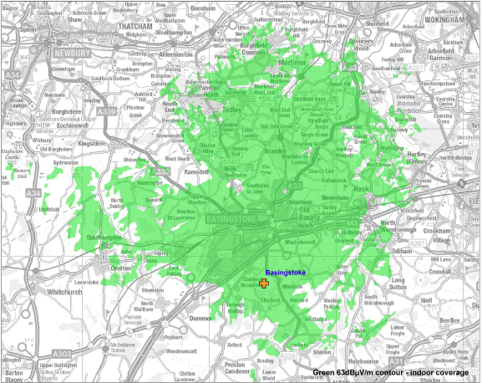
In the UK
OFCOM defines the technical standards and runs the license awards process
The essence of the licensing rules are the same as for existing local and national DAB multiplex operators
In UK the multiplex is run by a multiplex operator
Most services are Community radio stations who subscribe to those operators
There are now several commercial organisations which provide SS-DAB services
Basingstoke coverage SW of London
Source: www.ofcom.org.uk
Notes:
In some cases the community radio stations may also be part owners of the local multiplex operator
There are now commercial SS-DAB service providers such as Viamux for SS-DAB systems and expertise, and OpenDAB

Slide 9
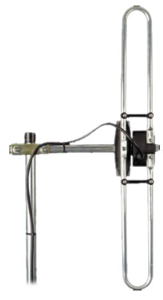
System architecture
Audio encoders at multiple broadcasters’ studios
PC unit with ODR software
Multiplexer
Audio transcoders
Monitoring
IP router and switch
Webstream Audio encoder
Modulator
Filter
Transmitter
Public internet
…
Main transmitter site
DAB+ Audio encoder
…
IP router and switch
PC unit with ODR software
EDI
Monitoring
DAB+ Audio encoder
Modulator
Filter
Transmitter
SFN transmitter site
Notes:
SS-DAB operates as a star network typically with the Multiplexer at the Transmitter site
Audio encoders at broadcasters’ studios or multiplexer site
The multiplexer / transmitter site is generally not at a broadcaster’s studio site
Audio encoders and Multiplexer run on low cost PC platforms with Linux OS
The modulator typically uses an Ettus B200 Software Defined Radio unit
The filter is a mechanical cavity type
The antenna is typically a dipole, folded dipole, sometimes a 2 element array or a co-linear
Note that there is no GPS receiver shown, GPS sync is essential for SFN operation and may be integrated into the exciter of done separately.

Slide 10
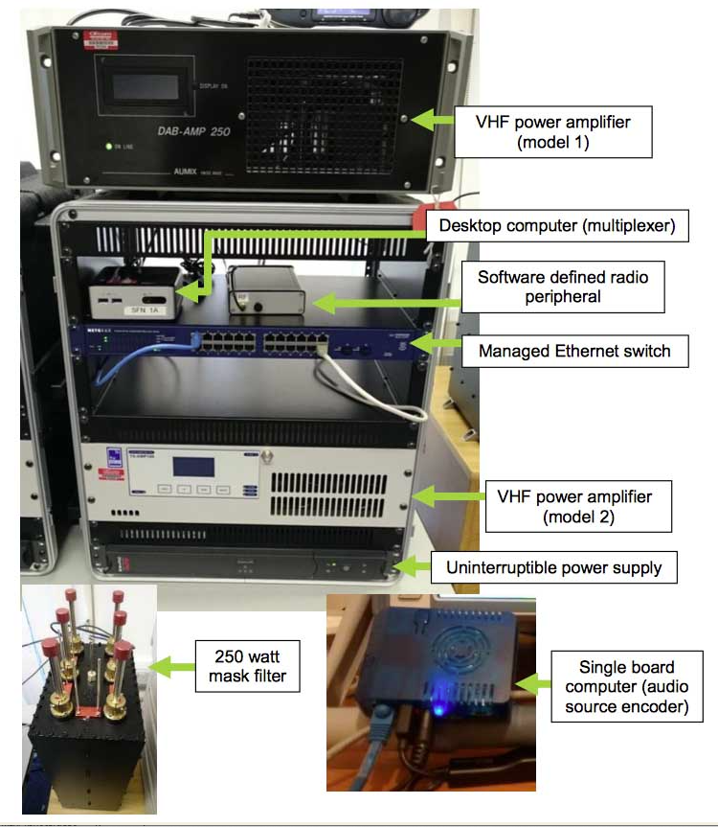
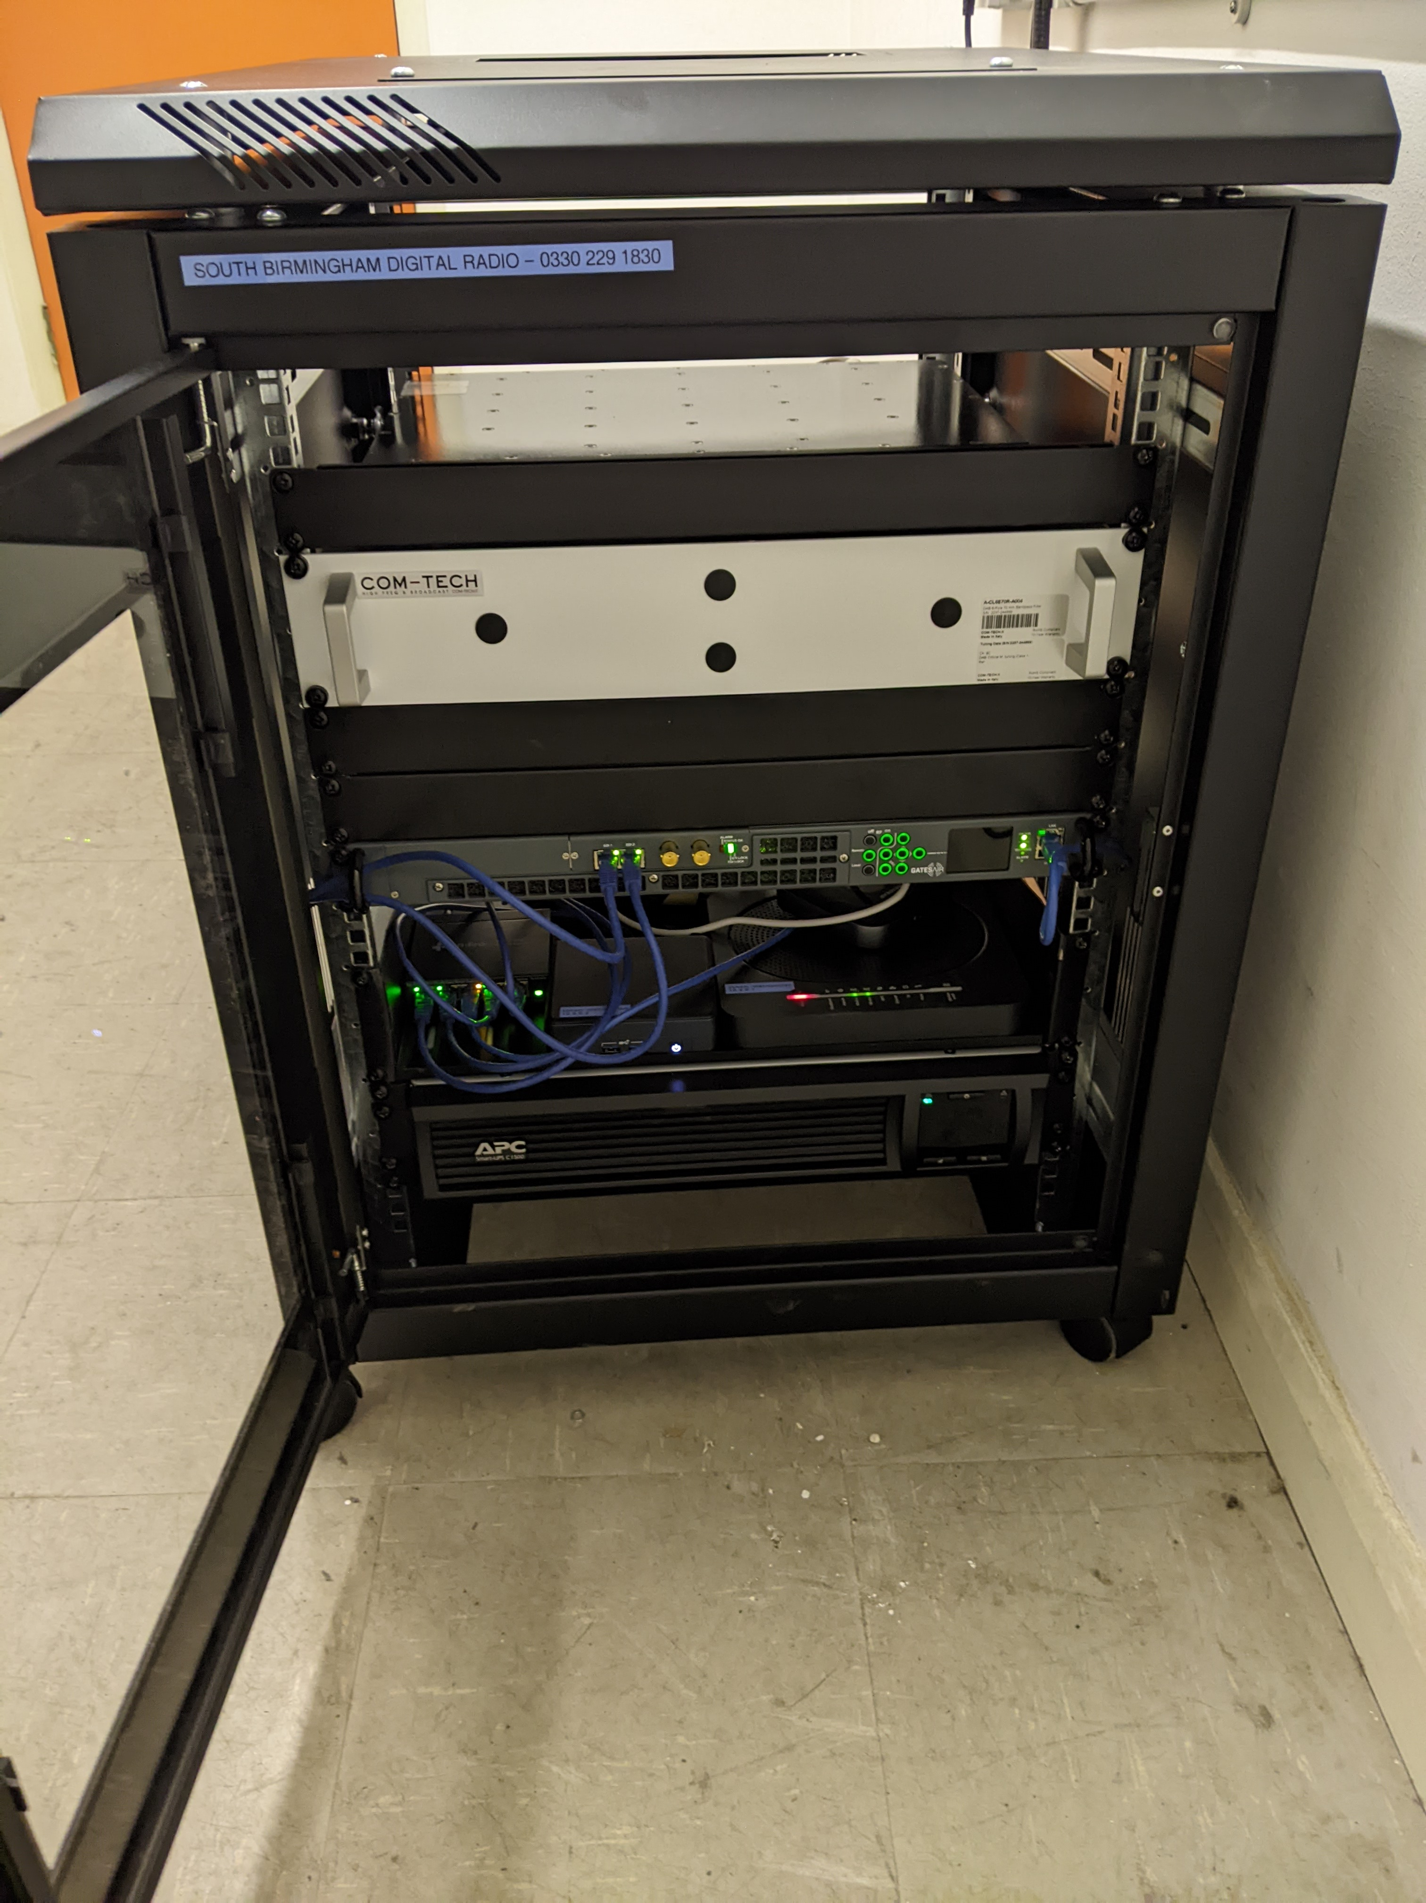
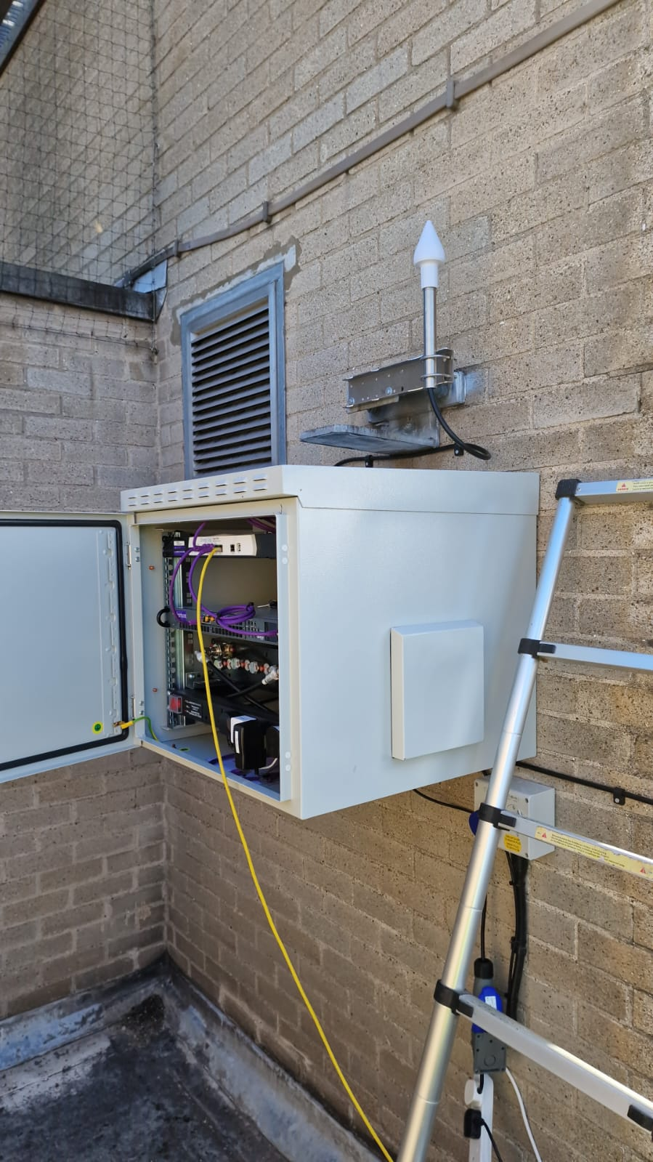
Examples
The original OFCOM system 2013
Typical current implementation 2023
Sources: www.ofcom.org.uk, Nick Piggott & www.viamux.com
Notes:
As you can see the equipment required is very limited, based largely on the increasing power of modern processors, the ODR software and the low power of the transmissions
The current system blocks are the same as a decade ago however the actual equipment has evolved. Nick will provide some more details about the current system implementations.

Slide 11
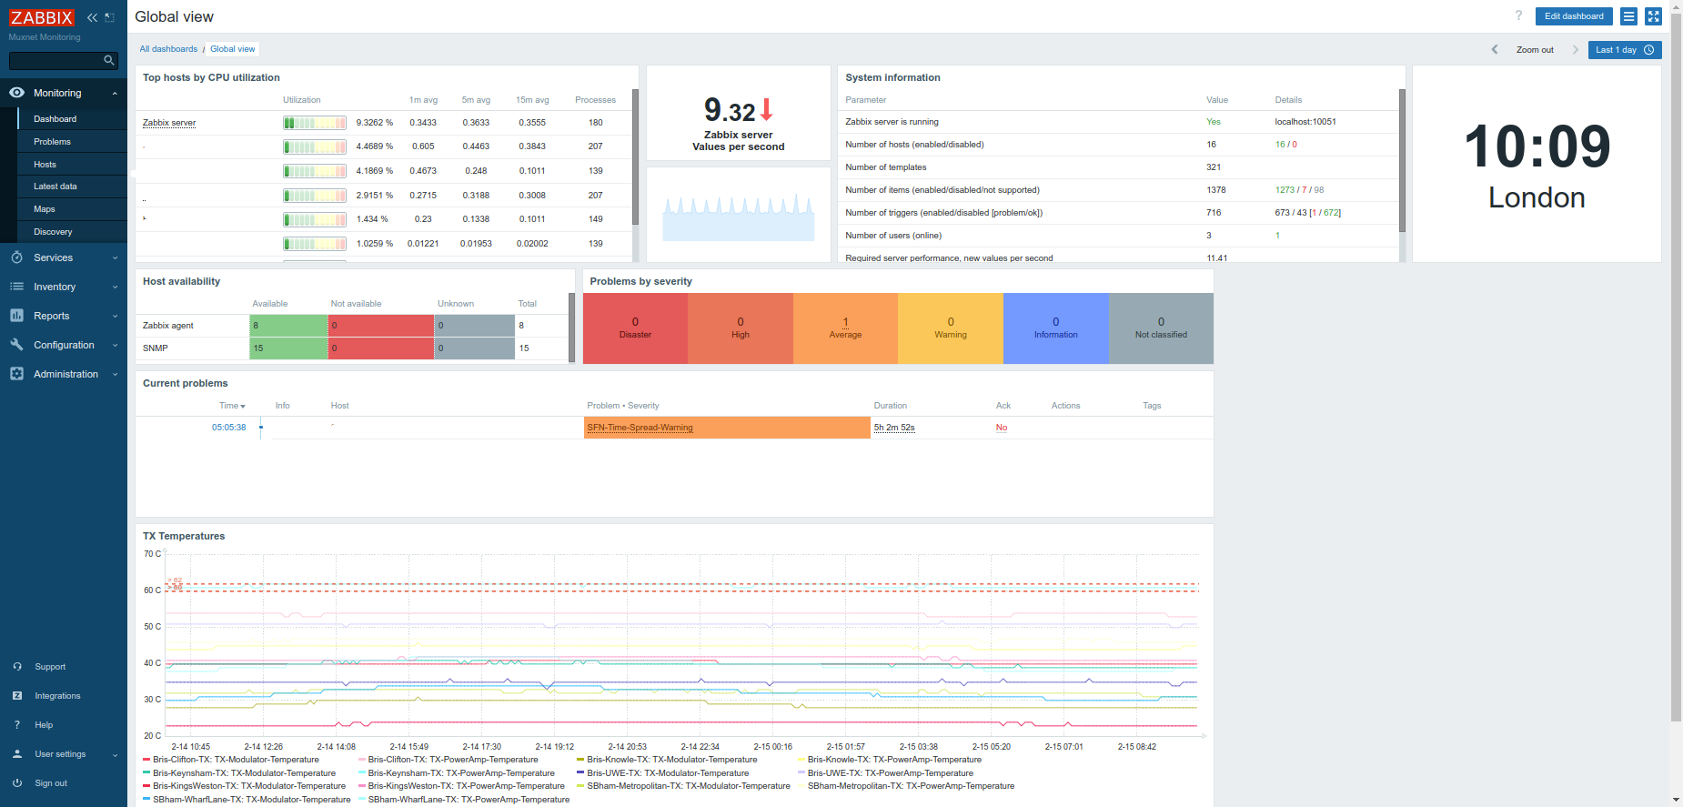
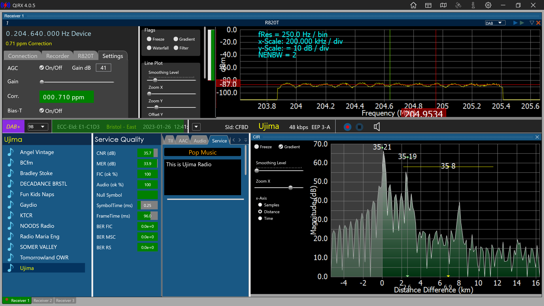
System trade-offs
Pros
Very low cost Capex and Opex
Can operate as an SFN
SPI can be delivered via IP (RadioDNS)
Redundancy is possible
Comprehensive monitoring available
Supports Announcements, Service Linking, Data services and SPI
Cons
May be area limited by Regulation
Use of public internet may impact service availability
Source: Nick Piggott / Severnside Digital Radio & Bristol Digital Radio
Notes:
So we see that ODR now provides software for most DAB functions
Monitoring can be provided by low cost solutions, e.g. QIRX SDR for RF monitoring with a RTL_SDR dongle or Zabbix open source monitoring for IT systems
The area covered is only limited by the regulation in each country, bigger Tx/antenna system will provide larger coverage area but at additional cost
The solution
Redundancy is generally not used to keep costs low

Slide 12
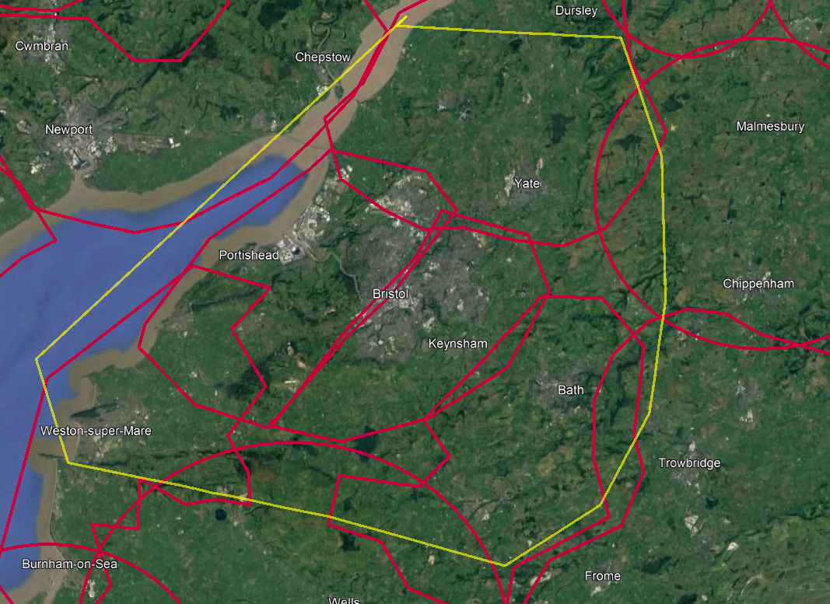
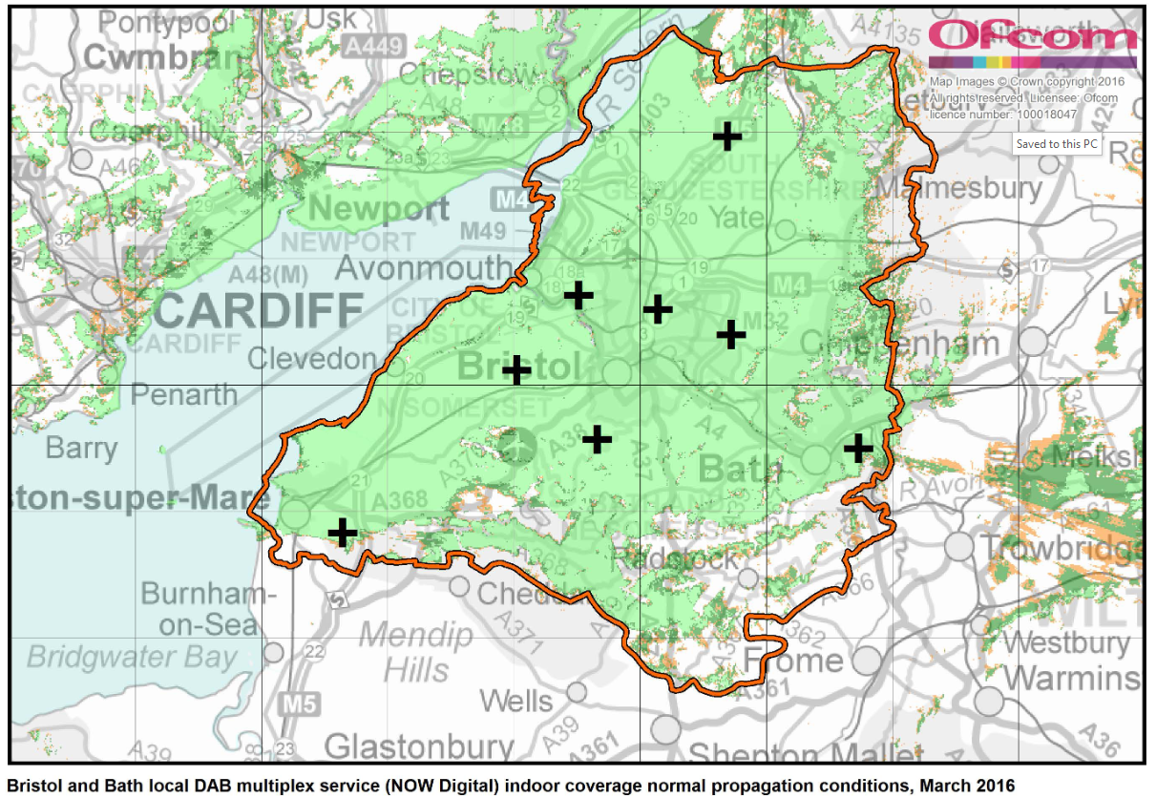
Licensing, coverage and cost
SS-DAB comparison
Notes:
We see that the Bristol-Bath local commercial area (yellow) covers over 3 SS-DAB areas (red) – east and west Bristol, Bath, most of Weston-super-mare and parts to the north and east
The Bristol city area is divided into 2 parts – Severnside Digital Radio for west Bristol and Bristol Digital Radio for East Bristol due to the OFCOM 40% population coverage limit relative to the local Commercial license area (yellow)

Slide 13
Licensing, coverage and cost
SS-DAB comparison
Aspect | DSP | C-DSP
Broadcaster type | Commercial | Community
Coverage | wide area | local area
Transmission areas | multiple | 1
Annual licence fee | £100 | £100
Example SS-DAB carriage fee (monthly) | 32 kbps DAB+ stereo, £399 | 48 kbps DAB+ stereo, £99
Example commercial local area DAB carriage fee (monthly) | 32 kbps DAB+ stereo, £3,500 – £6,000
1
2
3
Sources: 1=www.ofcom.org.uk, 2= http://www.edinburghdab.co.uk/ , 3= http://www.getmeondigitalradio.com/dab-digital-radio/costs-of-dab/
Notes:
Local DAB area not in London
So the cost of commercial radio service of SS-DAB is around 1/10 of a Local area but covers about ¼ of the area (or population?) with Community radio focused on a specific area such as ¼ of a Local area being around 1/40th of the cost. No wonder SS-DAB is popular with community radio in the UK

Slide 14
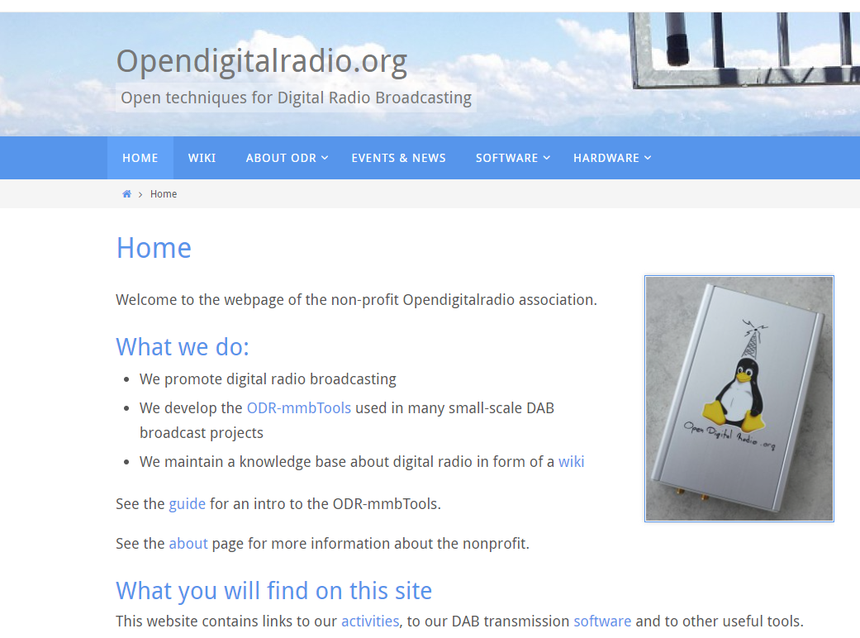
Support
What support for SS-DAB is there?
https://www.opendigitalradio.org/
The non-profit organisation Opendigitalradio was created in November 2012 in Geneva, Switzerland, according to Swiss law.
Mission
The goal of the NPO is to promote development of digital radio. This leads to the following activities:
Promote and develop open technologies for digital broadcasting.
Experiment and document the techniques for digital broadcasting.
Teach and help for the construction and deployment of open broadcasting systems.
Offer radio broadcasting services for temporary or permanent setups.
Integrate open systems for broadcasting projects.

Slide 15
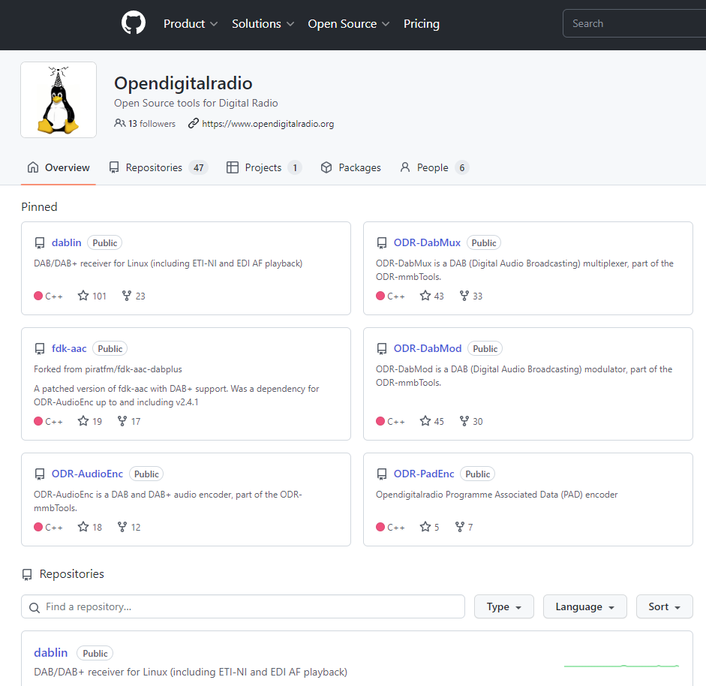
Support
What support for SS-DAB is there?
https://github.com/Opendigitalradio
Repositories for software code
ODR-DabMux
ODR-AudioEnc
ODR-PadEnc
ODR-DabMod
Lots of activity!!

Slide 16
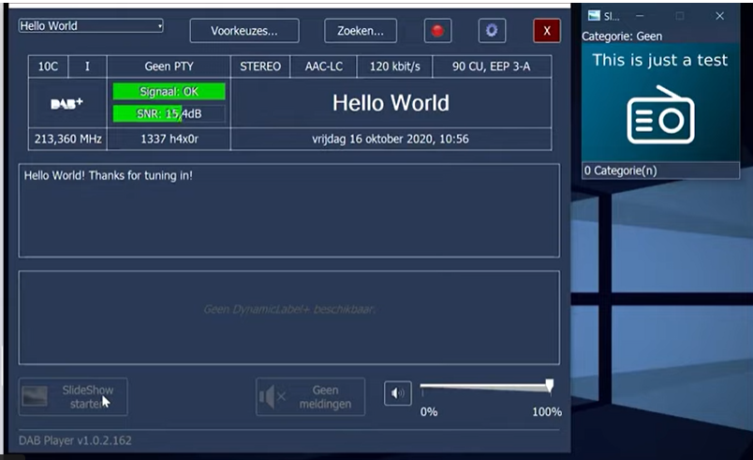
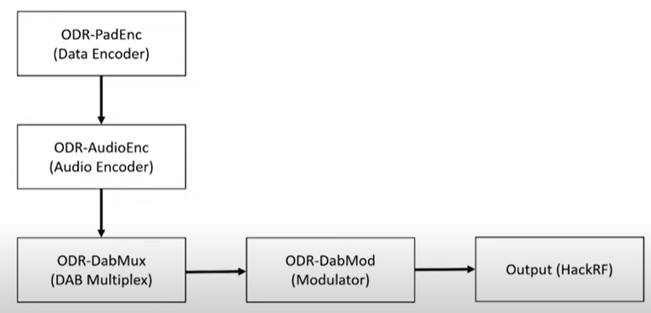
Support
What support for SS-DAB is there?
How to setup your own DAB+ transmitter using OpenDigitalRadio
https://www.youtube.com/watch?v=zexQsN-Cf7k

Slide 17
Conclusions
SS-DAB+ is essential to allow small Community Radio stations to participate in digital radio future
SS-DAB+ is being increasingly valued and added to countries’ regulation frameworks
Often uses other Open Source software and SDR solutions for support systems
Technical enhancements continue
New functionality
Better reliability
Better efficiency
Lower cost
Notes:
The technical enhancements come from the ODR software team, while the reliability, efficiency and cost are products of continuing technical advancement in computer and RF engineering.
Watch this space as it may provide new opportunities in your country.
And with that I will pass over to Nick Piggott to provide the real world details of how SS-DAB was established in Bristol

Slide 18
Thank you
For further information, please contact:
www.worlddab.org
or
les.sabel@scommtech.com.au
Notes:
Please contact me if you would like to discuss any of this or other DAB+ aspects.

